Slide 1

Writing
Revision

Slide 2
Contents
Page
3-6 Writing mark scheme for both papers
7 5 Easy ways
8-9 Punctuation
10 Overview of Paper 1
11 Basic tools for describing
12 Example of labelling images
13 Preparing description for key nouns
14 Preparing descriptions for characters
15-16 Vocabulary – choosing words for effect
17 A list of descriptive techniques
18-19 Structuring your writing
20 Planning/ developing a persona
21 Finding devices / continuation task
22 Structure of a story
23 Sentence structure – starting sentences in different ways
24 Upgrade your sentences
25 Examples of descriptive writing
26-
Exam practice images
27 Paper 2 overview
27-29. Purpose, audience and form
30- 31. Persuasive techniques
32-33. Planning ideas
34. Connectives to use when arguing
35. The layout of a letter
36-37. Examples of writing to express a viewpoint
38-39. Exam practice questions

Slide 3
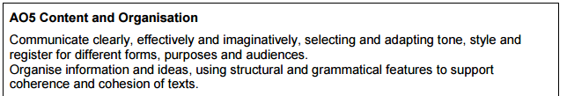
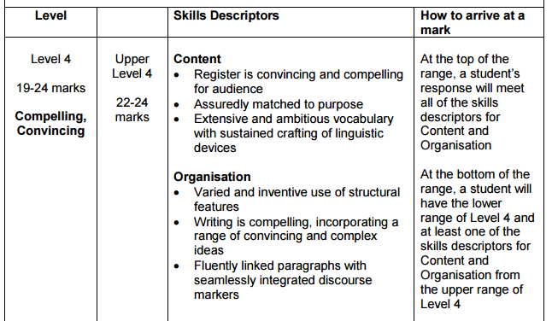
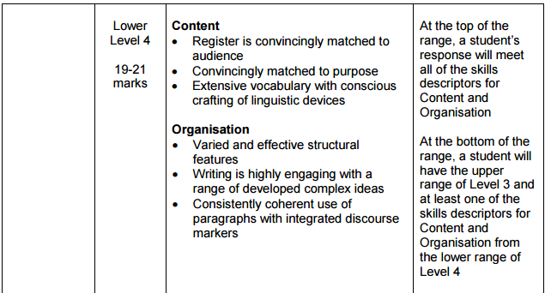
VOCAB marked twice

Slide 4
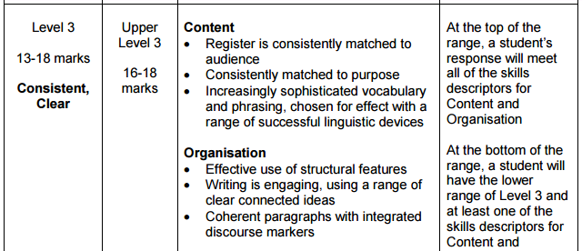
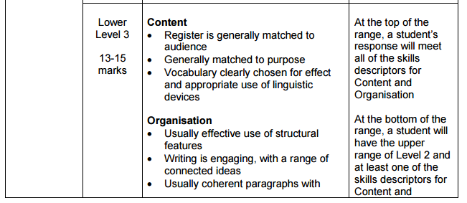
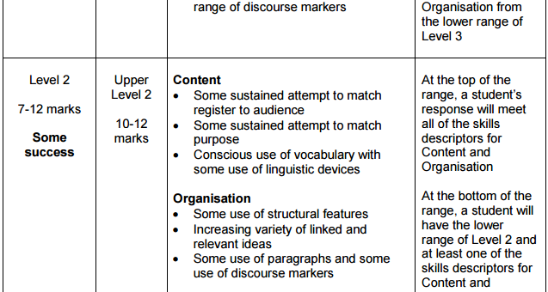

Slide 5
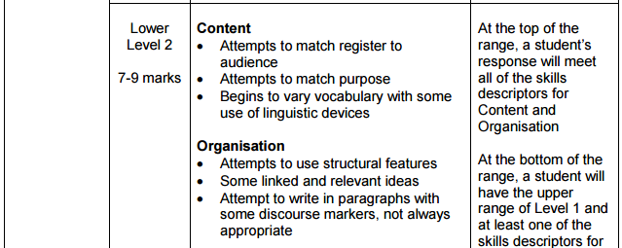
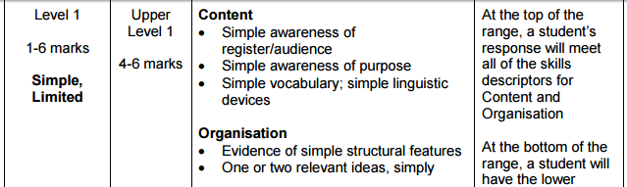
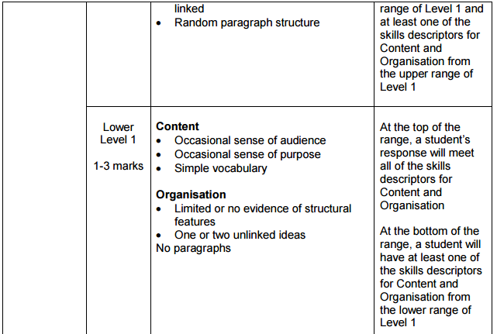

Slide 6
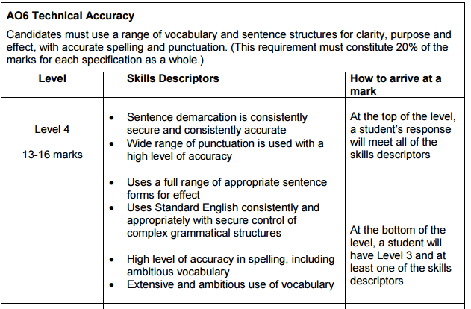
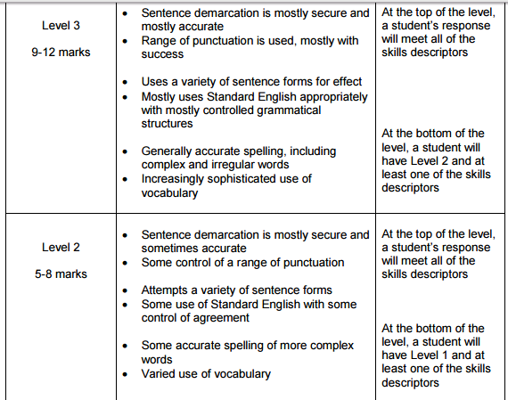
VOCAB marked twice

Slide 7
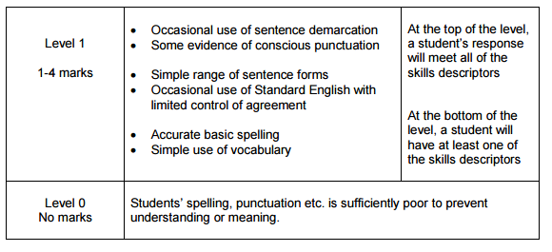
5 Easy Ways…
…to meet the mark scheme
1.Vocabulary – ambitious and varied
2. Punctuation – ambitious and varied
3. Sentence and paragraph
Structures – think long, short, very short
4. Be accurate
5. Writing devices – varied and creative

Slide 8
Using a range of punctuation
Make a list of the punctuation you plan to use – cross it off at the end
Comma , This usually indicates a short pause when reading.
It is used to help a sentence make sense. The two women, who had just caught a train to the city, were planning a day of shopping.
To divide items in a list or to separate a series of adjectives.
To make sentences clearer in meaning. He left, happily. (people think it was a good thing he left) He left happily. (this is how he felt)
Used instead of a dash or brackets to add more information to a sentence. The house, which had just undergone a renovation, was on the market.
Ellipsis ... This is used to show that words have been left out or there has been a break in thought, or to create suspense.
“You know, after discussing, I still can’t decide ... but I hope to make a decision soon.
According to the magazine article, “The best remedy ... is to drink plenty of liquids.”
“And there it was, in the distance…”
Be ambitious
Colon : This shows the end of the main part of the sentence before introducing more information. For the excursion to the museum please bring the following: a raincoat, sunhat, water, food for recess and lunch, and a notebook and pen.
The holiday was much better than I expected: exciting, adventurous, with wonderful food and fabulous companions.
Be accurate

Slide 9
Dash – A dash is longer than a hyphen and is used to add more information to a sentence. Commas or brackets can also be used.
The school boys – who were constantly late for class – were advised to use an alarm to wake themselves up in the morning.
Exclamation mark !
This shows a strong feeling or emotion. It is used for an exclamation or interjection.
Wow! What a fabulous sight! Watch out! There’s a huge puddle.
Help! I’ve just had an accident.
Brackets ( ) These are used to put additional information into a sentence. Commas could be used instead. Or used for an aside when speaking more directly to the reader.
The two girls (who were twins) dressed in similar clothes.
Apostrophe ‘
There are two types of apostrophe – make sure you know when to use them
apostrophe of omission/contraction
apostrophe of ownership/possession.
Semi Colon ;
This is used to join to closely related sentences together. The semi-colon can replace a full stop and or but, and so should join two complete clauses (sentences) that make sense on their own.
The weather had been awful; it had not stopped raining all day.
She smiled at him brightly; he felt her warmth comfort his aching heart.

Slide 10
Paper 1 Section B
Creative writing
40 marks, 45 minutes
For this paper, you will be asked to either write to DESCRIBE or NARRATE
There will always be a choice of TWO TASKS – you choose ONE
There will probably be AN IMAGE on which to base a description and another task probably asking you to write a story based on a topic.
We strongly advise you to do the DESCRIPTION task
You should spend 5 minutes planning your writing – list punctuation to tick off, label the image, jot down writing techniques to use, plan your structure, list your ambitious vocabulary
There will be 24 marks available for the CONTENT and ORGANISATION; there will be 16 marks available for TECHNICAL ACCURACY

Slide 11
Don’t forget you can use your literacy booklet for more information
The building blocks of descriptive writing
In the exam, start by labelling the image with nouns, adjectives, verbs, adverbs…use ambitious vocabulary as you plan
Nouns: The objects (things, people etc) in the image – you will build up sentences around the nouns. Think about the less obvious objects, too.
Adjectives: words that describe nouns. Be ambitious and varied with your word choices. Build up several adjectives for nouns.
Verbs: action words. Be ambitious and varied with your choice of verbs. Create lists of interesting verbs for different objects.
Adverbs: words that describe the way an action is carried out (often end in –ly).

Slide 12
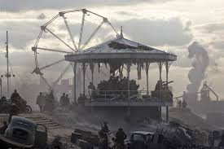
Nouns
Ferris wheel
Steps
Smoke
Bandstand
Soldiers
Clouds
Sun
Adjectives
Tattered Ghostly
skeletal
Twisted Derelict
Proud
Verbs
Lay
Moved
Poised
Stood
Sliced
Dragged
Adverbs
Wearily
Longingly
Proudly
Silently
Achingly

Slide 13
Nouns likely to appear | Descriptive ideas
Rain | Constant hard rain, soft drizzle, metaphor/ simile Sensory feel Driving, relentless torrents of rain blasted
Wind | Soft breeze, harsh gale Movement personified, verb choices, sounds Merciless, biting wind sliced
Sun | At different times of day – dawn, midday heat, twilight/ dusk, temperature, shape, colour, position, personification Scorching, blistering eye of heaven Arid air, suffocated us, reverberating with heat
Moon | Shape and position, colour/ tones, personification
Snow/ frost | Metaphor/ simile, temperature, sensory feel, visual
Water | Sea, waves, lake, river – metaphor/ personification, movement, sound, colour
Stone | Rocks, concrete, house walls – texture, colours, strength
Sky | Sapphire Azure Diamond granite Billowing clouds, tumbling, menacing grey mass Cosmic night sky glistened Immense omniscient sky watched over us
Trees/ vegetation/ grass | Colours, shapes, contrast summer and winter, texture, personification, metaphor

Slide 14
Character | Ideas
IST PERSON | Feelings linked to place, hints relating to past – contrast e.g. isolation, fear, loss compared to previous warmth, happiness? Significant object symbolic of something important – you look at, describe, touch. Temperature and physical reactions – reflecting feelings e.g. shivering, sweating. Clothing – significant to situation. What you would notice e.g. shoes, buttons, collar, textures, colours Actions/ repetitive habits Vision and changing perceptions
Child/ young person | Symbolises innocence – imagery linked to hair, face, eyes Movement/ sound (quick/ soft etc) – metaphor/ simile Clothing – bright/ vibrant? Change of circumstance? Tattered, worn? Significant object – toy? Symbolising security?
Older person | Symbolising experience/ endurance – imagery linked to hair, face, eyes Movement/ sound – (slow/ harsh) metaphor/ simile Clothing/ significant object – linked to memories, circumstance, job position? (maybe mix up some of the associations with youth/ age for further originality in your characterisation)
Positive Adjectives for characters or nouns:
angelic beautiful saintly upright talented skilful worthy grateful gentle wise generous wholesome courageous patient considerate gracious sympathetic obliging sincere trustworthy tolerant sensible truthful flamboyant eccentric ostentatious
Negative adjectives for characters or nouns:
brutish violent rotten evil wicked vicious mischievous ferocious wild vile spiteful undisciplined sick destructive foul disobedient ghastly shocking immoral devilish cruel vindictive slanderous venomous savage rough aggressive hostile murderous menacing savage rugged

Slide 15
Choosing Vocabulary for effect
Using words that add detail, especially if this is a story, will help to suggest a mood and setting for the reader. Vague words deaden a piece of writing; precise words, full of descriptive energy, bring it to life.
Describing a church yard at night to create at tense mood:
Bats swooped dangerously close to my head as the haunting outline of the moon glared over the silhouette of the gravestones. The stench of decay hung in the damp night air, as a warning to those that dared to enter
Describing a church yard at a wedding to create a positive mood:
Doves soared overhead as we bustled from the church doorway. The clouds parted for the beaming sun that warmed the backs of the guests. Confetti and the scent of perfumed flowers filled the air; laughter twirled like ribbons around the bride and groom
Setting | Mood | Example vocabulary
City | Happy | A bright sun glinted from the skyscraper windows…
Jungle | Sad | The baboons’ plaintive cries pierced our hearts…
Desert | Determined | The sand burned, the dust stung; but we marched on regardless…
Mountains | Hopeful | Small white cloudlets hovered so close to our heads we felt we could touch them…
Beach | Excited | Crabs scuttled hither and thither, children squealed in delight…

Slide 16
Bank of high level vocabulary
Colours: saffron, indigo, scarlet, azure, emerald, hazel, turquoise, jaundiced, pea green, cyan, magenta, burgundy, cherry, ruby, sapphire, crimson, bloodshot, vermilion, maroon, auburn, chestnut, cobalt, aquamarine, navy, khaki, camouflage, vanilla, , pearly white, antique white, violet, beech, cadet blue, firebrick, tomato, coral, orchid, honeydew, ivory, lemon, peach, plum, gold, lavender, beige, fuchsia.
Dramatic Verbs: snared, disturbed, smashed, blazed, swayed, tormented, straggling, lacerating, plunged, clashed, crackled, penetrated, blistering, jolted, splitting, darted, collapsed, trembled, engulfed, scurried, flickered, twitched, shattered, obliterated, throbbing, shuddered, exploded, oozed, quivered, gushed, raged, toiled, twisting, , writhed, swelled, crept, flapped, collided, pummelled, punctured, dissolved, clenched.
Emotions: apprehension, solemnity, melancholy, underlying guilt, nausea, ennui, jealous, depressed, heartbroken, crestfallen, despondent, anxiety, vexed, morose, confused, hostile, ecstatic, elated, hatred, shame, contempt, pity, envy, benevolence, boredom, restlessness, bewilderment, awe, humiliation, suspicious, impatient, panic-stricken, disbelief, exasperation, resentment, defiance, curiosity, expectation, remorse, exhilaration,
Adjectives: rigorous, merciless, relentless, arduous, rigid, vile, deformed, jagged, serrated, furtive, repulsive, monstrous, intolerable, distinct, prodigious, perilous, ghastly, vast, transparent, ruinous, obscure,
Words to create an interesting character: mute, hesitant, aloof, prodigious, insolent, dispassionate, timid, bashful, surreptitious, indifferent, detached, unapproachable, intriguing, negligent, irresponsible, isolated, irritable, impudent, compelling, edgy, cantankerous, evasive, deceitful, fiery, impulsive, fervent, introverted, eccentric, callous, amoral, immoral, fickle, sentimental, compassionate, eager, inquisitive, indecisive, naïve, infatuated, affectionate, threatening, vicious, unpredictable, cynical, pessimistic, impertinent,
Adjectives for describing food: bittersweet, acidic, peppery, spicy, tangy, sweet, flavoursome, fruity, bitter, sour, salty, sapid, citrus, appetising, sharp, sugary, insipid, bland, stale, watery, succulent, unpalatable, savoury, lukewarm, tingle, aftertaste,
Sound Nouns: click, whisper, hush, silence, tiptoe, creak, tap, thud, knock, din, tone, resonance, vibration, ring, toll, chime, echo, scream, thump, yell, bawl, screech, wail, yelp, roar, shriek, bang, shout, uproar, babble, clunk, tick, inaudible, rattle, plod, hum, whirr, rev, crunch, beep, rumble, squeak, clatter, snore, bleep, yawn, snorted.

Slide 17
Detailed / describing words
Extended metaphors & metaphors
Similes
Colour
Repetition
Imagery
Personification/ pathetic fallacy
Tone
Imagine with your senses
Varied vocabulary / verbs
End with a bang
Be ambitious: you could use the same extended metaphor for any description– e.g semantic field of war / the military
e.g. nature
Learn a range of descriptive techniques and practise using them to describe different objects and settings

Slide 18

How to structure your description
Wide angle – weather, overall goings on
Lots of details about the scenery.
2. Zoom in – choose a character to pretend to be, circle them on the image or imagine one if there are no people – what are your feelings / thoughts? What are you doing there? Why?
3. Tracking shot/ close up – look around you giving close-up details as you move around or observe the goings-on.
4. Action shot – something happens to develop your description
5.Wide angle- zoom out again, link back to something at the start, add in a new detail. Think about the final sentence carefully to create impact.
Think Camera
Be ambitious: you could always try to use a repeated single sentence paragraph or one word paragraph throughout your writing

Slide 19
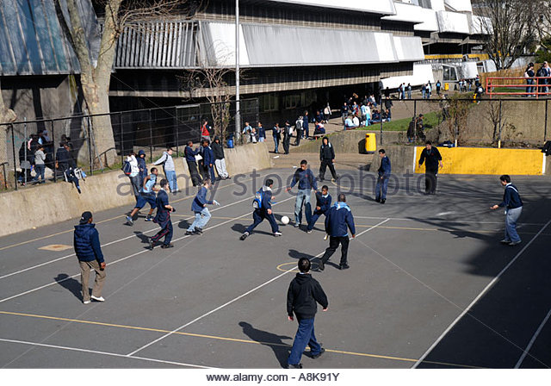
Plan your structure using this 5 point method:
Wide angle: weather, playground, hustle and bustle, concrete, games
Zoom in on a child who feels alone / thoughts
Track what’s going on around him
Action – barged into by bully. Fight.
Wide angle – playground noise , weather boy left alone. Bell rings.
Think Camera!
Here’s how this description may begin; continue it by using the plan…
Grey, gloomy shadows of the clouds above rolled across the noisy, wet playground, overlooked by oppressive concrete storeys of classrooms. It was break time. Desperate for air, swathes of students flooded the playground, and seemed to fill every inch of the hard, grey sea.
I watched from the shadows. Unseen but seeing. Everything.
Next to me, was a swarm of giggly girls, hatching plans and texting furiously on their phones, laughing flamboyantly with their heads thrown back. What was it like to laugh like that?
The well-worn football, laden with rain, lugged itself through the air and landed with a dull thud against my backpack.

Slide 20
Pre-planning around a persona/ narrative perspective.
You may wish to have an idea of a persona whose perspective you can write from in the first person before you even see the question/ picture. A strong narrative voice will be engaging for the reader and you can consider his/ her 'backstory.’.
Paragraph 1 - put the person in the picture and describe setting 'looking out’
Paragraph 2 – zoom in to describe a significant object
significant to the person and prompting a memory recall
Paragraph 3 – use a flashback for dramatic contrast, e.g. make this place significant to the person in some way and recall the same place with a different atmosphere
Paragraph 4 – return to present – action – keep it simple but meaningful
Paragraph 5 – link back to description from paragraph one and consider change in atmosphere for impact/ position and feelings of person . Aim to have a 'symbolic thread'

Slide 21
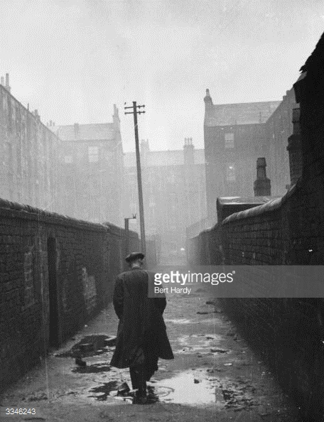
Can you spot the devices used here?
Hollow, ghostly houses overlooked the alleyway; they had seen it all before. They echoed solemnly with the sounds of emptiness and fear. Their gaping windows, soulless eyes that stared unblinking at the deathly passage below. An endless stone wall stretched far into the mist, encasing all in a never-ending path through the forgotten houses to the other side of town. Dark and eerie pools of tainted rainwater collected in distorted shapes of terror on the paving. Here, the sound of footsteps was an unusual sound. But not tonight.
Can you continue the description following
the suggested structure?

Slide 22
Structuring a story

Slide 23
Starting sentences
in different ways
Start with an “-ING” verb:
jumping, moving, hearing,
Start with a conjunction :
when, until, before, after, once, unless, although, even though, despite, if, whereas
Start with a preposition:
under, below, above, in, next to, opposite, beyond, behind, at, of, towards, with, by
Start with an adjective:
hard, weary, lifeless
Start with an adverb
Gloomily, quickly, softly

Slide 24
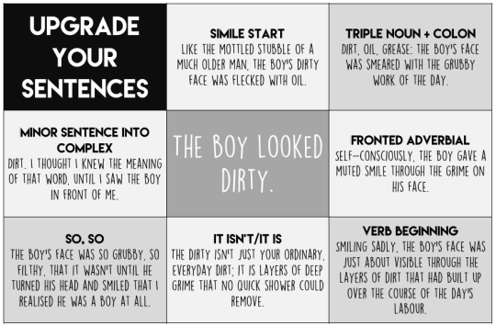
TASK:
Split a full
page into
9 squares.
You are
going to create
a short, simple
sentence and
write that in
the middle of
the grid.
Then, copy
the titles of
each box and
use these as
ways to upgrade
your simple
sentence.
Use the
examples to
help you.

Slide 25
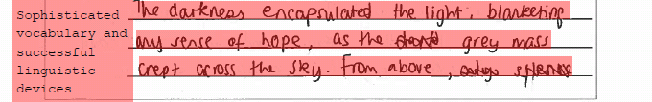
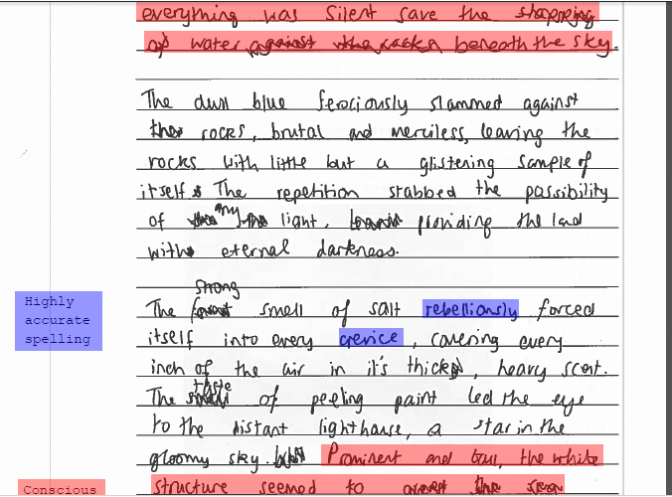
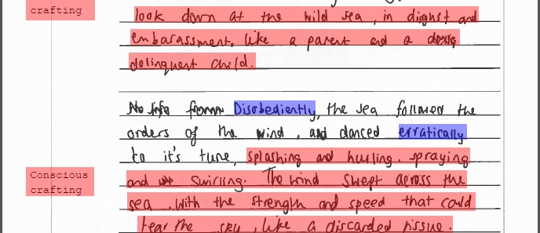
Write a description of a stormy sea suggested by the picture.
(

Slide 26
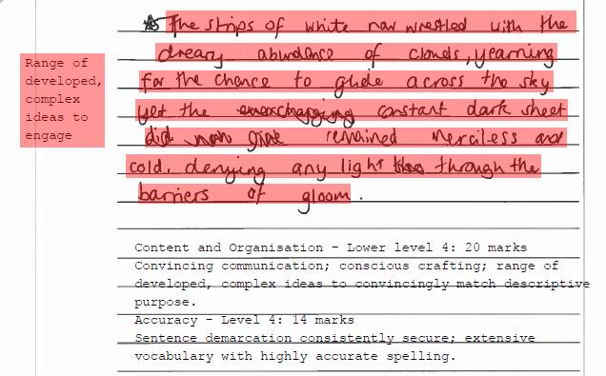
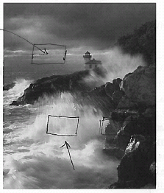

Slide 27
Example of descriptive writing
This was written by a Year 11 student preparing for their GCES exam. The image was of a shopping centre. Can you find and label the descriptive techniques?
Tired packs of moneyless individuals filter drearily out of the unwelcoming double doors. A cold, sharp recorded voice echoes around the deserted corridors “Blue Water Shopping Centre is now closed, please exit through the main doors”.
Silence strikes like an unfed python, seeping through the desolate remains left behind by the hungry shoppers. Shutters begin their lengthy journey down the dingy shop doors; moaning painfully as they slowly descend.
Unwanted freebies along with rejected burger wrappers rattle gloomily in the ghostly breeze, running for their sorry lives, trying to escape the ravenous cleaners.
The outlets sleep softly, gradually preparing themselves for the coming days’ perils. The waste bins thankfully regurgitate large amounts of the day’s forced feeding. Daylight starts to revive the building.
The overhead lights begin to arise. Morning has come.
The doors are violently forced open. The hoard of lions roar their way into the jungle. Shutters rise. Stocks replenish. The cleaners of the night salvage the last of their prey. Silence is overcome by the deafening sound of demanding shoppers.
Bargain hunters plough their way through the crowds scouring each and every outlet, preparing to feast on the weak. Security guards patrol the perimeter, bringing the unwanted to justice. No one is safe. Desperate females flock towards the welcoming salons, colliding with football craving men, searching desperately for a nearby sports complex of anywhere showing ‘the match’.
The stock piles start to fade into non-existence, the shoppers flee to the dining area, the food is served. Hundreds of obese, calorie-craving hogs pile their way through endless fries, burgers and whatever else is on offer, deserting their leftovers for the cleaners to devour. Sugar-filled fluids are heaved down their necks under close observation of the bearded-invalid crouched in the shadows.
The heaving centre begins to fade, tired packs of moneyless individuals filter drearily out of the unwelcoming double-doors. The cycle continues.

Slide 28
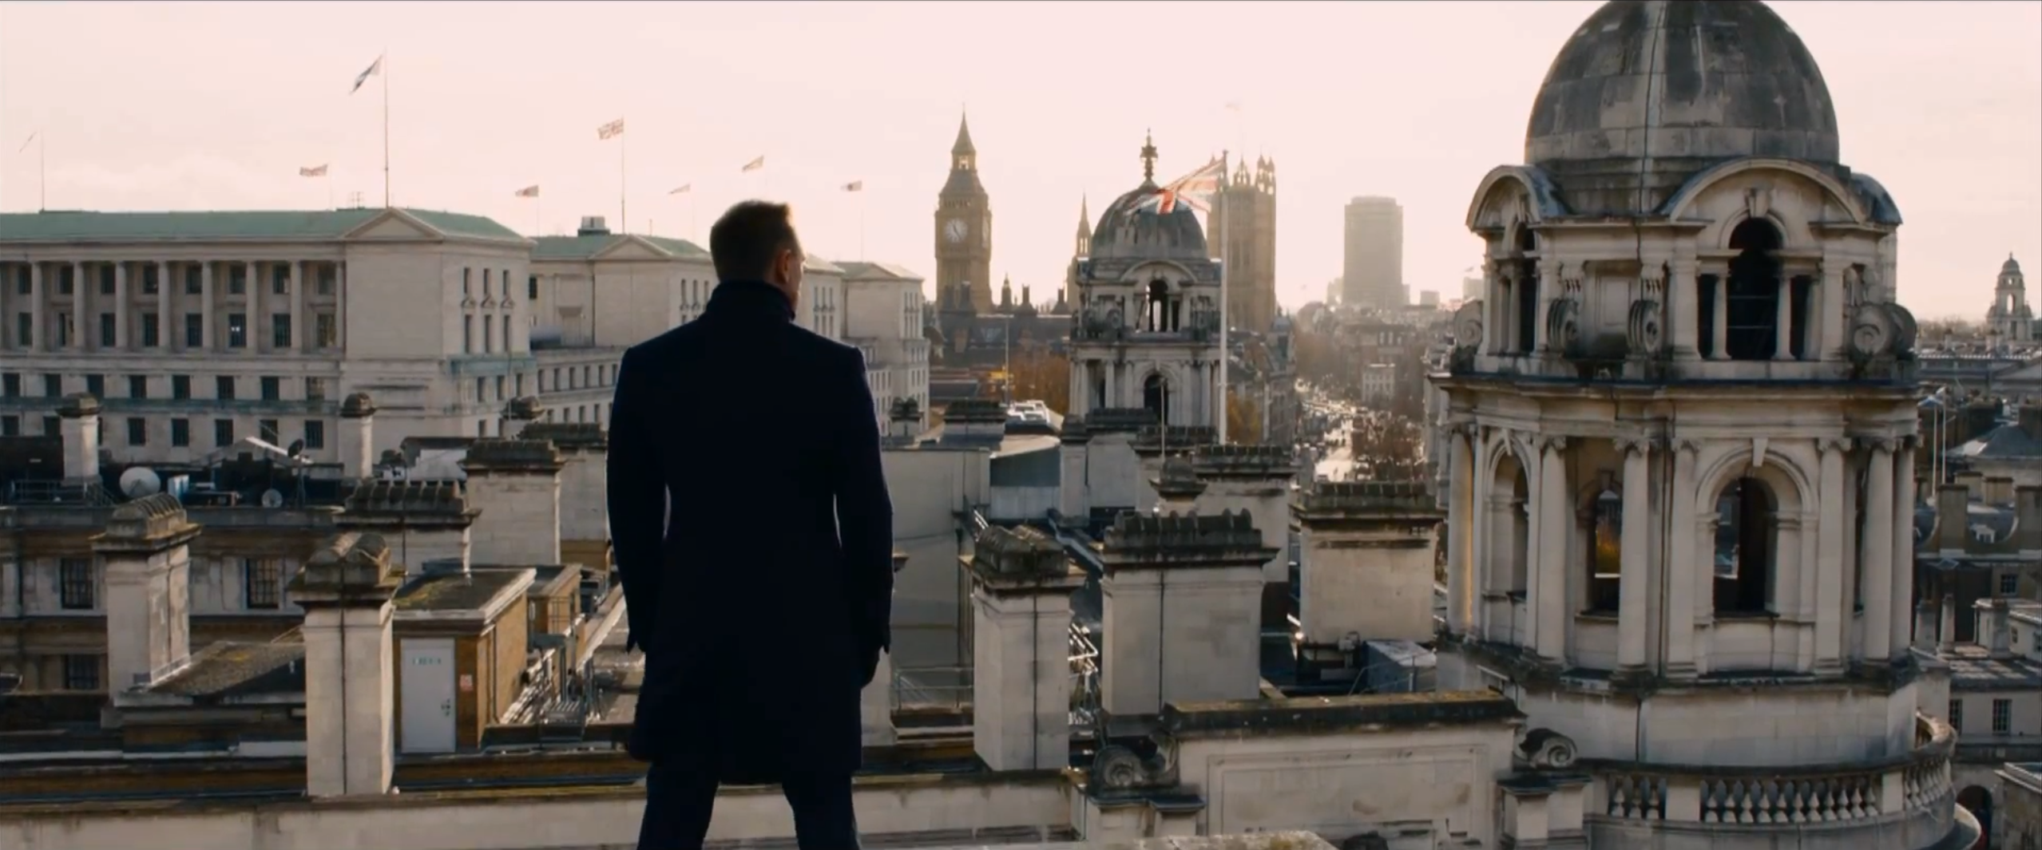
Exam Practice
Using the guidelines, plan then write the description based on this image of a city.
Label nouns, adjectives, verbs, adverbs
Create descriptive devices to use
List punctuation to use
Jot down ambitious vocabulary
Plan your 5 step structure
Remember your 5 easy ways

Slide 29
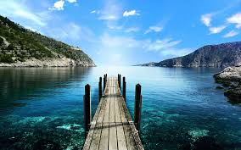
Using the guidelines, plan your ideas then write a description based on this image of a lake.
Label nouns, adjectives, verbs, adverbs
Create descriptive devices to use
List punctuation to use
Jot down ambitious vocabulary
Plan your 5 step structure
Remember your 5 easy ways

Slide 30

Using the guidelines, plan your ideas then write a description based on this image of a girl on the street:
Label nouns, adjectives, verbs, adverbs
Create descriptive devices to use
List punctuation to use
Jot down ambitious vocabulary
Plan your 5 step structure
Remember your 5 easy ways

Slide 31
Paper 2 Section B
Expressing a viewpoint
40 marks, 45 minutes
For this paper, you will be asked to either write to ARGUE, PERSUADE, EXPLAIN or ADVISE/ INSTRUCT
There will ONE task to complete
There will a statement related in some way to the sources in Section A which you will need to respond to.
You will need to express a strong, convincing viewpoint based on the given topic (even if it is not your personal opinion)
You will probably be given the audience, purpose and form you should use
You should use FORMAL language
There will be 24 marks available for the CONTENT and ORGANISATION; there will be 16 marks available for TECHNICAL ACCURACY

Slide 32
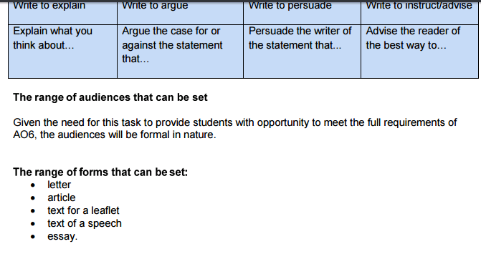
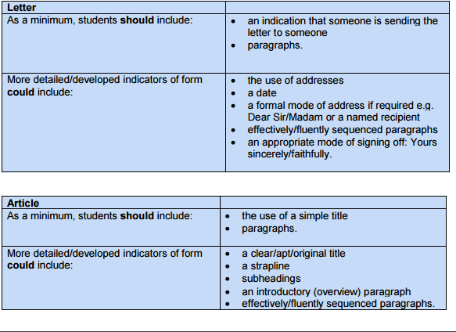
Purpose, audience and form
Write to explain Write to argue Write to persuade Write to instruct/advise Explain what you think about… Argue the case for or against the statement that… Persuade the writer of the statement that... Advise the reader of the best way to…

Slide 33
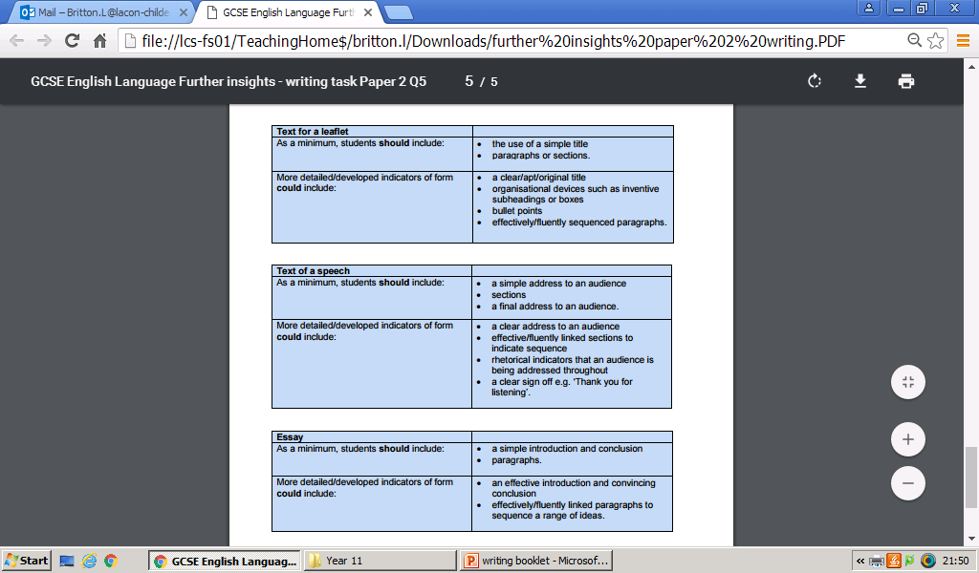
Know and show
the form of writing

Slide 34
To explain
Clear view achieved through straightforward vocabulary and syntax;
Logical order;
Present tense;
A balanced view can be given
Avoid being too persuasive
if news article, give headline and link back to headline at the end
give examples, personal anecdotes
Bullet points or subheading if appropriate
To persuade
Establish strong one-sided position;
Emotive language;
Rhetorical questions;
Strong images;
Use of quotations;
Supporting evidence, statistics
Illustrative examples, accounts of specific case testimony;
Use of rhetorical devices such as alliteration, repetition, lists in threes etc.
To argue a case
Establish clear viewpoint from start
Clear structure: opening premise, arguments to back up what you are saying, conclusion;
Referring to opponent’s arguments to contrast your own views;
Use of rhetorical questions;
Use of supporting evidence, statistics, facts, technical terms;
Use of humour, sarcasm and irony;
Use of rhetorical devices such as exaggeration, alliteration, repetition, lists in threes.
To amuse
Wordplay;
Jokes;
Comic anecdote;
Surprise/incongruity;
Exaggeration;
Strong verbal images;
Sarcasm; irony;
Using a particular type of language in an inappropriate setting.
To advise / instruct:
clear, logical order
Use of imperatives
Suggest different options
Serious, informative, positive tone
Refer to outcomes
Features of writing for different purposes

Slide 35
Level 1:
Simple Communication
Lacks argument
Limited grasp of task
Basic vocab
Simple train of thought
Inappropriate content
Limited scope
Brief/very brief
Incomprehensible
Misinterprets task
Incorrect focus
Random ideas
Simple assertions
Mistakes audience
Colloquial
Nonsensical
Contradictory
Unfinished
No discernible structure
Level 2:
Some Communication
No central argument
Illogical/muddled
Imprecise use of vocab
Difficult to follow
Implausible/unrealistic
Under-developed points
Argues both for/against
Anecdotal/narrative
Dull/repetitive/rambling
Over-use of ling devices
No distinct point of view
Difficult to summarise
Dead end arguments
Fails to engage
Tangential focus
Erratic tone
Uneven register
Tenuous assertions

Slide 36
Level 3:
Clear Communication
Identifiable argument
Easy to follow
Logical paragraphs
Joined up thinking
Sequence of points
Vocab used accurately
Realistic/credible/viable
Engages interest
Focuses on purpose
Recognises audience
Approp. level formality
Develops ideas
Easy to summarise
Maintains point of view
Signposts discourse
Sustains even tone
Provides detail
Adopts approp. tone
Level 4:
Convincing Communication
Coherent argument
Confident approach
Varies tone confidently
Individual voice
Flows almost seamlessly
Impressive vocab
Conceptualises ideas
Contextualises ideas
Momentum/pace
Deliberate crafting
Wide-ranging ideas
Distinctive argument
Highly plausible
Enthralling
Original/subtle
Complex ideas
Surprising/inventive
Fluid structure

Slide 37
IN DA FOREST:
Persuasive techniques/ devices
Imperatives (commands)
Negative or positive tone
Direct Address (pronouns such as ‘you’ and ‘your)
Anecdotes/ Alliteration
Facts
Opinions
Rhetorical questions
Exaggeration/ Emotive Language
Statistics/ Shock tactics
Tricolon (listing in 3s)

Slide 38
ERSONAL PRONOUNS (you, your, our, us)
MOTIVE LANGUAGE / EXAGGERATION
EPETITION / RHETORICAL QUESTIONS
HORT SNAPPY SENTENCES / SLOGAN
SE LIST OF 3
LLITERATION
TATISTICS
MPERATIVE
OCABULARY (persuasive e.g obviously, surely)
END WITH A BANG!
PERSUASIVE

Slide 39
Planning your ideas for your argument
Read the statement you are given carefully and then jot down all of the ideas both for and against the statement in 2 columns. Below is an example:
‘Street art is an important part of modern culture,
it certainly is not an act of vandalism.’
Write the text for the speech to be delivered in your local art gallery in which you argue your point of view in response to this statement.
For Street Art
Against Street Art
Public messages
Encourage art
Gives street character
Looks cool
Expression of viewpoint
A picture can say 1000 words
Artist recognition
Inspiring
Liven up otherwise drab areas
Inventive
Express stories – morality
Business?
Offensive
Bad reputation
Lack of artist credit
Misinterpretation
Landlords and property owners might not want it
Illegal activities
Run down areas?
inexpensive
Eye sore
Vandalism aspect – extremely hard to remove
Lack of ownership
You will argue whichever side you have the most points for whether you agree with it or not. It means that you’ll have more to write about.

Slide 40

The Magic List
Age
Gender
History
Geography
Money
Health
Social class
Politics
Minority groups
Media
Religion
You can use the magic list to generate ideas that will broaden your argument.
Use any topic in the list to see if you can develop a point in your own argument
e.g if the argument was about uniform, then history, money, social class and religion might come into the debate.

Slide 41






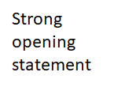
Fill in with rhetorical devices e.g. emotive vocab, stats to use, expert opinion, examples, anecdote, descriptive details
to present your view clearly

Slide 42
Get in the habit of using these sentence starters
Primarily, it is | Unfortunately, | Based on evidence | Although | In contrast to
Unquestionably, it can be seen | On reflection, | Often, it is the case | As an alternative to | Ultimately,
Usually | Not only | Remember that | Undoubtedly | Arguably,
The instant | Currently, | Historically, | Usually | During
Even if | Keep in mind | While | Regardless of | Conclusively,

Slide 43
Varied Vocab!
Choose a word you could use when writing to argue/ persuade:
Ludicrous (nonsense)
Extraordinarily
Nonetheless
Undoubtedly
Jeopardising (putting at risk)
Unfathomably (unbelievably)
Renowned (well known for)
Inexplicably (hard to explain)
Astronomically (huge)
Insufferable (can’t put up with)
Undeniably (can’t deny)
Immeasurable (can’t measure)
Unfounded (not backed up)
Irrefutable (can’t argue with)
Challenge: can you think of/ find any for yourself?

Slide 44
Use connectives when
arguing
To express you views:
I strongly believe that…
It is my firm belief that…
Certainly,
Indeed,
Surely,
Obviously,
For too long now...
Just imagine:
To argue back:
Despite this,
However,
Nevertheless,
To develop your point:
Moreover,
Furthermore,
To acknowledge the other view:
Some people may argue..
I realise that …
I can understand why some people may believe…
Perhaps in some ways,
To widen your argument:
Globally speaking,
From a broader perspective,
Internationally,
To finish:
Finally,
In conclusion,
In sum,

Slide 45
Writing your article
Create your headline – make it catchy, use a pun or other writing device
Make your view clear from the start
Create your strapline – this should include the main topic your article will be about with the view you are going to express
Paragraph 1: use a connective to start off you first main point, try some imagery or personal anecdote.
Include the opposite view – some may argue that but then dismiss it and go back to your own view
Paragraph 2: use another connective to add a new point. Use facts or statistics. Try a list of 3. Include the alternative view but then dismiss it and go back to your point
Paragraph 3: use another connective to widen your argument then add in your third idea. Use a rhetorical question, or a ‘just imagine’ idea. Include the other side but then dismiss it.
Conclusion: End with a bang! Think back to your headline and use a sentence that links to it and finalises your argument in a powerful way – maybe a rhetorical question or a very short sentence that answers it

Slide 46
Setting out a letter
Your Address
Their address
Date
Dear…
Clear
organised
accurate
paragraphs
Yours sincerely/ faithfully
Never 2 SS
Sir/ Madam = faithfully
Name them = sincerely
Your name

Slide 47
Charlie Brooker on Nightclubs
Clubs are despicable. Cramped, overpriced furnaces with sticky walls and the latest idiot tunes thumping through the humid air so loud you can’t hold a conversation. And since the smoking ban, the masking aroma of cigarette smoke has replaced by the over-bearing stench of sweat and hair wax.
Anyway, back to Saturday night, and apart from the age gap, two other things struck me. Firstly, everyone had clearly spent far too long perfecting their appearance. I used to feel intimidated by people like this; now I see them as walking insecurity beacons, slaves to the perceived judgement of others, trapped within a self-perpetuating circle of crushing status anxiety. I’d secretly like to be them, of course, but at least these days I can temporarily erect a veneer of defensive, sneering superiority. I’ve progressed that far.
The second thing that struck me was frightening. They were all photographing themselves. In fact, that’s all they seemed to be doing; standing around in expensive clothes, snapping away with phones and cameras with one pose after another, as though they needed to prove their existence, right there, in the moment. Crucially, this seemed to be the reason they were there in the first place. There was very little dancing: just pouting and flashbulbs.
Surely this is a new development. Clubs have always been vapid and awful and boring and blah – but I can’t remember clubbers documenting their every moment before. Not to this demented extent. It’s not enough to pretend you’re having fun in the club anymore – you’ve got to pretend to be having fun in your Flickr gallery, and your friends’ Flickr galleries. It’s an unending exhibition in which a million terrified, try-too-hard imbeciles attempt to outcool each other.
Clubs are insufferable dungeons of misery. Shut them all down.
Examples of expressing a viewpoint

Slide 48
Your school or college wants to ban Saturday jobs for students. Write a letter to your Headteacher or Principal in which you argue either for or against the idea of Saturday jobs.
Dear Mr XXX,
I am a pupil at Rainhill High School and I am disgusted at the recent proposition to ban Saturday jobs for students. I don’t know whether or not you have ever had a Saturday job, but I have one now and I can assure you it has been extremely advantageous for me.
Many people are of the opinion that all young people require a good social life as they mature. I couldn’t agree more with this statement, and Saturday jobs will in no way reduce social life. On the contrary, they provide the money that teenager are always in need of for their social life.
Saturday jobs provide teenagers with essential skills and knowledge for later life. They will learn how to handle money and tax, how to organise their time effectively and efficiently, how to interact politely and confidently with colleagues and superiors. Without skills such as these, there is a probability that some teenagers will be at a disadvantage in later life. Since it is a major aim of all schools to prepare and equip teenagers for later life, surely it is your responsibility to ensure teenagers have as many opportunities as possible to develop themselves. If this means favouring Saturday jobs, then that is what you as a Head teacher must do.
There are examples all around us of people who have failed because they were denied opportunities such as this. Take a walk down a subway and you will surely see a sorry beggar, his paltry earnings spread over a scruffy copy of the Financial Times newspaper. They can be found in any city centre, and I would be willing to bet all my possessions on the fact that some of them are there because they have been financially exploited or simply had no idea what to do with the money they earned. But if they had been able to learn those skills at a younger age, imagine what they could be doing now. Taken to an extreme they could be the doctor that treats you, the engineer that designs your car, the MP that represents you. But instead society reduces them to almost nothing.
Not all he reasons for Saturday jobs are selfish ones. If teenagers are working selling groceries or chopping meat, they will not be hanging around on the streets. By allowing Saturday jobs you could eliminate one of the biggest social problems of today. Picture a street in the suburbs. The delicate flowers have not been trampled on. The memorial bench has not been disrespectfully smashed. The wall is not covered in obscene graffiti for innocent five year old children to read on their way to school. If this sounds unrealistic, you could be the man that makes it happen.
These teenagers will also be providing a service to the community. Stand outside a grocery store and most customers will, upon be asked, say that they enjoy having an extra staff member to help them. They benefit the community, while at the same time they receive low wages and are only a tiny burden on the local economy. Their wages are far cheaper than, for example, the cost of cleaning a suburb of graffiti.
The advantages of Saturday jobs are abundant. So the only question that remains is, what will you do to promote them?
Yours Sincerely
XXX
Use the writing mark scheme at the start of the booklet to mark this yourself out of 40

Slide 49
‘Theme parks are overpriced and overcrowded; there are much better ways to spend a day with your family’
Write an article for your school magazine arguing for or against this statement.
40 marks
A day at a theme park: fun, thrilling and unforgettable!
Louise Britton argues that theme parks are the best way to spend a day out with your family.
Can you remember the last time you felt adrenaline pumping through your body and your heart racing so fast you could scream? I can. Waiting to ride ‘The Wickerman’ Alton Towers’ new ride. And what a ride it was! The twists, the turns, the racing speeds, the stomach-dropping dips…nothing can beat that feeling. Theme parks are the adrenaline junkie's best day out. But what about the rest of the family? I hear you say. Well, in my opinion, there is something for everyone.
Some might argue that the queues are too long and the day is wasted away mindlessly waiting. I agree this is frustrating, but grab yourself a fast-track ticket and you’ll be flying past the queues.
What better way to spend your day picnicking, strolling around the parks and laughing and screaming along with your family? The excitement of each ride brings the whole family together, a shared experience of joy. Especially when you get to soak your mum or dad with a water pistol!
So forget the cost (which you can avoid with using vouchers) and forget the distance to get there… the time you have once you’re there is fun, thrilling and truly unforgettable!

Slide 50
Sample questions to try
‘Young people these days are not reading enough. They have poor vocabulary and do not have creative minds. Students should be reading regularly.’
Write the text for a speech to pupils and staff at your school persuading them about your point of view on this statement.
(24 marks for content and organisation
16 marks for technical accuracy)
[40 marks]
‘School uniform is an important part of school. Students should wear it with pride.’
Write a letter to your headteacher in which you explain your point of view on this statement.
(24 marks for content and organisation
16 marks for technical accuracy)
[40 marks
Your school or college is raising awareness of healthy eating and lifestyles.
Write the text for a leaflet advising and instructing people how to eat a healthier diet and live a healthier lifestyle.
(24 marks for content and organisation
16 marks for technical accuracy)
(40 marks)

Slide 51
‘Young people spend too long on the internet and gaming; they are wasting their lives when they could be experiencing real life outdoors.’
Write an article for a national newspaper supplement in which you explain your point of view on this statement.
(24 marks for content and organisation
16 marks for technical accuracy)
[40 marks]
‘There is no point making the effort and taking the risk and travelling the world, disturbing people and animals as you go, when you can see it all on TV and the internet.’
Write a magazine article which persuades young people either to travel or stay at home.
(24 marks for content and organisation
16 marks for technical accuracy)
40 marks
Many people believe that it is our duty to cut back on our use of the world’s resources and that we must invest in greener forms of energy for the future – whatever the cost.
Write the text for a speech which argues for or against this idea.
(24 marks for content and organisation
16 marks for technical accuracy)
(40 marks)
‘Social media and its influence on teenagers is out of control. It’s ruining lives and destroying childhood.’
Write an article to appear on your school website arguing for OR against this statement.
40 marks

