Slide 1
Unit 6 – Sports Leadership
Learning Aim A - Know the attributes associated with successful sports leadership

Slide 2
Skills
Communication
This is when the leader is able to verbally communicate with their group in order to clearly explain what they want them to do. This must be clear and used in a language that the players can understand. This is important because if the leader can communicate what they want their players to do, then they are more likely to do what is asked and achieve the leaders goals.
Organisation of Equipment
Is when the leader is running specific coaching sessions and the set up of their equipment in those sessions. It is important for a leader to organise their equipment well so that their players have more trust in them that they know what they are doing, and also to make sure that the session can progress easily and players will gain more out of it.
Knowledge
Relates to the knowledge that the leader has on that specific sport that they are leading. This would include knowledge of tactics, training sessions and rules and regulations. This is important to have as a leader because if the leader has good knowledge of tactics they are able to create a formation for their team which allows them to win. Good knowledge on training sessions will mean that their players will always be improving, and good knowledge of rules and regulations will mean that they are able to educate their players about these rules and be able to help them to not break the rules and accurately abide by them in a game situation.
Communication
This is when the leader is able to verbally communicate with their group in order to clearly explain what they want them to do. This must be clear and used in a language that the players can understand. This is important because if the leader can communicate what they want their players to do, then they are more likely to do what is asked and achieve the leaders goals.
Organisation of Equipment
Is when the leader is running specific coaching sessions and the set up of their equipment in those sessions. It is important for a leader to organise their equipment well so that their players have more trust in them that they know what they are doing, and also to make sure that the session can progress easily and players will gain more out of it.
Knowledge
Relates to the knowledge that the leader has on that specific sport that they are leading. This would include knowledge of tactics, training sessions and rules and regulations. This is important to have as a leader because if the leader has good knowledge of tactics they are able to create a formation for their team which allows them to win. Good knowledge on training sessions will mean that their players will always be improving, and good knowledge of rules and regulations will mean that they are able to educate their players about these rules and be able to help them to not break the rules and accurately abide by them in a game situation.

Slide 3
Responsibilities of a sports leader…

Slide 4
Core responsibilities
Professional Conduct – is when leaders act in a professional manner at all times.
No swearing or disrespect, wearing correct clothing
Players will replicate this and have high standards
Health and Safety – having the health and safety of their players in mind and attending courses to help them with this.
Sessions and games are safe and participants feel that they can take part in the session and improve
Equality – having strong values about all participants have equal rights and opportunities
All feel included – players feel like part of a team

Slide 5
Wider responsibilities
Insurance – is when the leader attends courses and has the correct insurance
Leader is covered if there are any injuries
Players/participants feel safe at all times.
Child Protection – when the leader is able to work with participants under the age of 18.
Leader is covered should there be any issues
Is able to work with all ages so can include all
Younger participants feel safe around them.
Legal obligations – when the leader must abide by their contract or job role that they are in.
Participants will feel their leader is doing the correct job
Ethics and values – having the professional approach to your team and the way they play. Doing the job for the correct reasons – to improve the team and be respectful etc.
Players will start to have high standards, which will improve their performance and manner.
Not having correct ethics and values will lead to poor leadership and players being disrespectful.
Rules and regulations – Having the correct knowledge of the rules and regulations of the sport that they are leading.
Players will learn more, will feel safe.
Players will be able to play the game within the rules and have a positive impact on their performances.
Players will have more respect for the leader if they have good knowledge of the rules and regulations.

Slide 6
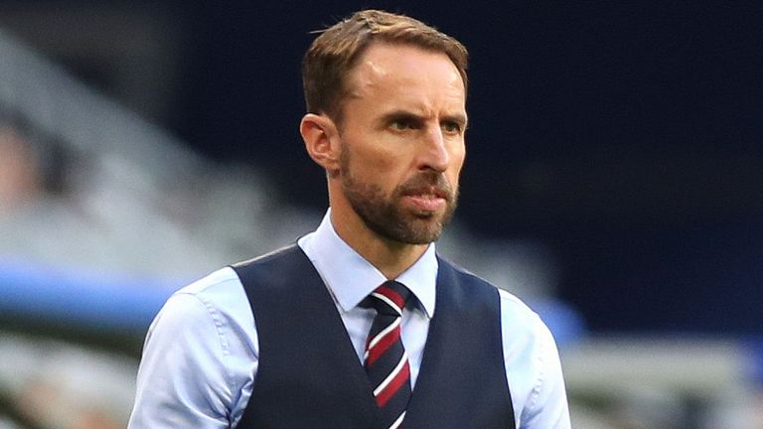
Gareth Southgate
Gareth Southgate is the current England football team manager. He has managed club sides in the past but mainly been involved in the England set up for the past few years. He recently guided England to a World Cup Semi-Final in the World Cup in 2018, which is the best the Country have done since winning the World Cup in 1966.

Slide 7
Gareth Southgate
In order to be successful, Gareth Southgate has had to develop many attributes to help him and his teams achieve. He will have good knowledge of the sport, because he is an ex England international himself. He will have respect from the players because he has played for his country before and this will mean that he will be able to use the correct terminology when discussing tactics with the players. He has good tactical knowledge of his sport, this is obvious as he was able to get England to the semi-final of the World Cup, which shows that he was able to outwit many opponents with his tactics.
His conduct is very professional as he is always dressed smartly which means the players will show more respect for him and have high standards of themselves. He always speaks very politely and clearly in interviews and never swears or disrespects anybody which means that he will gain more respect from other people because of this.
He will have to adopt many leadership styles in his role as the England manager, but he seems to mainly use a democratic approach most of the time, but there will be times when he has to become autocratic when it comes to disciplining his players when they have not done so well or done what is expected of them.
In order to be successful, Gareth Southgate has had to develop many attributes to help him and his teams achieve. He will have good knowledge of the sport, because he is an ex England international himself. He will have respect from the players because he has played for his country before and this will mean that he will be able to use the correct terminology when discussing tactics with the players. He has good tactical knowledge of his sport, this is obvious as he was able to get England to the semi-final of the World Cup, which shows that he was able to outwit many opponents with his tactics.
His conduct is very professional as he is always dressed smartly which means the players will show more respect for him and have high standards of themselves. He always speaks very politely and clearly in interviews and never swears or disrespects anybody which means that he will gain more respect from other people because of this.
He will have to adopt many leadership styles in his role as the England manager, but he seems to mainly use a democratic approach most of the time, but there will be times when he has to become autocratic when it comes to disciplining his players when they have not done so well or done what is expected of them.

Slide 8
Evaluation of Gareth Southgate
The attributes that Gareth Southgate has all combine together to make him a successful sports leader. Having good knowledge of the game, along with knowledge of tactics, adopting a range of leadership styles as well as always being professional, allows him to gain a lot of respect from him players. Having more respect from his players will mean that he is more likely to get better results and achieve more.
The only attribute that Gareth Southgate seems to lack is confidence. I think this is because he does not have a lot of experience in managing at the top level so he does seem to struggle when it comes to the more important games. I think that he will become a more successful leader in the future when he manages more games and more teams.
The attributes that Gareth Southgate has all combine together to make him a successful sports leader. Having good knowledge of the game, along with knowledge of tactics, adopting a range of leadership styles as well as always being professional, allows him to gain a lot of respect from him players. Having more respect from his players will mean that he is more likely to get better results and achieve more.
The only attribute that Gareth Southgate seems to lack is confidence. I think this is because he does not have a lot of experience in managing at the top level so he does seem to struggle when it comes to the more important games. I think that he will become a more successful leader in the future when he manages more games and more teams.

