Slide 1
Other resources
For Y11 – if you might be thinking about taking Geography at college.
I have annotated the Paper 3 materials with questions you might like to think about.
Also – some good FREE courses at www.Futurelearn.com particularly on weather and climate.
In addition:
iPlayer – Earth from Space / Stacey Dooley on BBC3 / Race across the world / Africa with Ade Adepitan
Books worth reading : Prisoners of Geography

Slide 2
If you are thinking about taking Geography at college you might like to spend some time working on the Paper 3, GCSE materials. You might be expected to have an opinion about why slum areas have developed in many parts of the world.
These would have been the basis of the first half of paper 3, but obviously, we have no idea what the questions would actually have been.
There is no expectation for you to complete and hand in this work – just for interest!
Due to copywrite reasons – it is important that the power point is not shared outside the group of pupils studying Geography and must not be shared on Social Media.

Slide 3
Paper 3

Slide 4
In what year were the urban and rural populations equal?
In 1990, what percentage of the world’s population lived in urban areas?
By what percentage is the urban population expected to grow between 2020 and 2050?
By what percentage is the rural population likely to reduce between 2020 and 2050?
Describe the shape of the line showing rural populations?

Slide 5
By what percentage is the urban population of Asia expected to grow between 2020 and 2030?
2020 urban pop. = 1.4 billion
2030 urban pop. = 2.6 billion
So:
2.6 billion minus 1.4 billion = ?
(?/1.4) x 100 = ?%

Slide 6
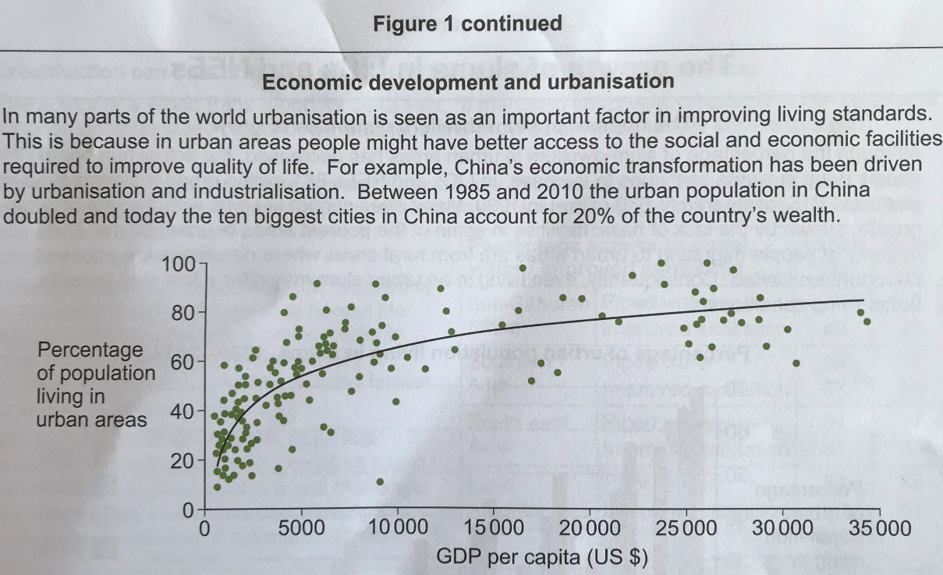
What is the correlation between living in a rural area and GDP per capita (US$)?

Slide 7
1 What is a Mega city ?
2 What is Rural-Urban Migration?
3 What are push-pull factors?
4 What is meant by ‘an unbalanced population structure?
5 Describe the distribution of megacities?

Slide 9
Why do you think the poorest people are unable to take advantage of the opportunities that exist in urban areas?

Slide 10
1 Based on the provisionof piped water and improved sanitation, rank the four regions in order of level of development.

Slide 12
Watch the following You tube clip.
https://www.youtube.com/watch?v=jQeKEGrDoQ4
Watch the following TEDtalk
https://www.youtube.com/watch?v=MSEHp9VMRuo

Slide 14
Read the article
What at least one of the Youtube programme below – preferably both
Make notes
https://www.youtube.com/results?search_query=Kevin+McCleod+slumming+it
https://www.youtube.com/watch?v=l-yjpvzGKZQ&t=952s

Slide 15
Potential long answer questions (9 +3 spg)
How far do you agree that slums are urban areas of hope?
To what extent do you agree that Governments should flatten and clear slum areas?
Assess the extent to which the lack of sanitation and clean water causes the development of slum areas.

Slide 16
Slide 1 Answers
1. 2007
2. 43%
3. 2000 Million
4. 200 Million
5 Between 1950 and the year 2000, the rural population increased steadily from 1,800 million to approximately 3,300 million. Between the years 2000 and 2020 and estimated to 2035, the rural population will remain steady at this number. By 2050, the rural population is expected to decline to approximately 3,200 Million,

Slide 17
Slide 2 Answer
85.71%

Slide 18
Slide 3 Answers
Rural areas generally rely on agriculture as the source of industry. Agriculture is a primary sector employer, producing low value goods. As such, the sale of these items does not generate a large sum of money and GDP in these areas is lower than in the urban areas where most industries are secondary or tertiary, with higher value products. In addition, the emergence of Quarternary industry, with the highest value, is taking place in larger urban areas, often linked to universities.

Slide 19
Slide 4 Answers
1. A city with a population of 10 million or more.
2 movement from the countryside to an urban area.
3 Push factors are things that repel you from an area eg drought in the countryside. Pull factors are things that attract you to an area eg better educational facilities in a large town or city.
4 An unbalance population is one where a particular age group might be disproportionately represented.
5 Megacities are not distributed evenly. Most are found in Asia, particularly China and India. There are two in Europe, London and Paris, three located around the coast of Africa, two in North America, again, coastal and three in South America. There are no megacities in Oceania.

Slide 20
Slide 5 Answers

Slide 21
Slide 6 Answers
Lack of qualifications + consequences
Lack of income + consequences
Lack of transport + consequences

Slide 22
Slide 7 Answers
1 Latin America
South East Asia
South Asia
Sub Saharan Africa.

