Slide 1
Church Project
Mr Barker

Slide 2
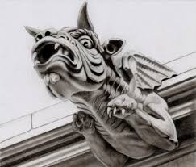
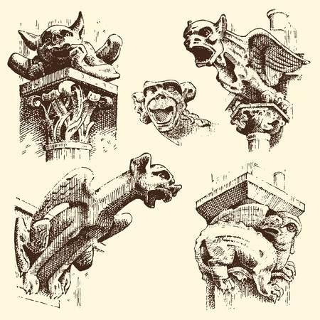
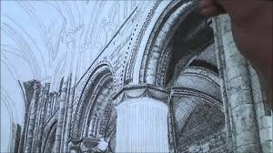
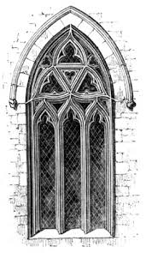
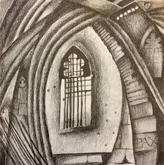
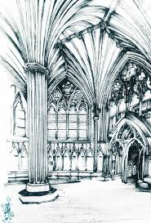
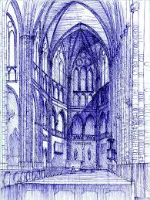
Draw 4 different images you would
Find in a church. Think about architecture,
Gargoyles, stained glass windows, grave
Stones etc.
I would like each drawing to be done using
a different media

Slide 3
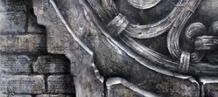
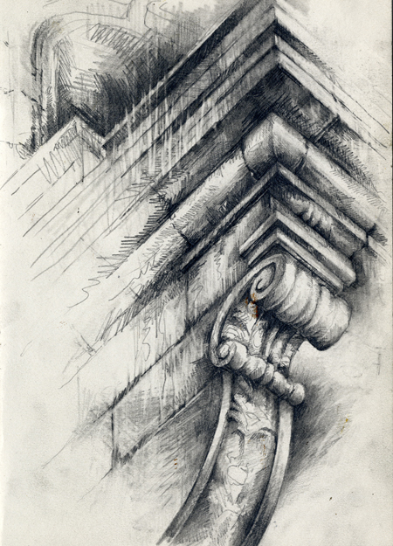
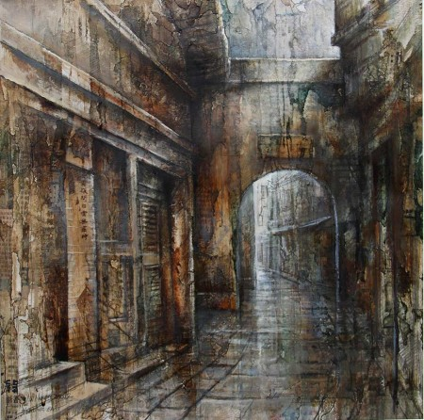
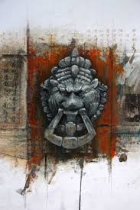
Produce a design sheet on
The artist Ian Murphy.
I would like to see you produce
3 images in the style of Ian
Murphy and some facts about
His work and your opinion of
His work. Talk about techniques
And styles he uses.

Slide 4
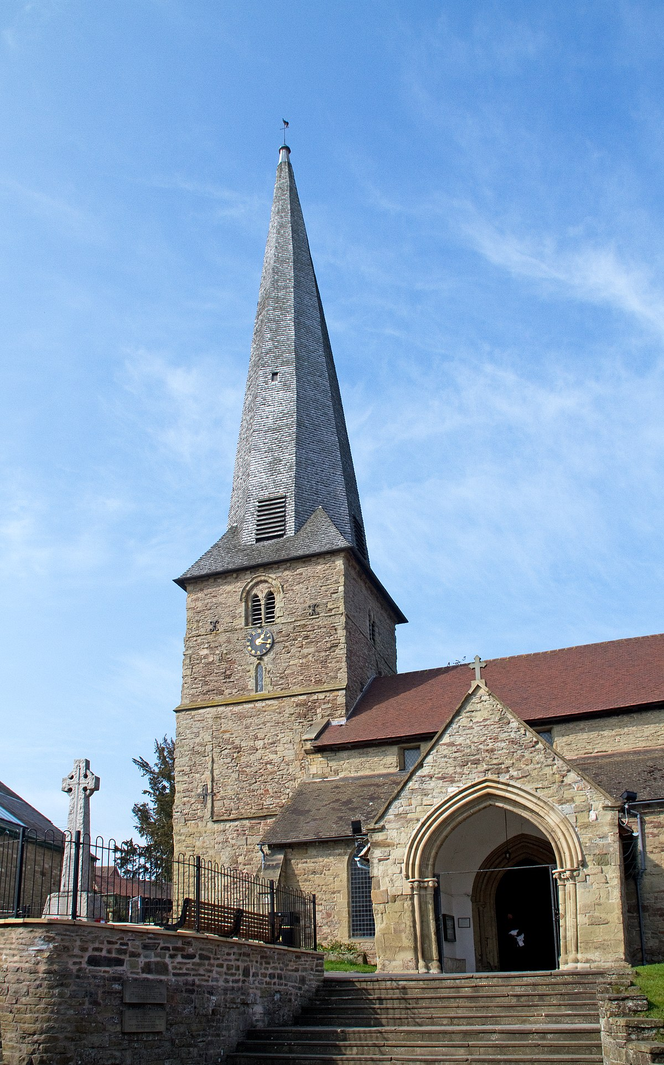
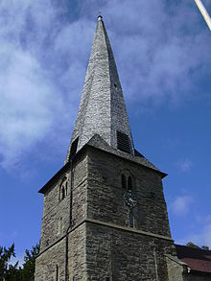
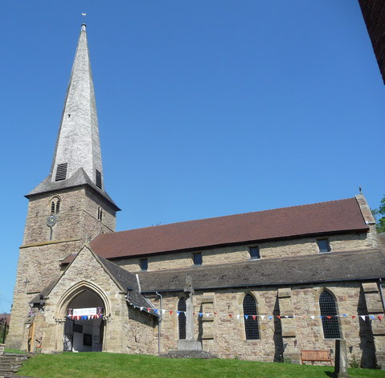
Draw an accurate pencil sketch of St Marys Church.
Use Detail, shadow and tone

