Slide 1
Water – Lesson 1
Work in your book.
Read the slides carefully
Follow all instructions in YELLOW boxes.

Slide 2
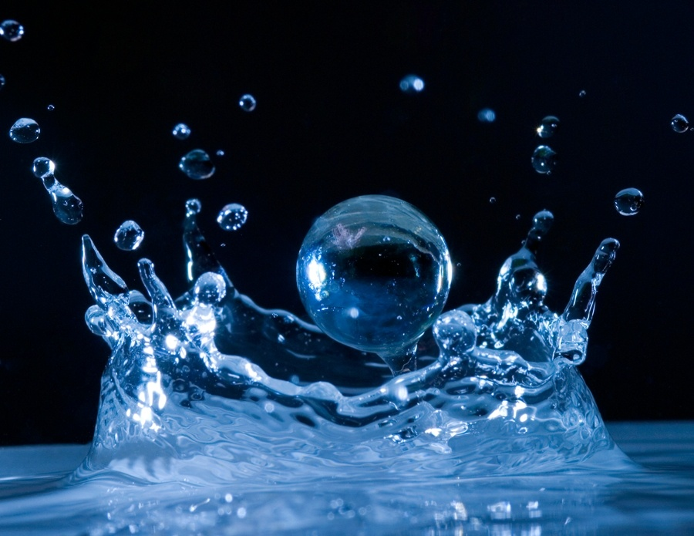
Can you think of any other ways to say the word water?

Slide 3
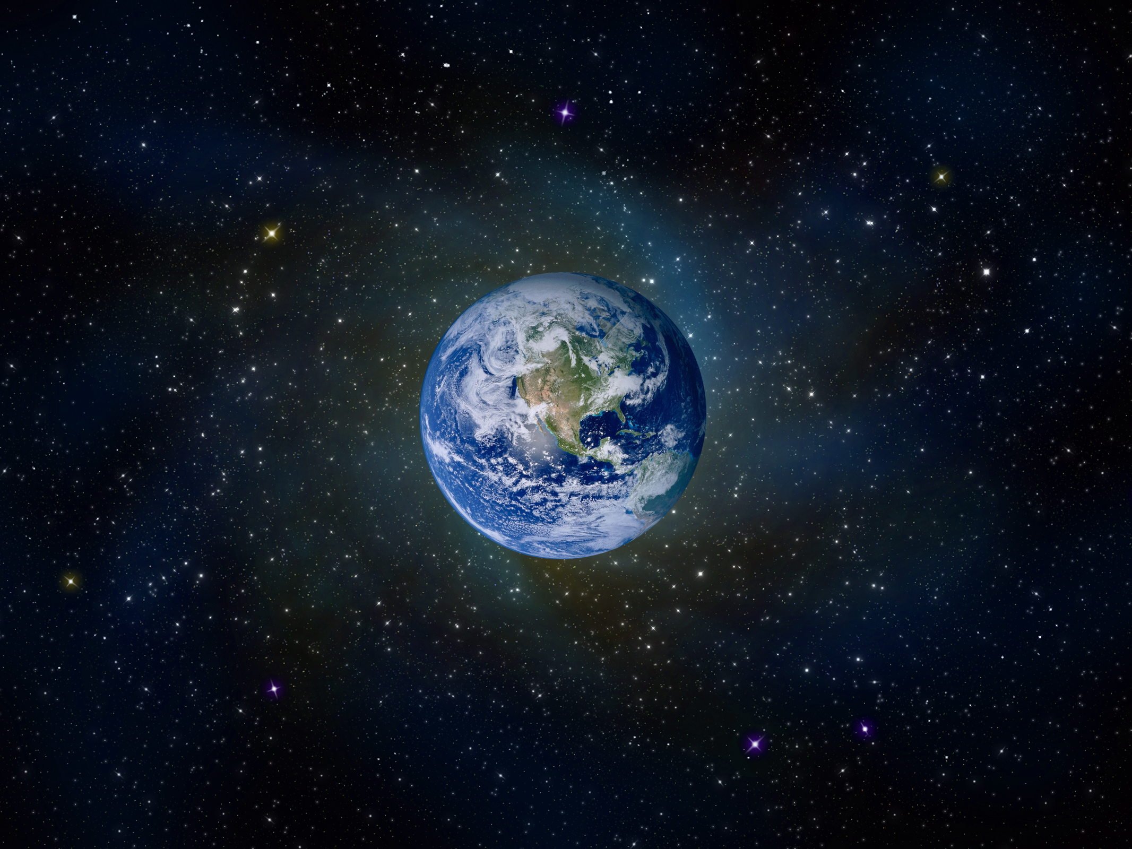
What percentage of the earth is covered in water?
70%

Slide 4
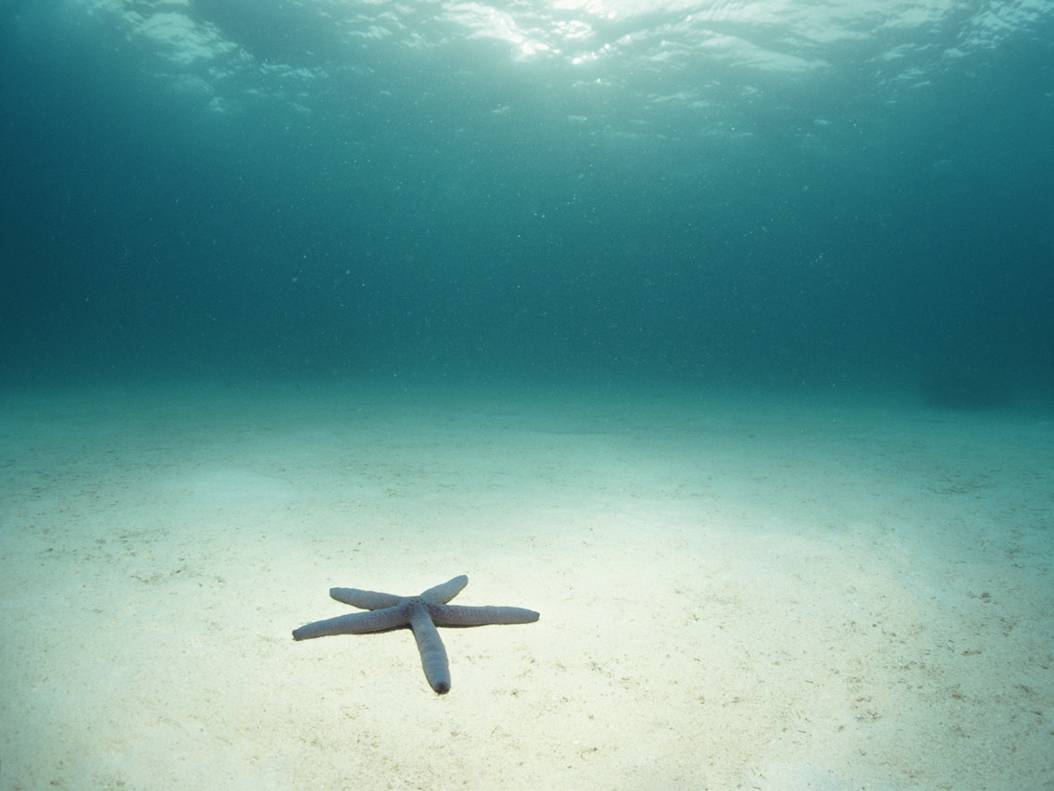
How much of that water is contained in the seas and oceans?
97%

Slide 5
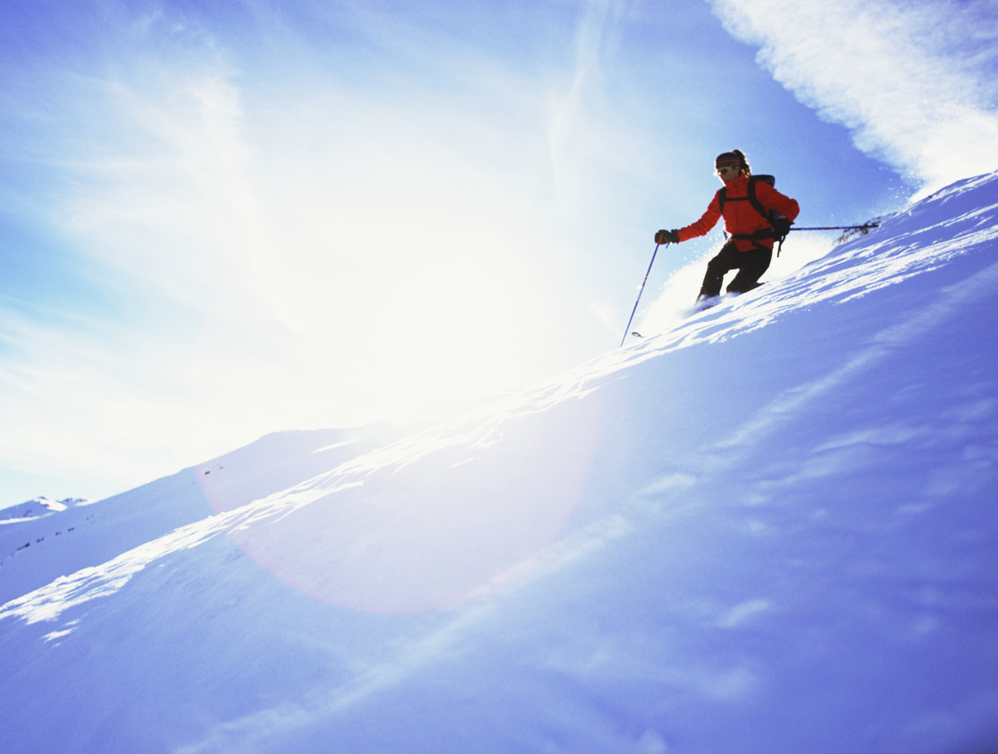
Of the 3% fresh water, how much is stored in ice caps and glaciers?
2%

Slide 6
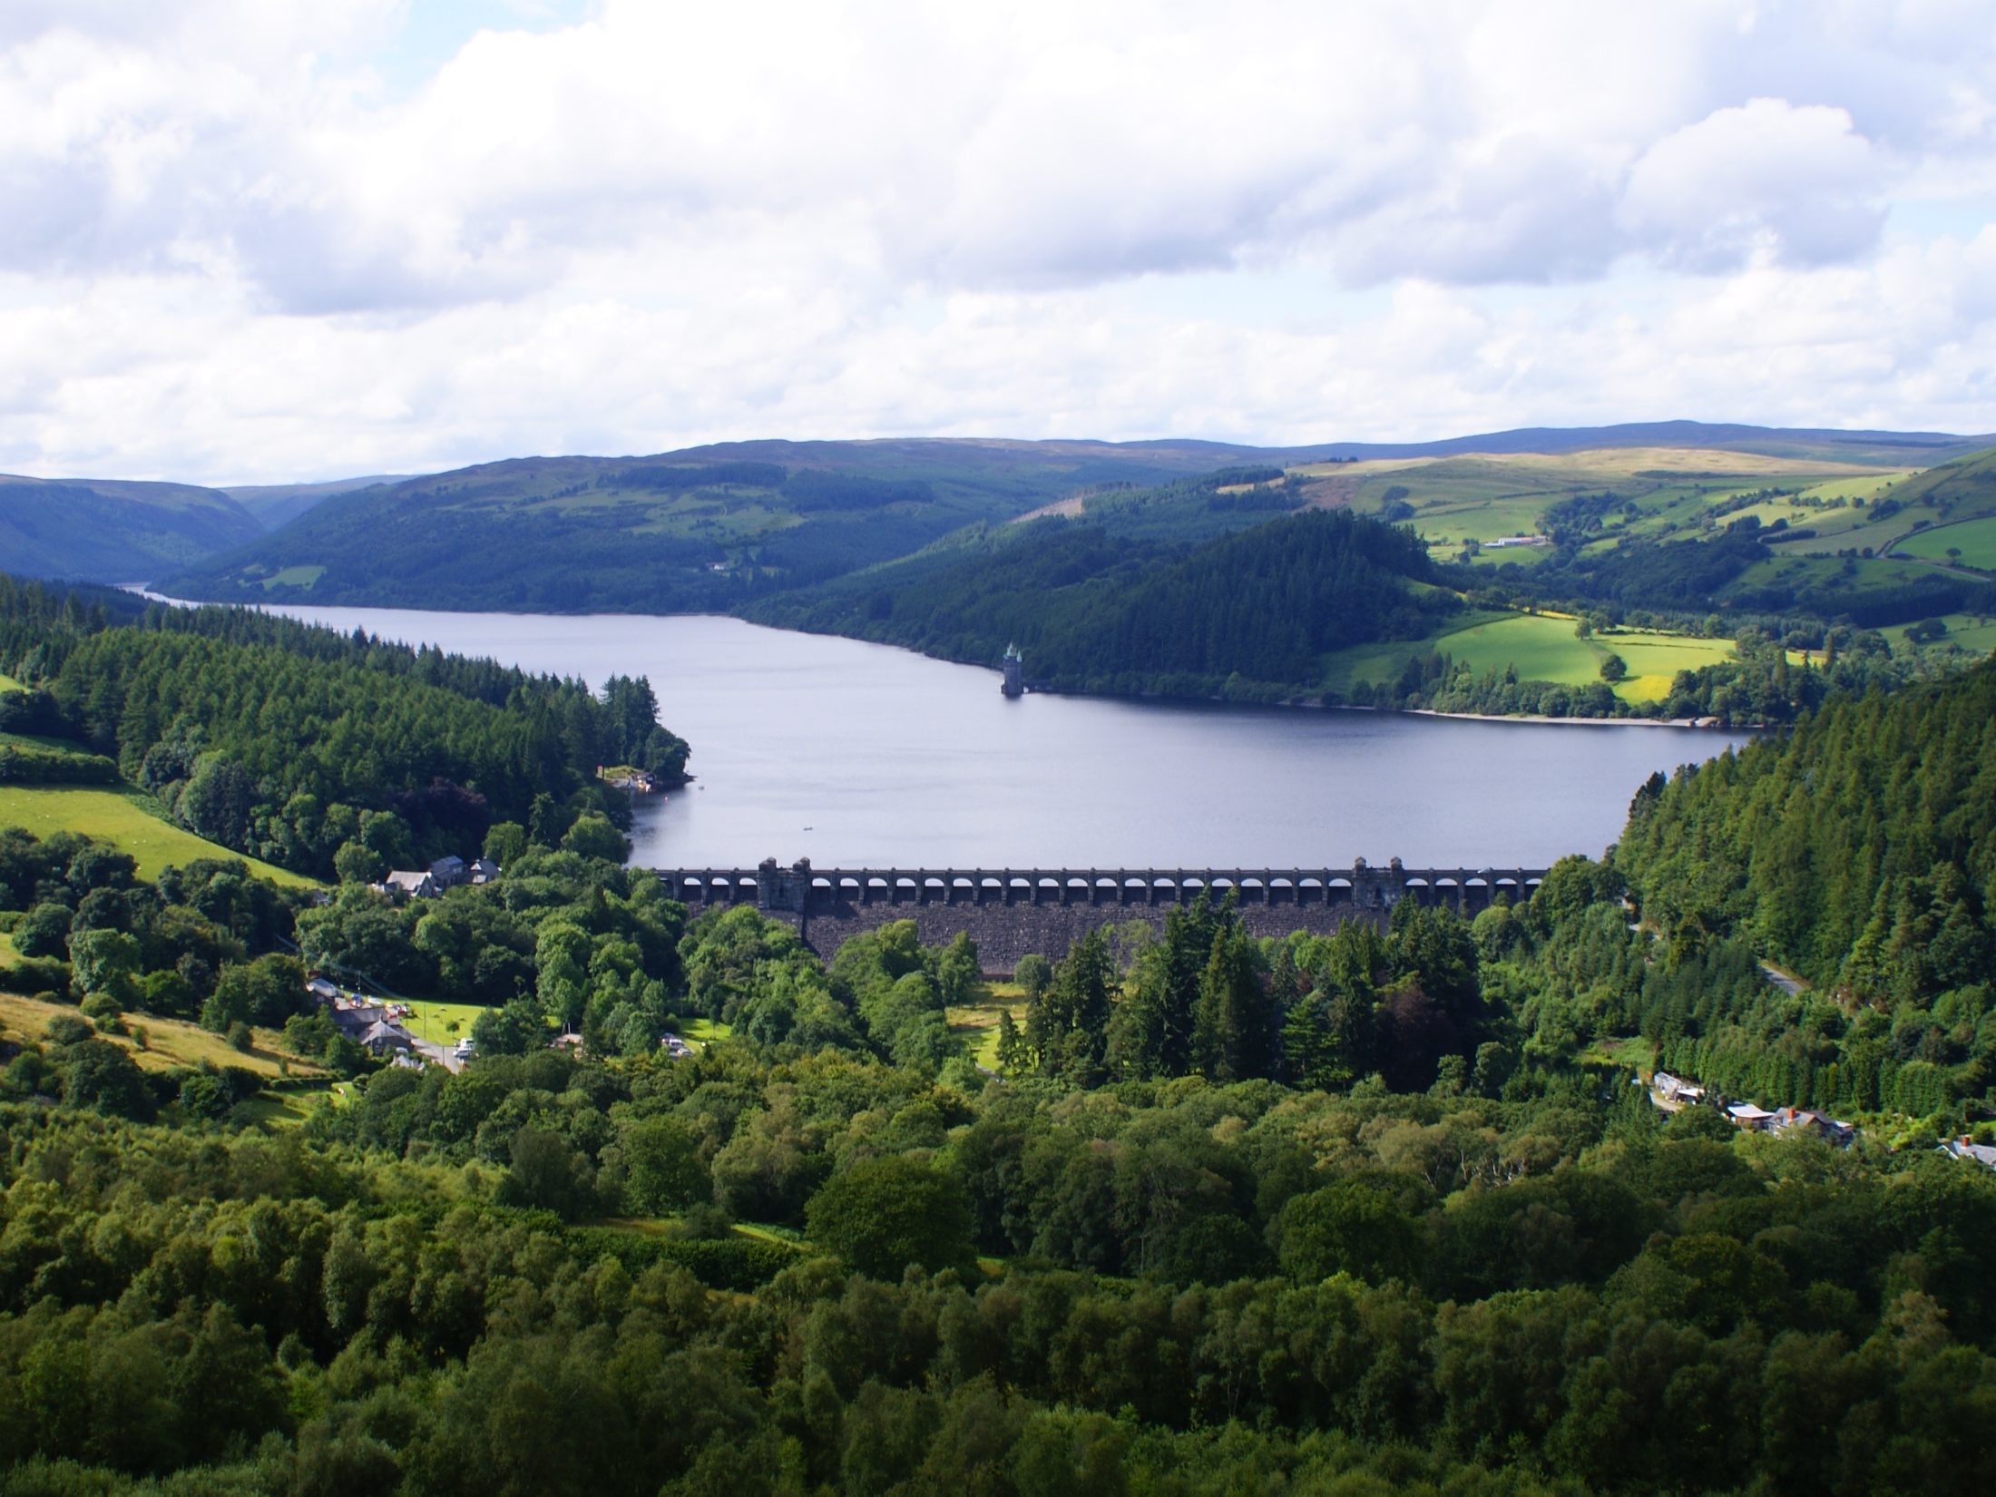
How much fresh water for drinking etc. does that leave?
1%

Slide 7
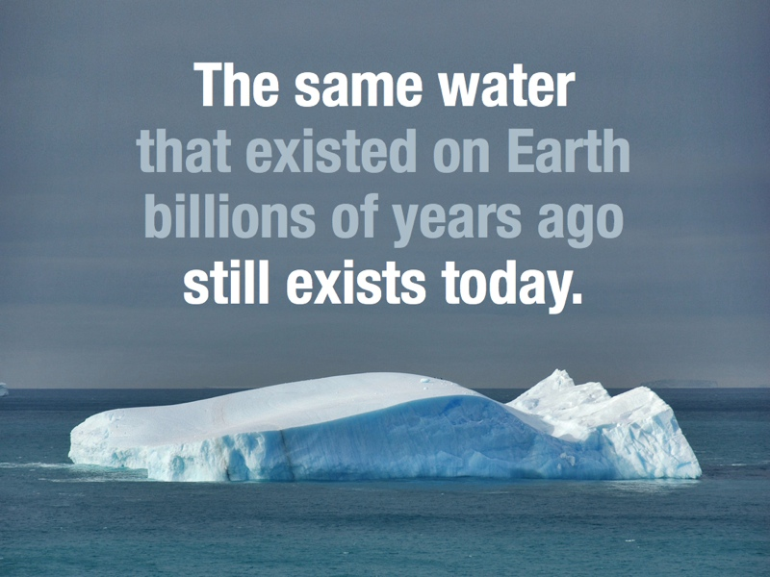

Slide 8
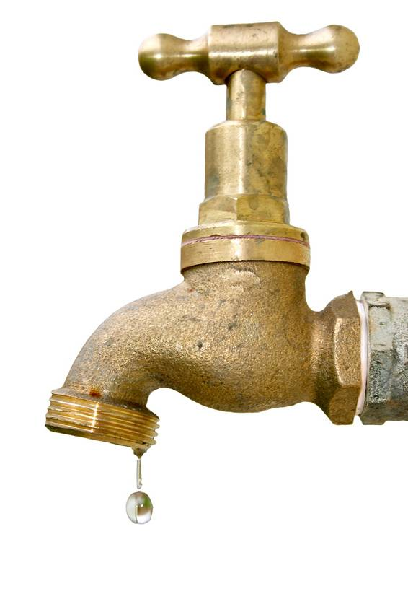
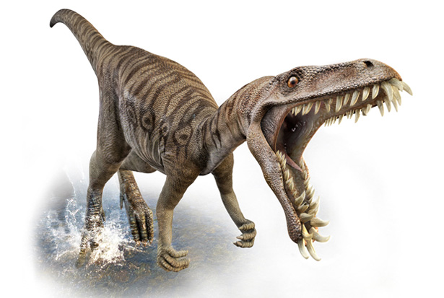
The water from your tap could contain molecules that dinosaurs drank.

Slide 9
Objectives
To be able to describe the idea of the water cycle.
To be able to explain some of the processes within the cycle using specific geographical vocabulary.
To apply the key terms within the water cycle to your own story of a water droplet.

Slide 10
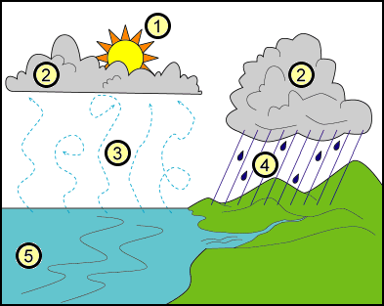
The Water Cycle
TITLE =The Water Cycle
Google the ‘WaterCycle’
Find out what the key words are.
Copy this diagram into your book
S
C
E
P
5. S
6. G
7. T
7
6

Slide 11
The Water Cycle
Check your answers.
Correct in Purple if necessary.
1. Heat from the sun
2. Condensation
3. Evaporation
4. Precipitation
5. Surface water
6. Ground water
7. Transpiration
7
6

Slide 12
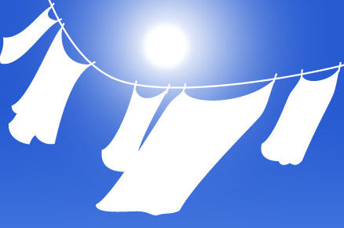
Evaporation
Evaporation is when liquid water turns into water vapour gas without boiling.
This happens you leave your wet washing out to dry.

Slide 13
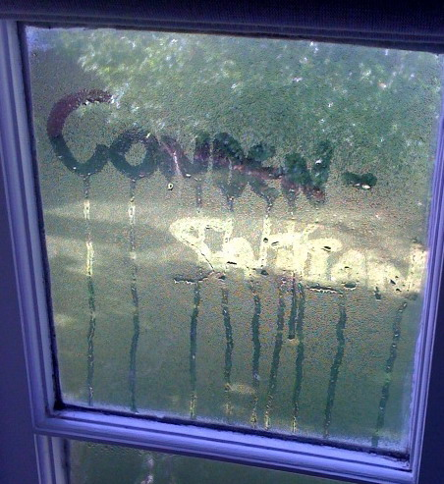
Condensation
Condensation
Condensation is when water vapour gas cools down and turns into liquid water.

Slide 14
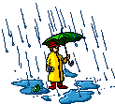
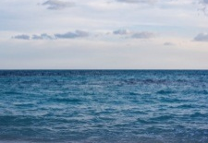
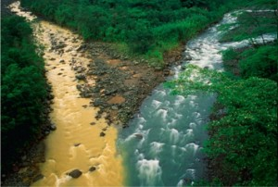
The key terms and definitions are mixed up – sort them out.
Precipitation
When the sun heats up water from the sea and it goes into the air.
Condensation
When water vapour cools and turns into clouds
When water flows through the rocks and soil underground.
Evaporation
Groundwater flow
When the sun heats up water from the leaves of trees.
When the water runs off the surface of the ground.
Surface run-off
Rain, hail, sleet and snow that falls from the clouds
Transpiration
Task; can you work out what key word goes which each different definition?

Slide 15
The key terms and definitions are mixed up – check and correct
Precipitation
1. Rain, hail, sleet and snow that falls from the clouds
Condensation
2. When water vapour cools and turns into clouds
3. When the sun heats up water from the sea and it goes into the air.
Evaporation
Groundwater flow
4. When water flows through the rocks and soil underground.
Surface run-off
5. When the water runs off the surface of the ground.
Transpiration
6. When the sun heats up water from the leaves of trees.
Extension; Add in a small picture to help you remember their meanings.
Write these key terms and definitions into your book.

Slide 16
The Water Cycle
Lesson 2
Read these key terms and definitions to remind yourself what they mean,
The movement of water between the air, the sea and the land.
Evaporation water travels over the ground
Condensation water changes from a liquid to a gas
Transpiration water travels under the ground
Precipitation water lost from trees and plants
Surface water rain, snow, sleet and hail
Ground water water changes from a gas to a liquid

Slide 17
Time to use your imagination….
On the next few slides, an adventure story has been started.
Read the story so far…..

Slide 18
Meet Droplet…

Slide 19
Once upon a time high above the earth, fluffy white clouds drifted through the atmosphere. In the clouds lived Droplet, round and content with life.

Slide 20
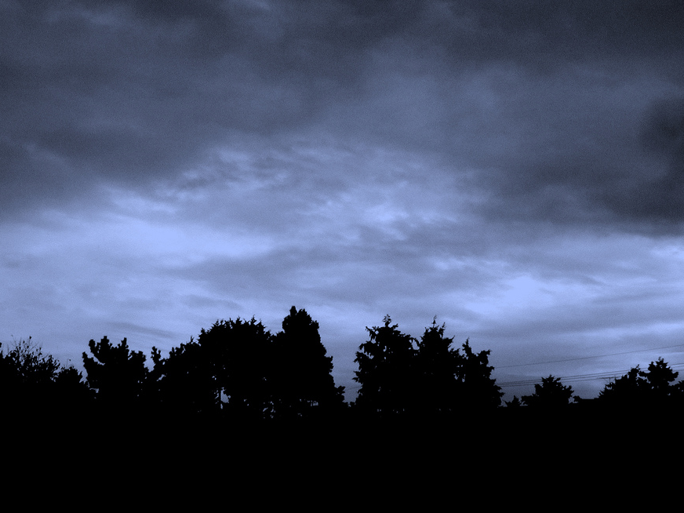
For as long as he could remember, he spent his days lying on his back, relaxing and soaking up the sun's warm rays. One day, he took his usual place in the sun but the light didn't seem to be as bright.

Slide 21
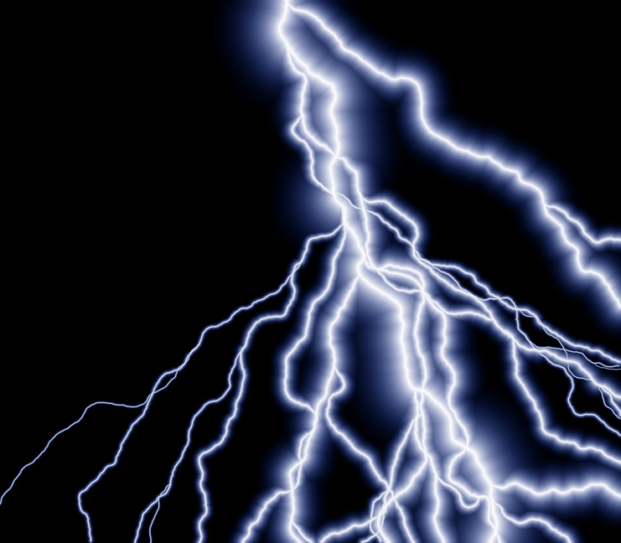
In fact, as the day went on, it grew darker and darker, loud claps of thunder shook the cloud, and Droplet felt as if he were getting so heavy he could hardly move.

Slide 22
Your Task…
Is to get Droplet safely to the ground, into the river, and out to sea so that the sun can warm him once again and help him get back to the clouds.

Slide 23
In your book, set out a whole page as on the next slide.
You need to continue with the story of the droplet as it travels around the water cycle. Be sure to use the key terms correctly
Water cycle
Evaporation
Condensation
Precipitation
Transpiration
Surface water
Ground water
When you story is complete and coloured in, take a photograph of it and email it to your teacher. (If you can print, do this on a computer to email it in WORD) and then stick in your book.

Slide 24
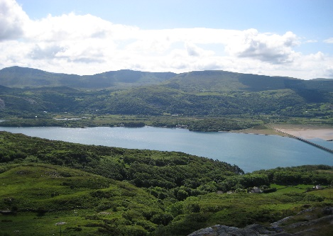
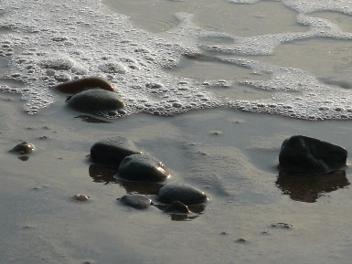
Water Droplet Story
Complet your story to show the full water cycle. Email it to your teacher.
1 The droplet fell from the sky as precipitation, and landed on the ground with a thud. The vegetation on the hillside made the landing soft. | 2 | 3 | 4
5 | 6 | 7 | 8

Slide 25
How does the water cycle affect us?
Lesson 3

Slide 26
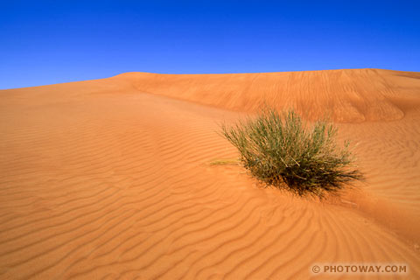
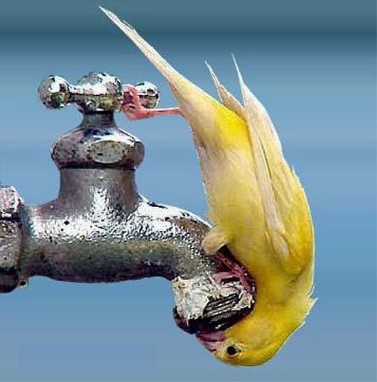
PRECIPITATION-GOOD POINTS
Precipitation – good points
Without precipitation, all of the land on the planet would be desert and we would find it difficult to get a drink.

Slide 27
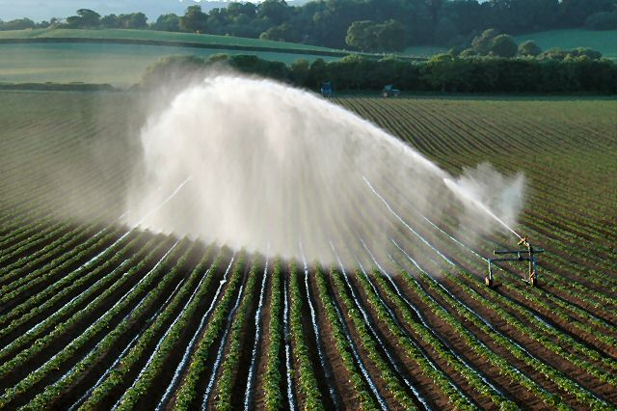
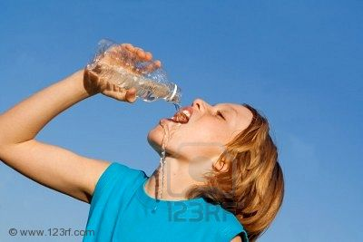
PRECIPITATION-GOOD POINTS
Precipitation – good points
Precipitation helps farmers grow crops and provides a fresh water supply for us to drink.
yourlocalweb.co.uk

Slide 28
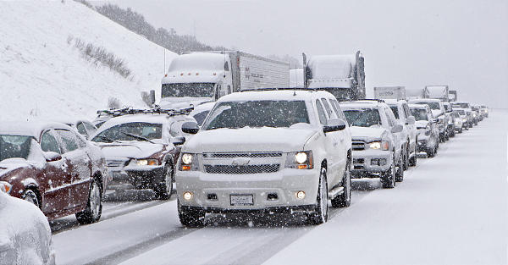
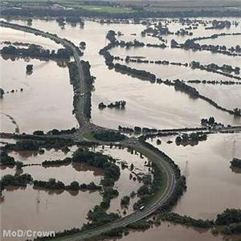
PRECIPITATION-BAD POINTS
Precipitation – Bad points
Precipitation can also be damaging.
Lots of rain and snow can cause flooding and lots of traffic accidents.

Slide 29
Condensation
Water vapour cools as it rises.
When this water vapour cools it forms as clouds in the sky. This is condensation in action.
There are lots of different kinds of clouds.
Clouds are also part of thunderstorms and hurricanes.
Think about how this can impact human activity?

Slide 30
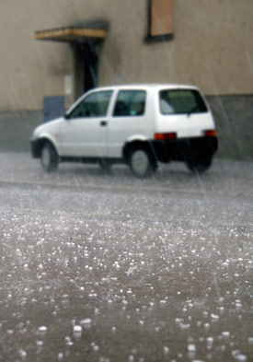
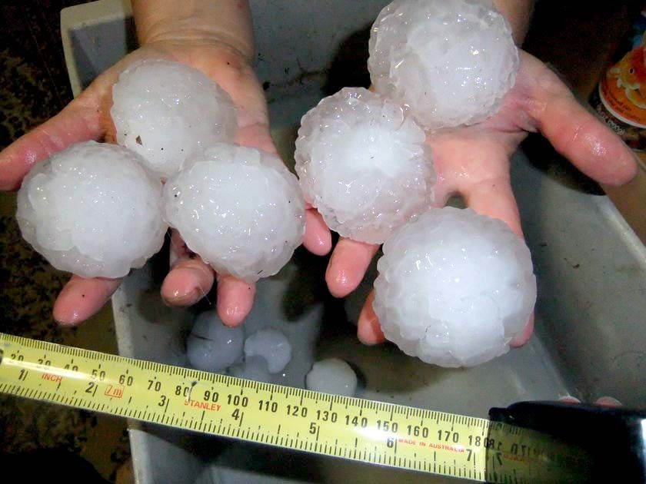
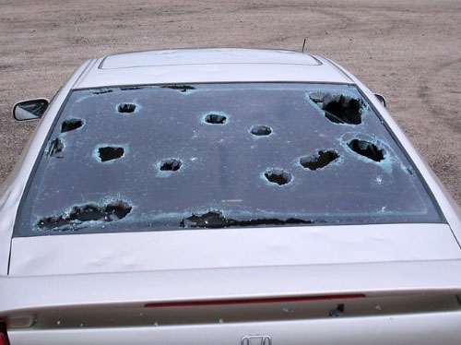
PRECIPITATION-BAD POINTS
Precipitation – Bad points
Hail can damage crops and cars.

Slide 31
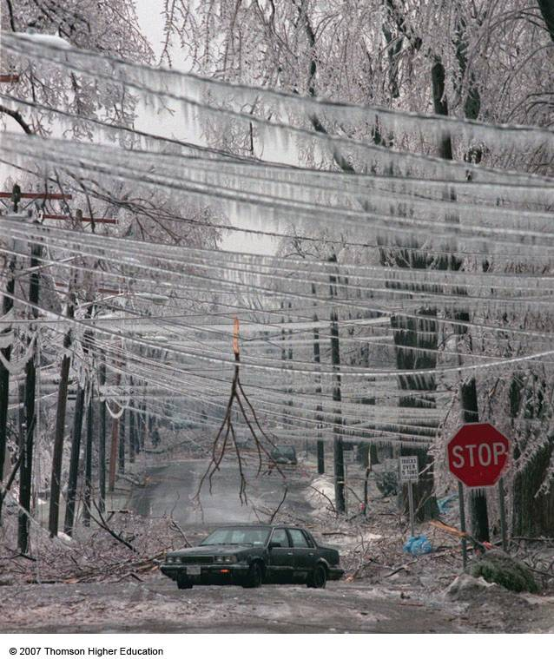
PRECIPITATION-BAD POINTS
Precipitation – Bad points
Freezing rain and sleet can destroy trees and power lines.

Slide 32
Title – How precipitation Affects Us
Introductory paragraph.
Use the previous slides to write an introduction tp explain how precipitation can affect us.
Then
Research the events that lead to the River Severn flooding in January/February this year.
Describe what happened.
Try to give three explained reasons why flooding happened.

