Slide 1
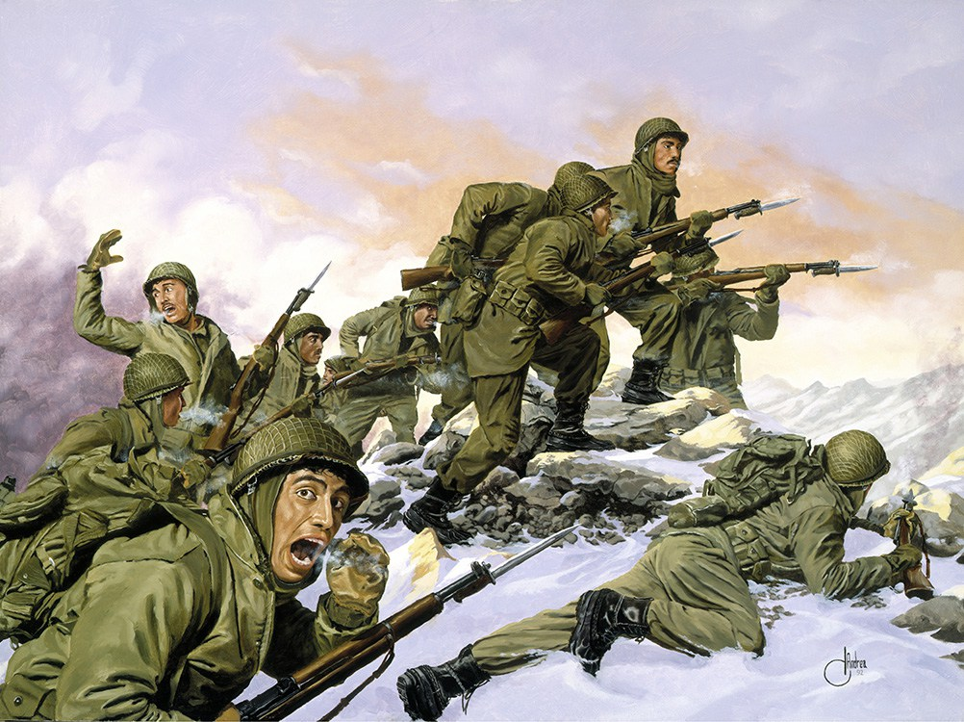
AQA ‘POWER AND CONFLICT’ POETRY
‘BAYONET CHARGE’ BY TED HUGHES
Notes:
@SPryke2

Slide 2
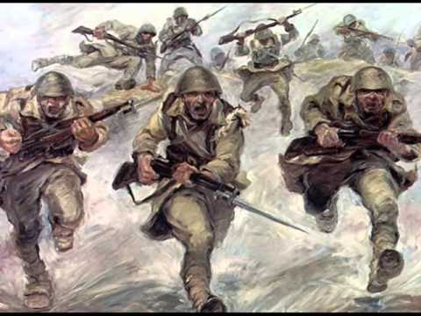
MAKING INFERENCES FROM ART
This painting illustrates the moment of ‘going over the top’ in WW1.
What emotions do you think the men would be feeling?
What might they be thinking about?
How does the bayonet (the knife attached to the end of the gun) suggest a difference experience of fighting to using a gun?

Slide 3
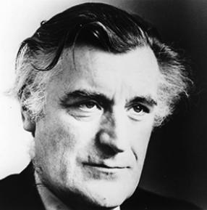
TED HUGHES: Background
Ted Hughes was born near Halifax, West Yorkshire in 1930. His father was a carpenter and a veteran of World War I. Although his family moved when he was eight years old, the landscape of his birthplace had a huge impact on his writing. He went to Cambridge in the 1950s where he read English Literature, Archaeology and Anthropology. While at Cambridge, he met his first wife, Sylvia Plath, whom he married in 1956.
After university he had various jobs, including working in a zoo, teaching and reading scripts at Pinewood Studios. Sylvia Plath and Ted Hughes had two children but later separated. In the year after their separation she committed suicide. Hughes followed his relationship with Plath by one with Assia Wevill. They lived together and she looked after his children from his first marriage. However, she also committed suicide, gassing herself and her daughter in a manner similar to that of Plath.
Hughes writes about the elements and aspects of the natural world in much of his poetry. The poet Simon Armitage said that for Hughes, poetry was ‘a connecting rod between nature and humanity’.
This poem seems to be heavily influenced by the fact that Hughes’ father was a veteran of the First World War (having survived his regiment’s massacre at Gallipoli), as well as by the poetry of Wilfred Owen. Ted Hughes served in the RAF, but he did not see combat. He spent much of his time in the services reading.

Slide 4
Questions to prompt your thinking
The poem opens in ‘Medias Res’, meaning, ‘in the middle of things’. What is the effect and why has Hughes chosen to open his poem like this?
The poem has an irregular rhythm meaning it can be difficult to read. What could this mirror?
How is war portrayed as a violent even here? Pick out specific words and analyse them.
How does Hughes make the poem a microcosm for ALL the soldiers’ experiences? Which word in particular is used?
Suddenly he awoke and was running – raw
In raw-seamed hot khaki, his sweat heavy,
Stumbling across a field of clods towards a green hedge
That dazzled with rifle fire, hearing
Bullets smacking the belly out of the air –
He lugged a rifle numb as a smashed arm;
The patriotic tear that had brimmed in his eye
Sweating like molten iron from the centre of his chest, –
Find examples of language devices and explain their effect. (HINT: How does alliteration mirror the sounds of heavy breathing?)
The poem is in free verse, meaning there is no set rhyme or meter patterns. Why has Hughes made this choice? What could it reflect?
Why mention the hedge is ‘green’? Considering the effects of war, what is the significance of this ‘green hedge’?
How does Hughes dehumanise the soldier in the last line?

Slide 5
Questions to prompt your thinking
Why is enjambment used extensively in this stanza? What could it reflect?
Why does Hughes decide to use a dash at the end of the first line?
What language device does Hughes use to show the soldier is uncertain as to why he is running?
How does the metaphor of ‘stars’ and ‘nations’ create a sense of authority? Consider the idea of celestial imagery. Why describe this authority as cold?
In bewilderment then he almost stopped –
In what cold clockwork of the stars and the nations
Was he the hand pointing that second? He was running
Like a man who has jumped up in the dark and runs
Listening between his footfalls for the reason
Of his still running, and his foot hung like
Statuary in mid-stride. Then the shot-slashed furrows
Why does Hughes use caesura after ‘mid-stride’? What is the effect?
What does ‘statuary’ mean? What is Hughes suggesting here?
What is the effect of the sibilance in the final line?

Slide 6
Questions to prompt your thinking
What does the verb ‘threshing’ imply?
What could the ‘yellow hare’ be symbolic of?
The structure of this stanza means the ‘green hedge’ stands out again because it is the longest line. Why does Hughes want to draw our attention to it again?
How is the mood of extreme terror created here?
Threw up a yellow hare that rolled like a flame
And crawled in a threshing circle, its mouth wide
Open silent, its eyes standing out.
He plunged past with his bayonet toward the green hedge, King, honour, human dignity, etcetera
Dropped like luxuries in a yelling alarm
To get out of that blue crackling air
His terror’s touchy dynamite.
How does this stanza portray the futility of war?
What is the soldier feeling when he says, ‘King, honour, human dignity, etcetera’? Panic? Fear? Frustration? Why is the soldier so dismissive of these three things?
What is the last line suggesting about the soldier’s emotions? Consider the noun ‘dynamite’ and its connotations.

Slide 7
Developing your own thinking and interpretation on imagery and ideas.
When asked about the significance of the ‘yellow hare’ on Twitter, teachers offered the following suggestions. Do you agree or disagree with anything mentioned here? What is your own interpretation?
‘According to some folklore, the hare is a symbol of an imminent tempest, inspired foreboding and trepidation. It can be seen to be unlucky to meet a hare and it is often associated with disaster.’
‘I think it’s interesting that it’s the only other life he sees (no humans mentioned) and it is a natural image which is killed, like the air.’
‘On a physical rather than figurative level, I always thought it was in part because the hare is running for its life like the soldier and it is only when he stops that he becomes aware of it and the image of it being torn apart indicates his own possible fate.’
‘I get students to consider the reason for a hare and not a rabbit. Rabbits will hide (I’m not David Attenborough so don’t judge me) and live together whilst a hare will run from danger and tend to be solitary. Then link this idea to the soldier in the poem.’

Slide 8
TEACHERS ON TWITTER: THE SIGNIFICANCE OF THE ‘YELLOW HARE’
‘I've always gone down human warfare destroying nature and also that it foreshadows the soldier's fate. He sees the hare & knows his will be the same.’
‘Consider survival techniques used by soldiers and hares: both use camouflage to evade attack; a hare will lie in their form in the ground, a soldier his trench; hares run in zig zags to avoid being caught/ shot at, a strategy used by soldiers.’
‘I always consider it as a representation of the effects of war on nature.’
‘It could be an image of nature in pain, suffering at the sight of man destroying one another and nature. Yellow links to illness/death, hare links to death/rebirth/resurrection. Maybe it's a warning that we all suffer and make sacrifices in conflict...maybe!’
‘Vulnerability? Cowardice?’

Slide 9
Extension and further thinking:
Watch a film which portrays the reality of trench warfare and the horrors of ‘going over the top’ e.g. War Horse.
Compare ‘Bayonet Charge’ to ‘Exposure’ – how are they similar/ different in ideas, perspectives, tone and atmosphere?
Draw a storyboard of 6 images depicting ‘Bayonet Charge’

