Slide 1
Year 8 Art You will have one lesson with Mrs Wilson on Thursday 18th June and one again in a fortnights time on Thursday 2nd July. You have two weeks to complete the first task and will need to photograph it and email it to me with your name and form before the next lesson chloe.wilson@laconchildeschool.co.uk
Welcome to those who have been completing the work set by me in the last two weeks. Your work has been good, well done if this is you. I will be setting an ongoing project that should last you until the end of the term. If you haven’t done so already, see the previous two weeks PowerPoints on the website

Slide 2
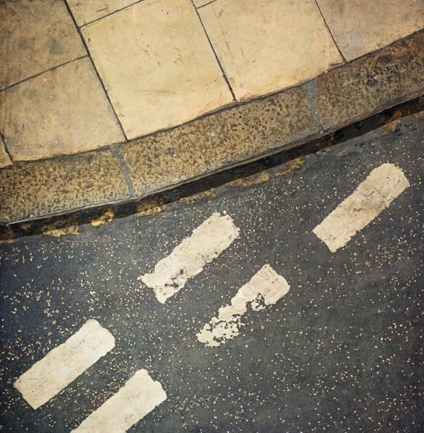
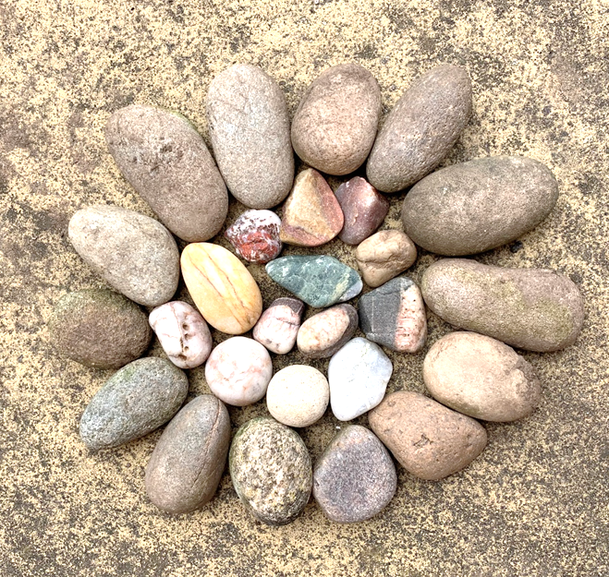
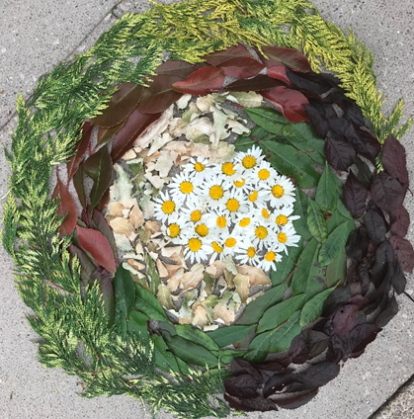
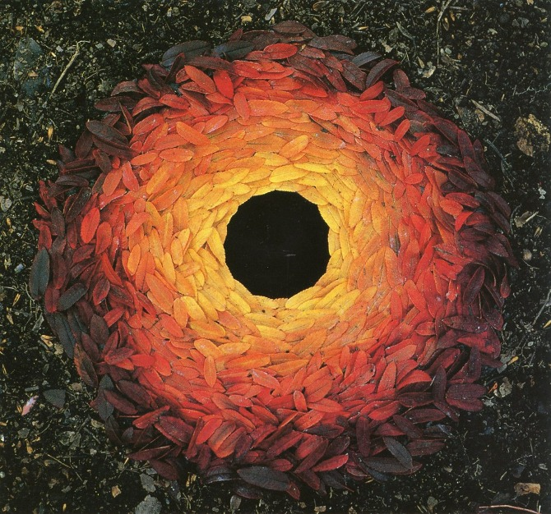
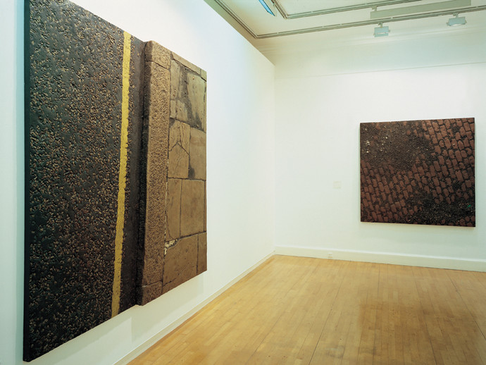
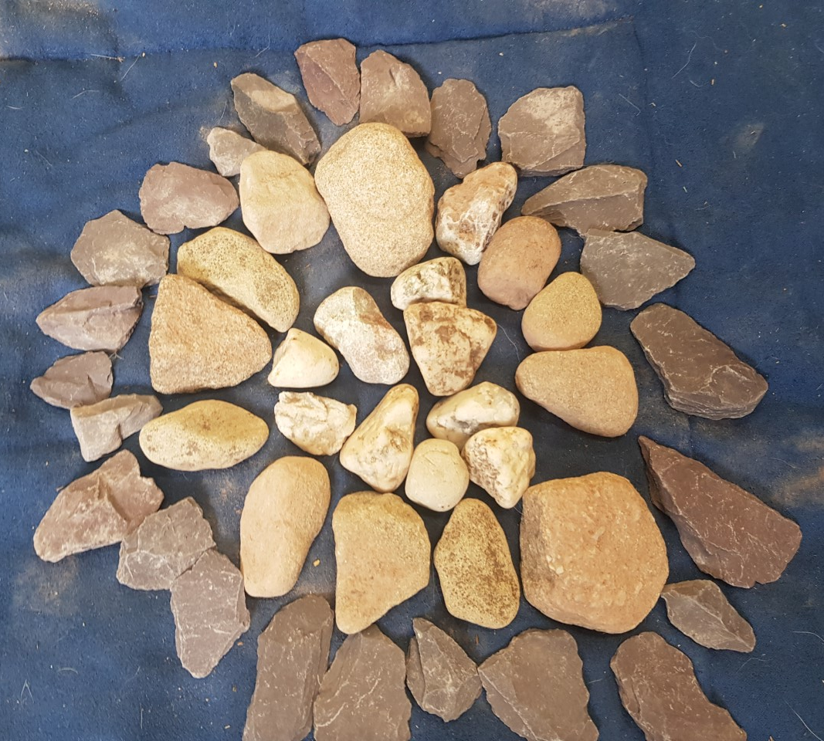
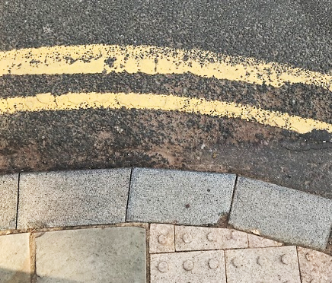
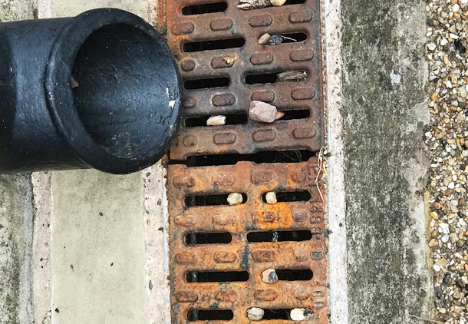
During the past two weeks you have created some great work in response to Boyle family and Andy Goldsworthy. Here are some examples of the lovely work I’ve had from you.
Addison Crescent Study (London Series) 1969
Painted fibreglass & mixed media
Holland Park Avenue Study, London Series (1967). Cobbles Study, Lorrypark Series (1976).

Slide 3
Mark making
You have been using your observational skills in the last two art tasks, looking up close at textures, patterns and colour. Now you will be able to create your own. You will make your own texture book (to bring into school in September) and to use as inspiration in the next fortnights lesson.

Slide 4
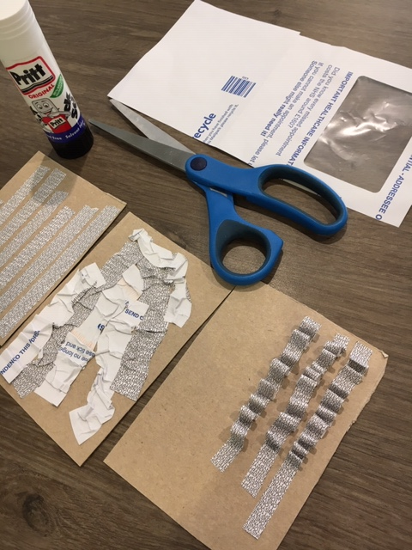
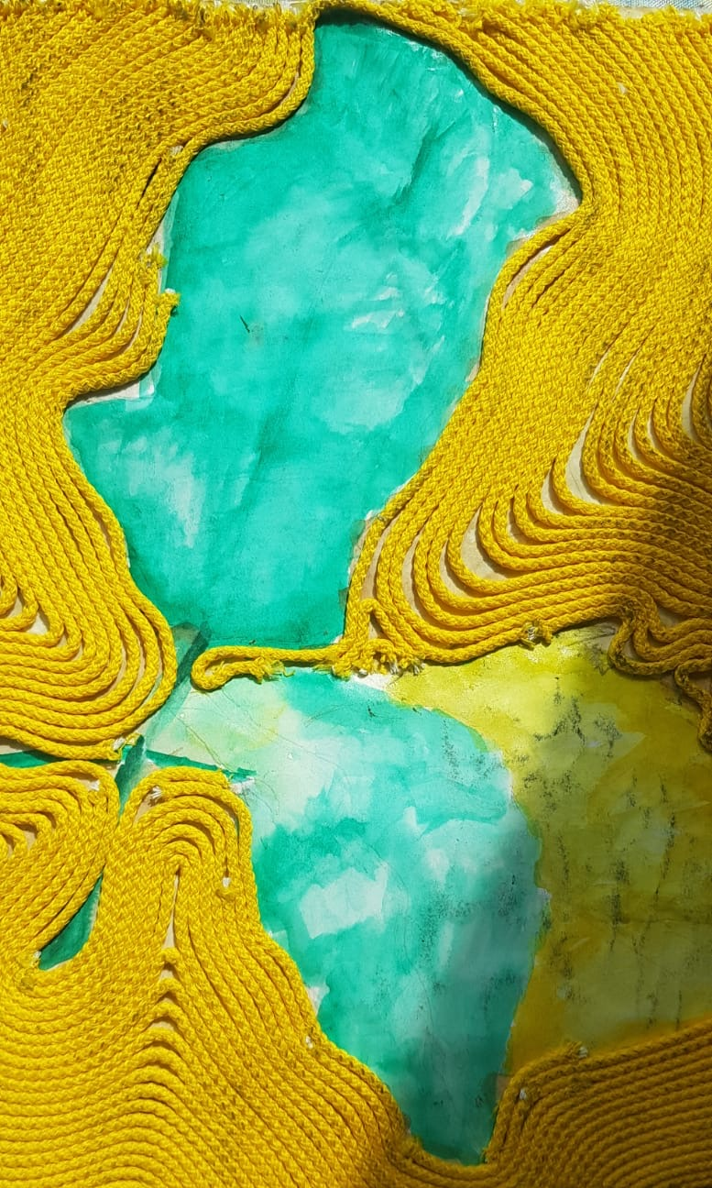
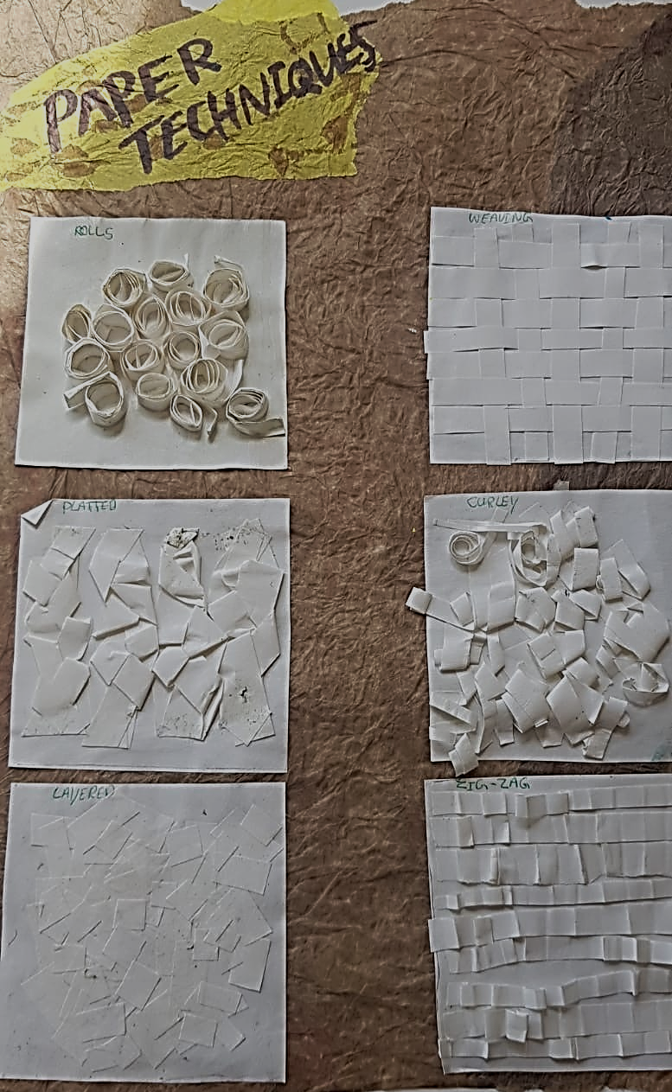
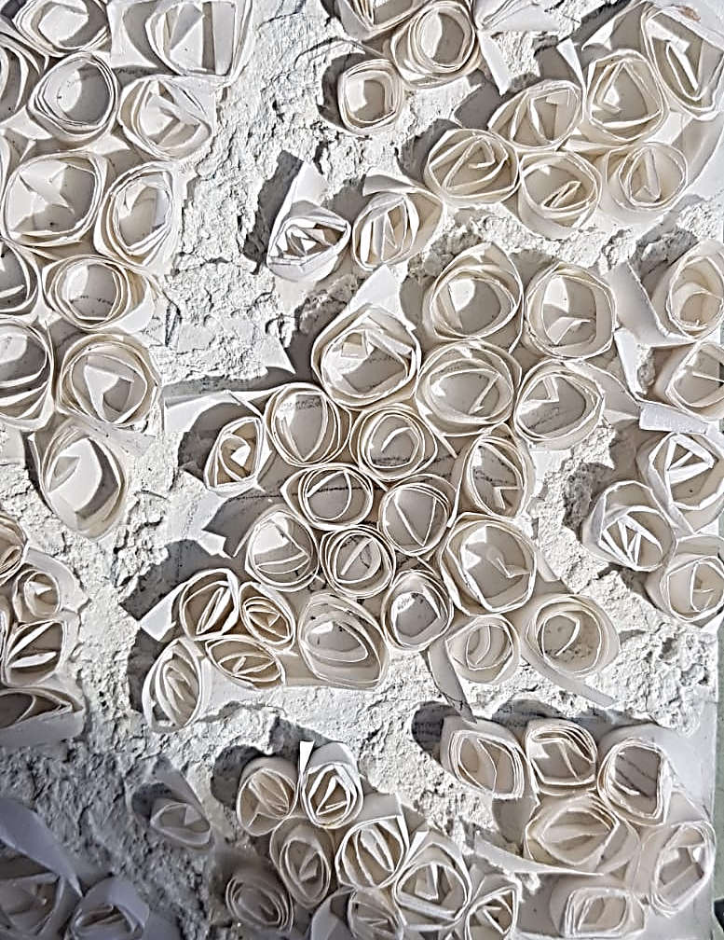
Paper technique examples
You could use newspaper, paper plate edging, paper straws, string, oranges bag. What textures or patterns can you make? I used the patterned side of an old envelope; you can make a variety of textures with one material. You don’t need to get fancy materials – be imaginative and recycle. Please ask permission before cutting anything up

Slide 5
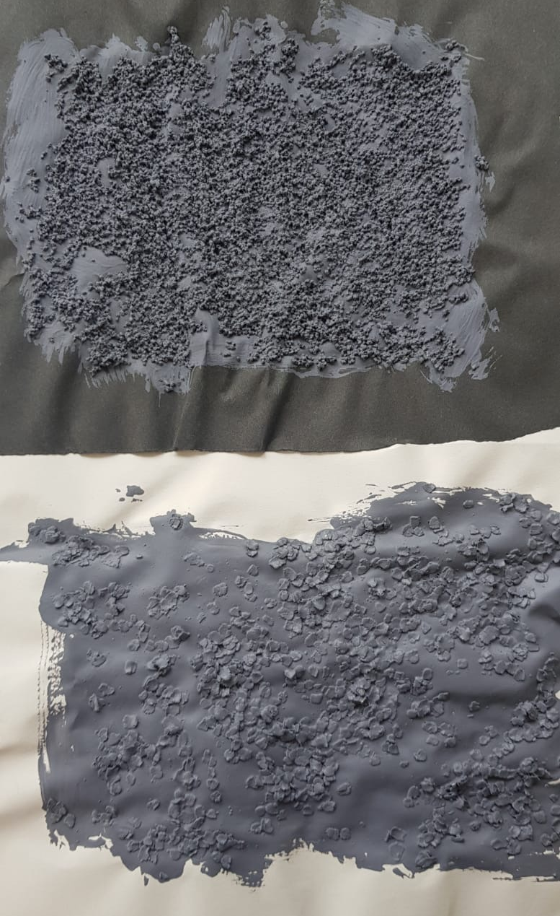
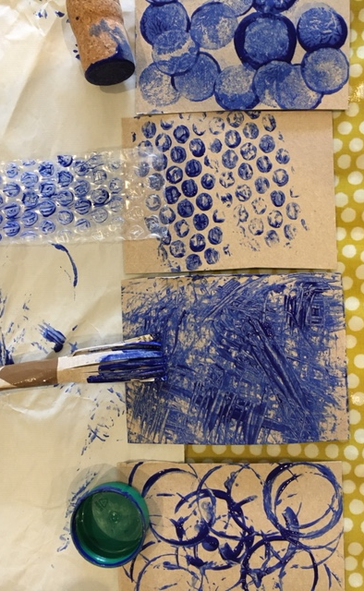
Painted technique examples
You could use paint and lentils/couscous/sand, try scrapping it printing, dabbing mixing it. What textures or patterns can you make? Please ask permission before using materials in your home or making a mess!

Slide 6
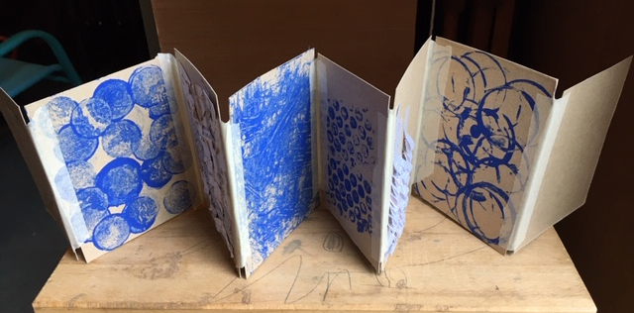
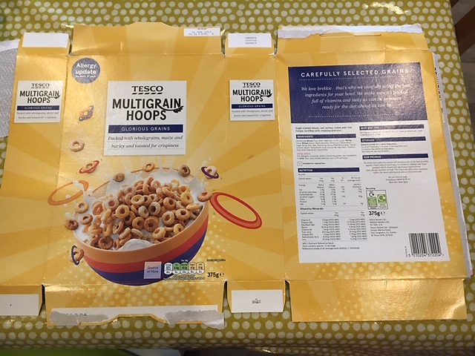
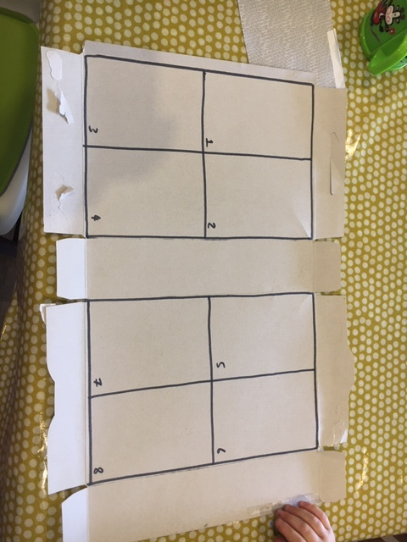
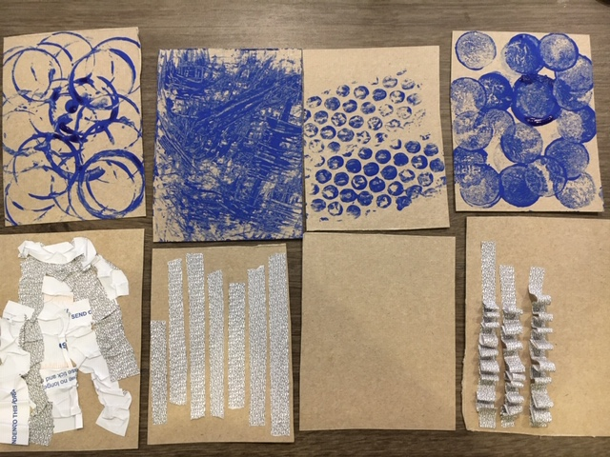
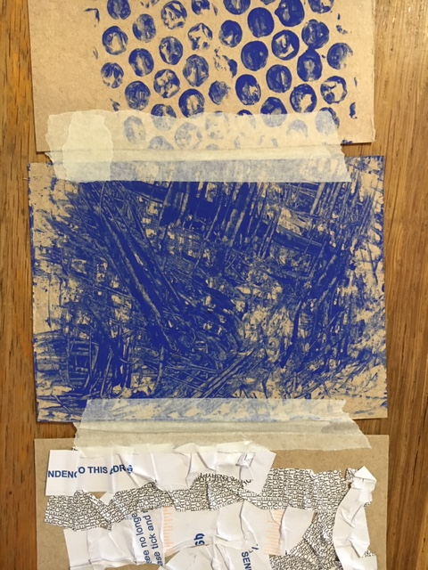
Texture book
Task 1-
Using the two largest areas of a cereal box cut out 8 equal squares/rectangles to create your texture book
b) Create 4 cards of painterly textures, you can use paint or google alternatives if you don't have any. Household emulsion or a strong mix of coffee and water might give good results (ask permission) and 4 cards of paper/string textures.
c) Once completed and dry, use tape to stick them together. Ensure you leave a gap between them or the book will not fold up.
d) Take a photo of your texture book and email it to me with your name and form. (as above). Keep it to show in the next online art lesson in two weeks time.
Challenge:
You could use the back of the book to do more textures, so it becomes double-sided. The more the better!

