Slide 1
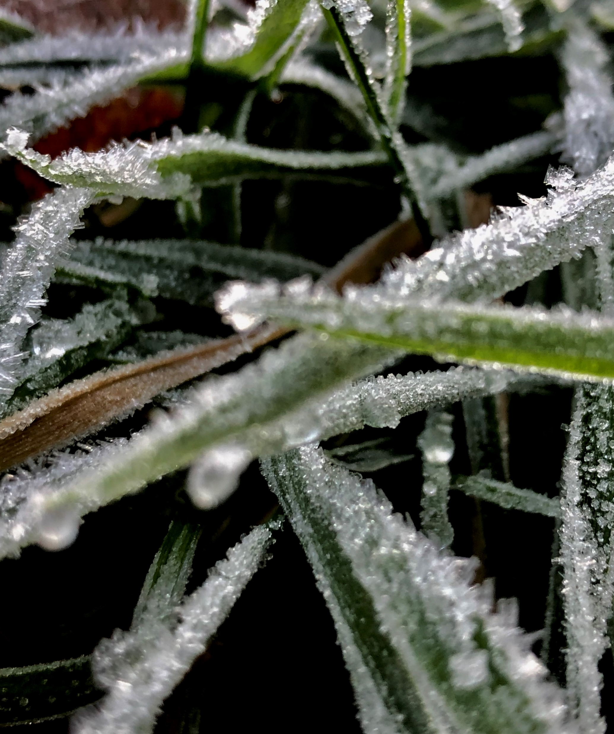
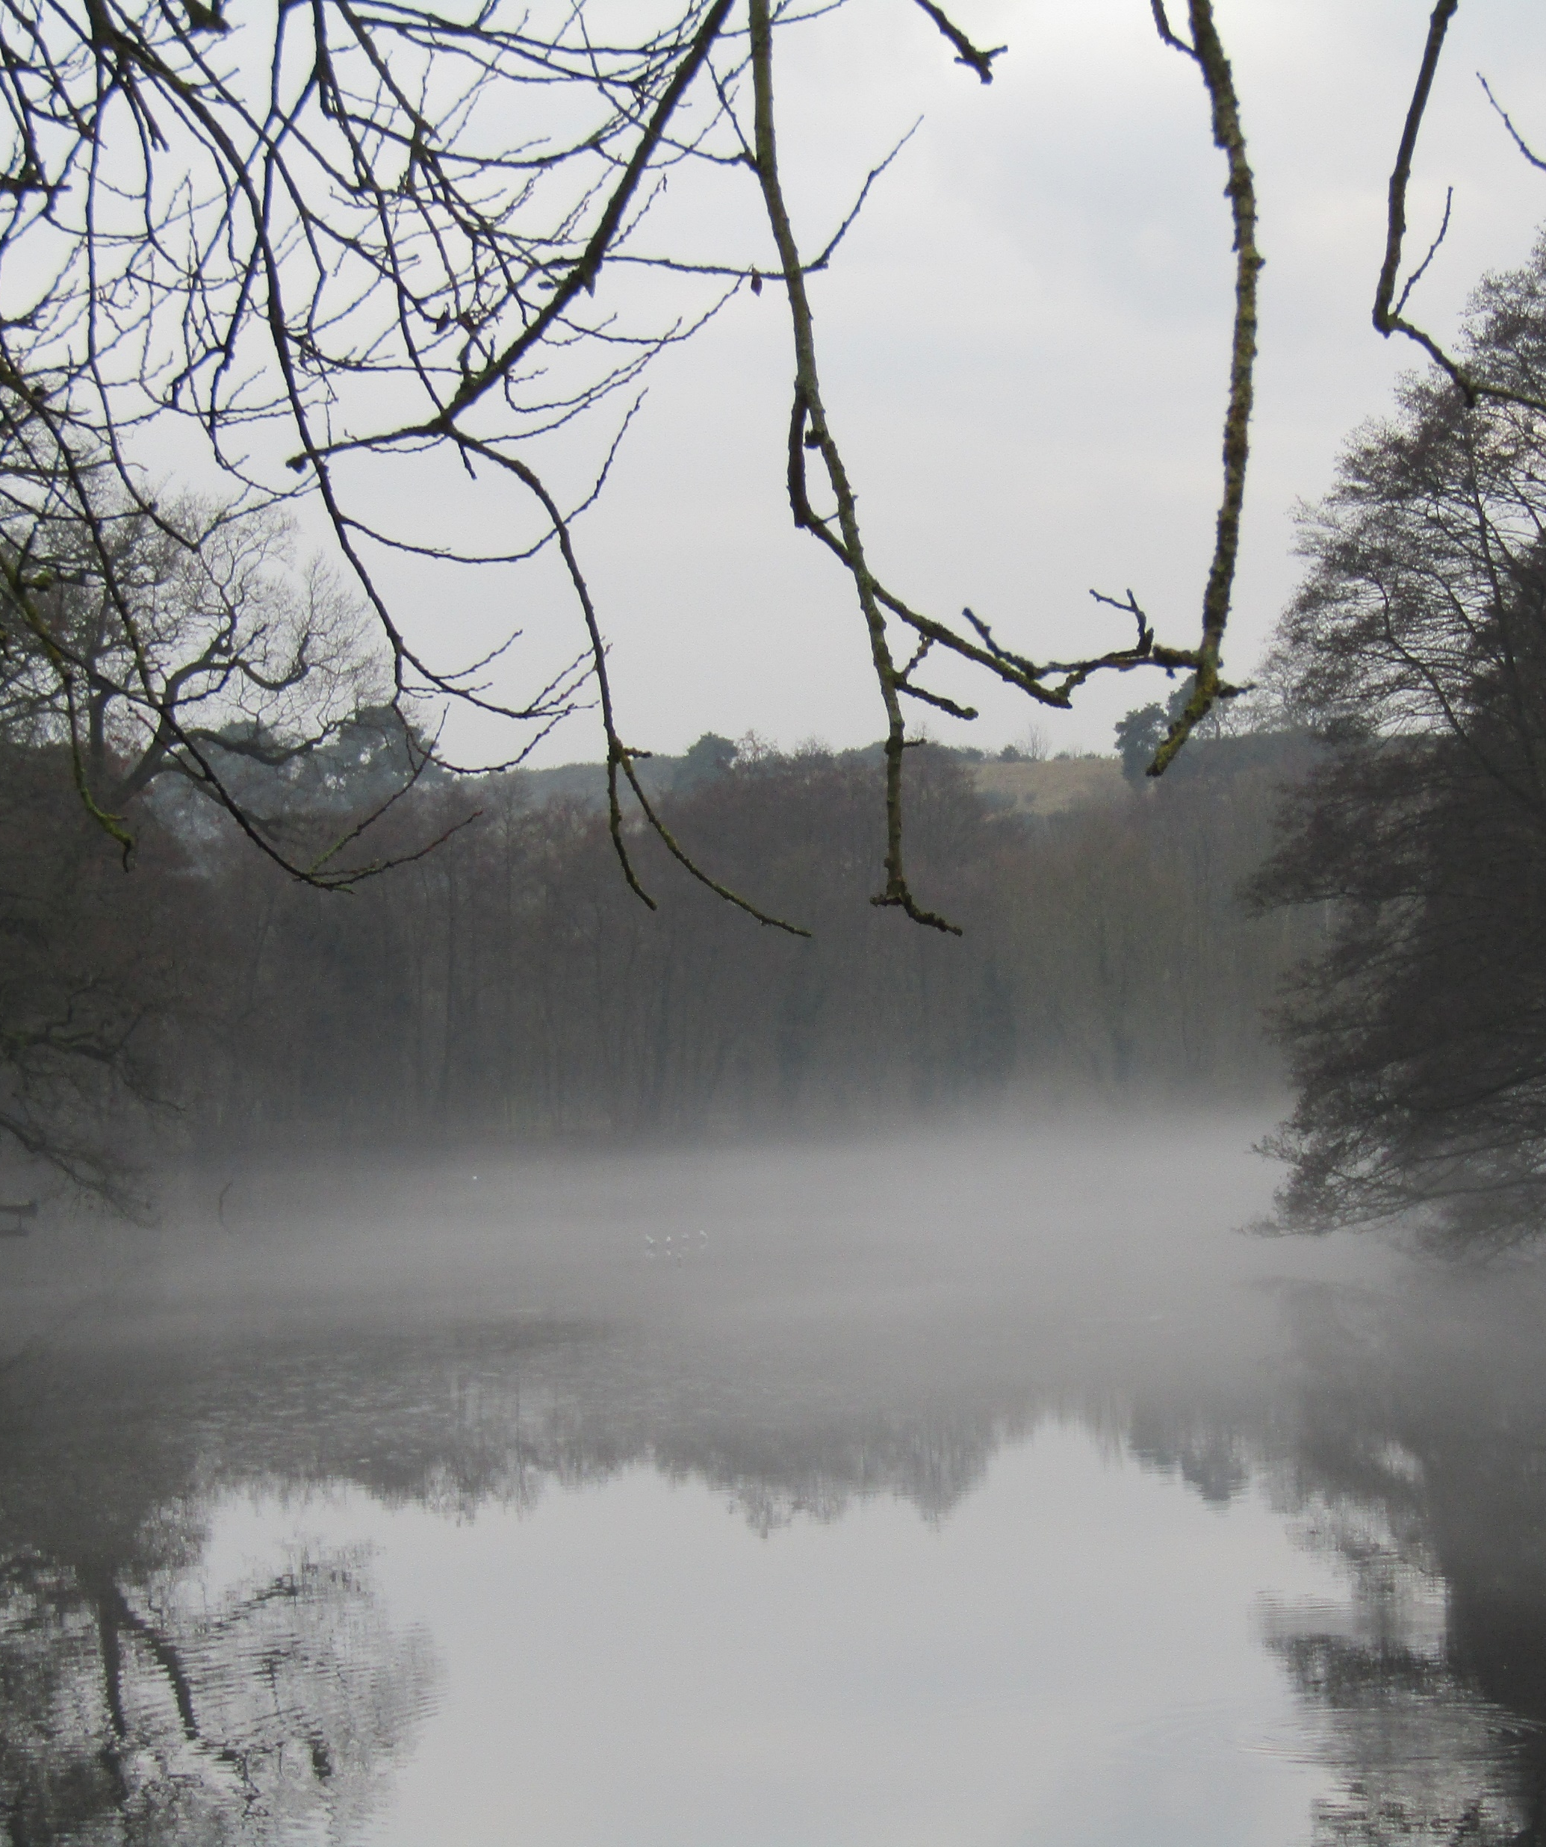
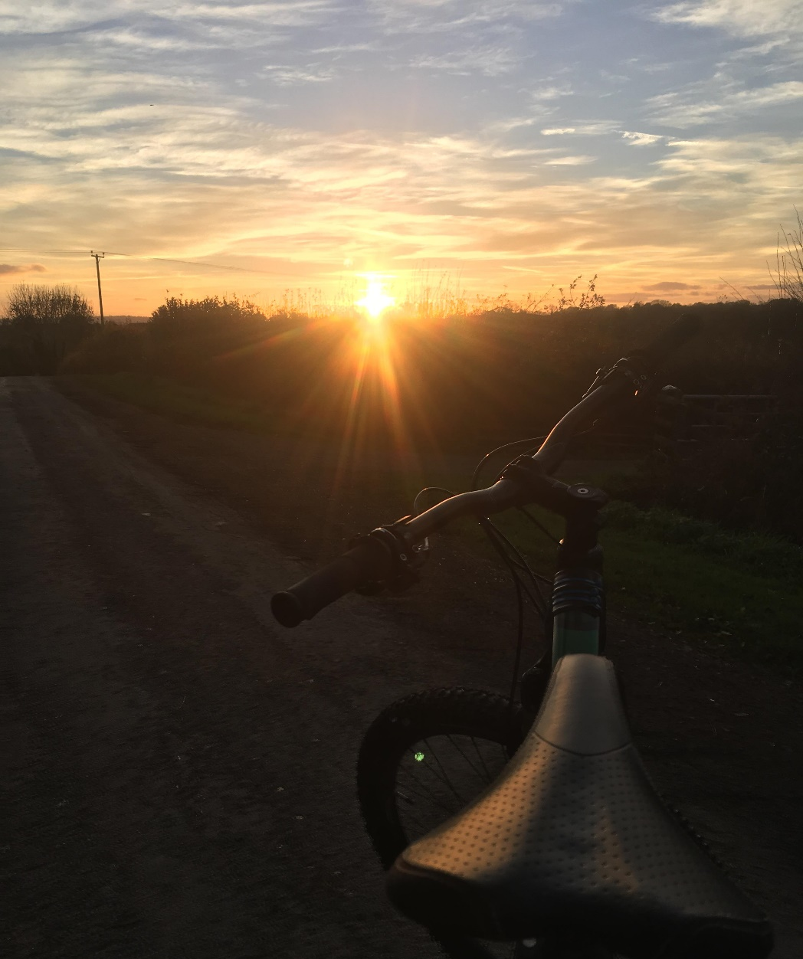
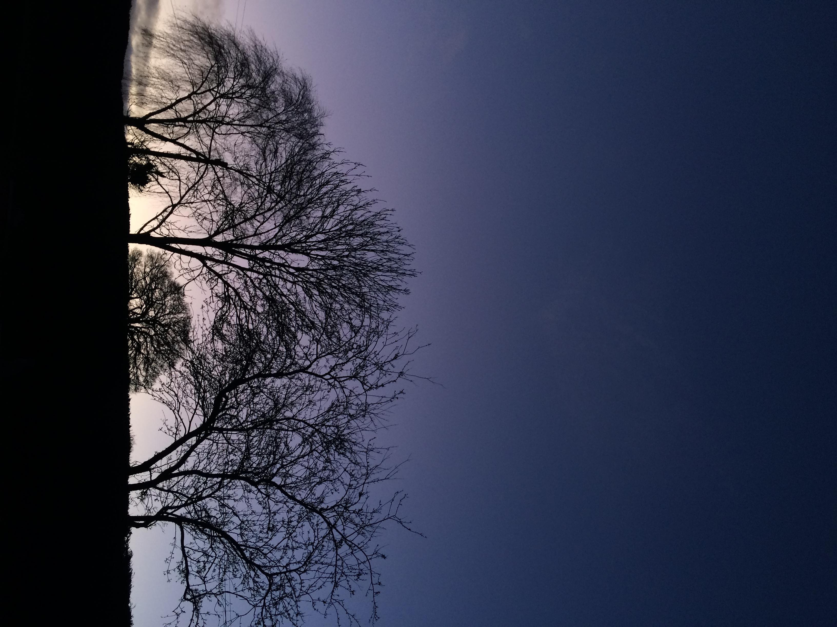
Lacon Childe Photography Competition
Past pupil entries
Theme: Lockdown Landscapes
Entry: KS3 and KS4 pupils
Submission details: No more than two digital photos, emailed with your name and form to Mrs. Wilson chloe.wilson@laconchildeschool.co.uk
Deadline: Monday 6th July
Prizes: Runner up and winner in KS3 and KS4

