Slide 1
Year 8 Art You have had one lesson with Mrs Wilson on Thursday 18th June and the next on Thursday 2nd July. You have had two weeks to complete the first task and should have emailed me a photo of it with your name and form before the next lesson chloe.wilson@laconchildeschool.co.uk
First task is the orange slides – Thursday 18th June
Second task is the blue slides – Thursday 2nd July
Welcome to those who have been completing the work set by me in the last two weeks. Your work has been good, well done if this is you. I will be setting an ongoing project that should last you until the end of the term. If you haven’t done so already, see the previous two weeks PowerPoints on the website

Slide 2
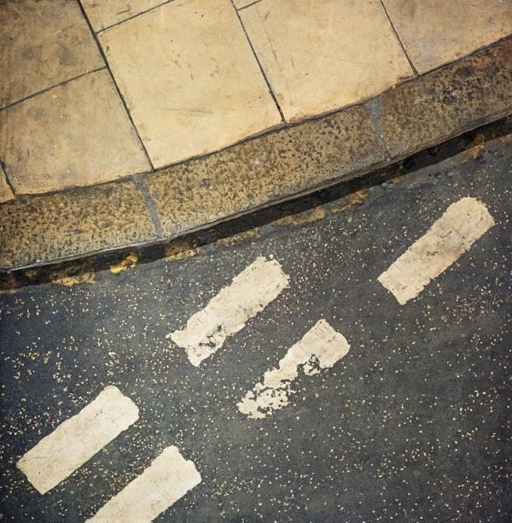
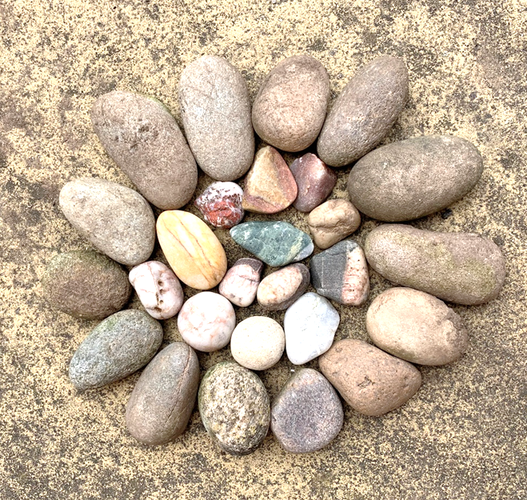
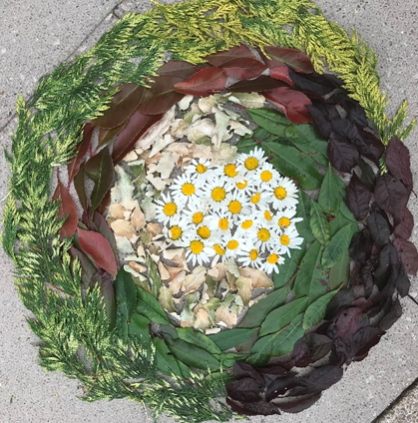
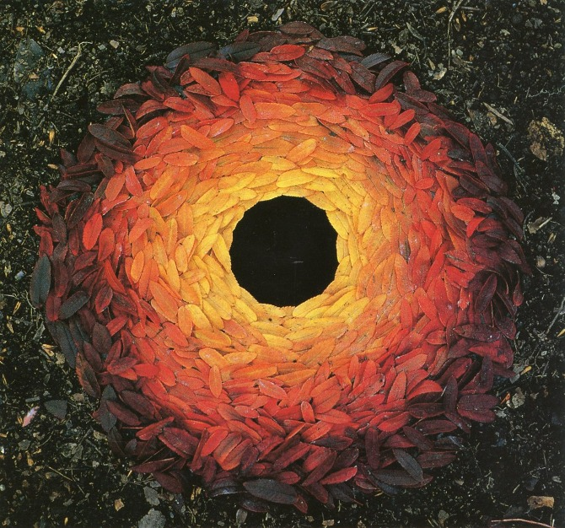
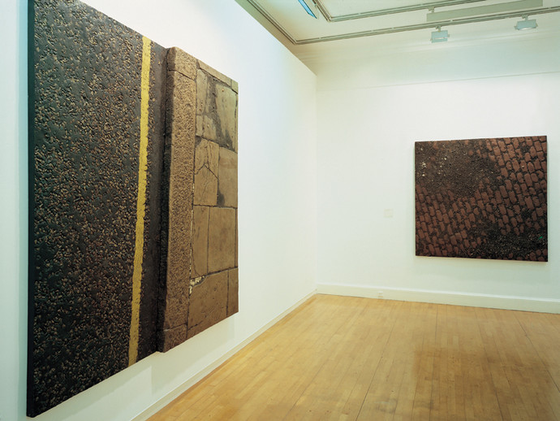
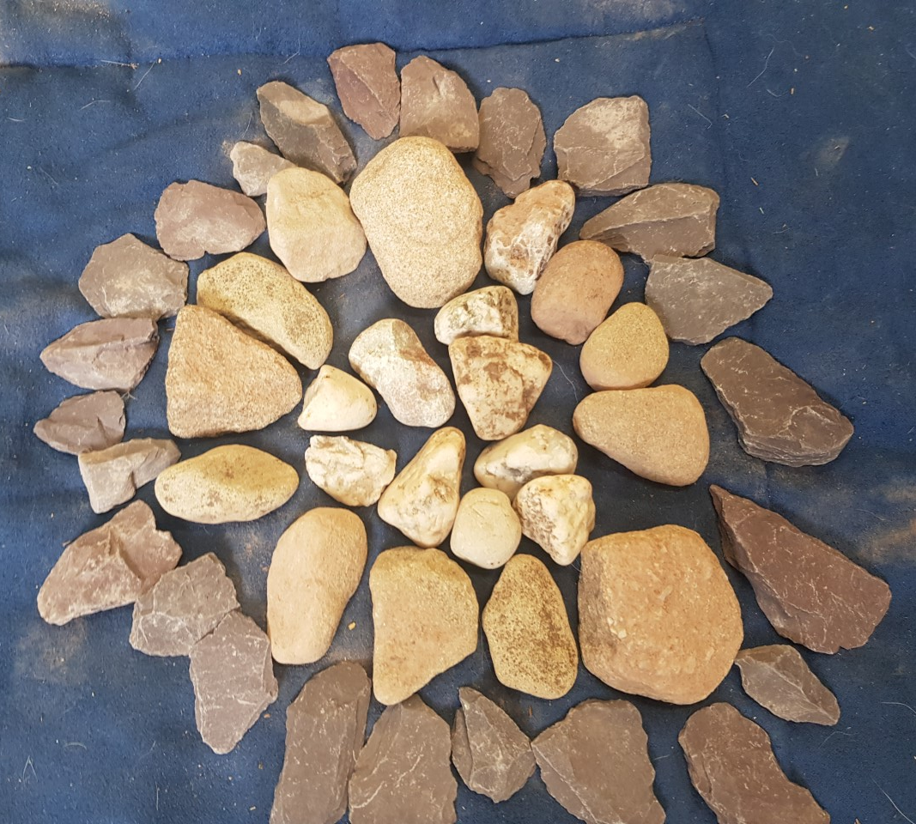
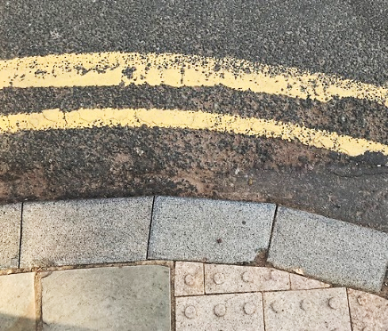
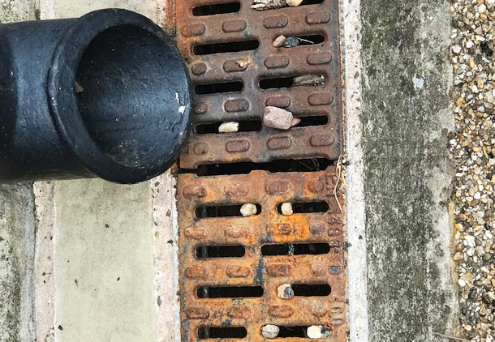
During the past two weeks you have created some great work in response to Boyle family and Andy Goldsworthy. Here are some examples of the lovely work I’ve had from you.
Addison Crescent Study (London Series) 1969
Painted fibreglass & mixed media
Holland Park Avenue Study, London Series (1967). Cobbles Study, Lorrypark Series (1976).

Slide 3
Mark making
You have been using your observational skills in the last two art tasks, looking up close at textures, patterns and colour. Now you will be able to create your own. You will make your own texture book (to bring into school in September) and to use as inspiration in the next fortnights lesson.

Slide 4
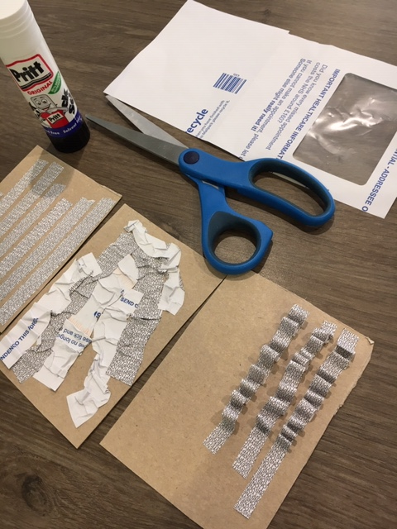
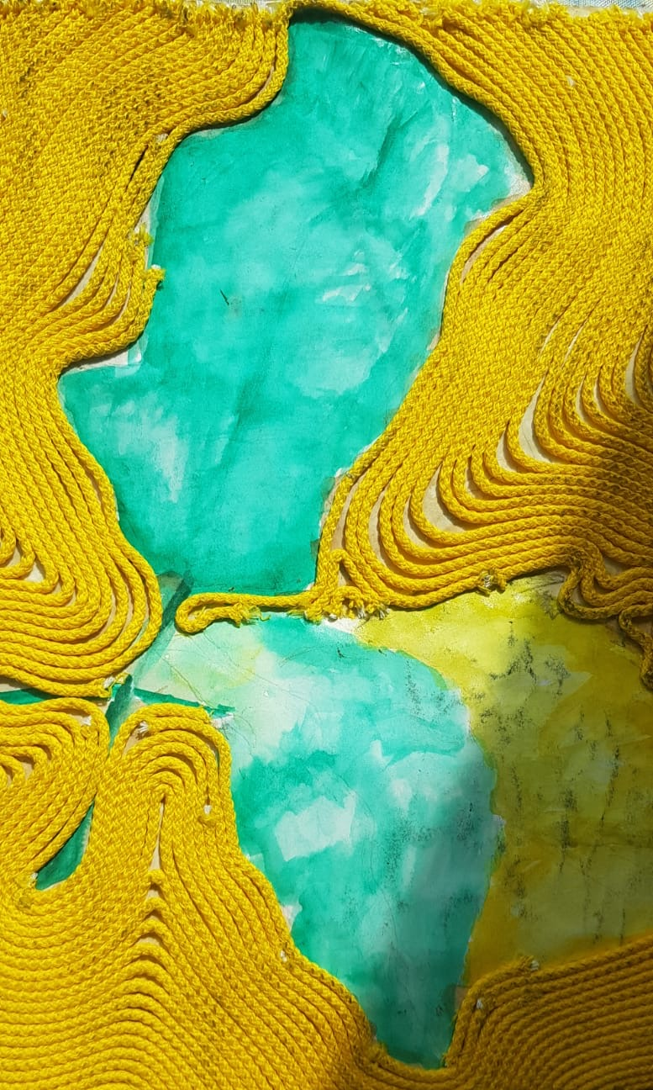
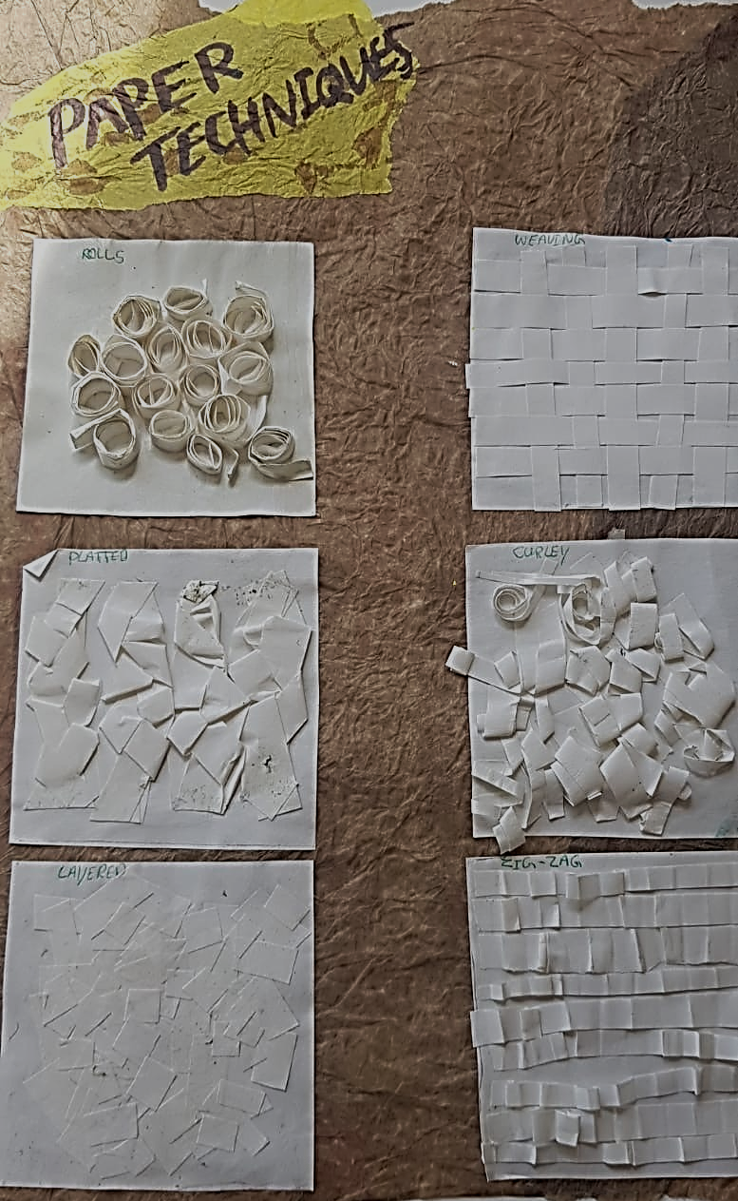
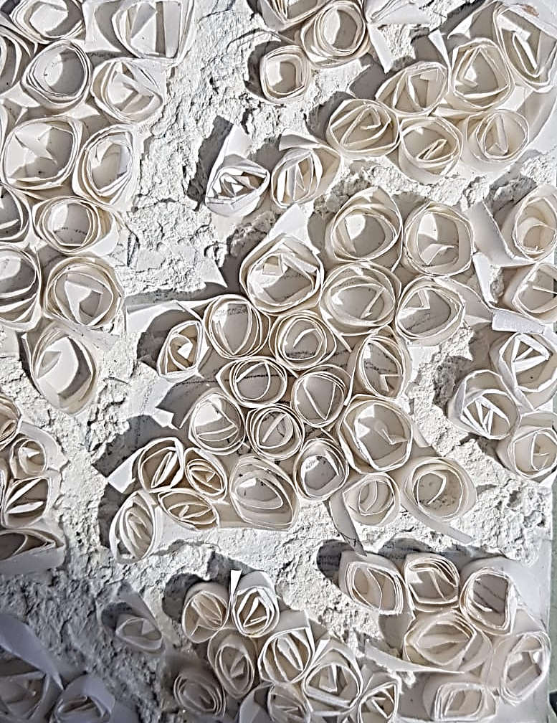
Paper technique examples
You could use newspaper, paper plate edging, paper straws, string, oranges bag. What textures or patterns can you make? I used the patterned side of an old envelope; you can make a variety of textures with one material. You don’t need to get fancy materials – be imaginative and recycle. Please ask permission before cutting anything up

Slide 5
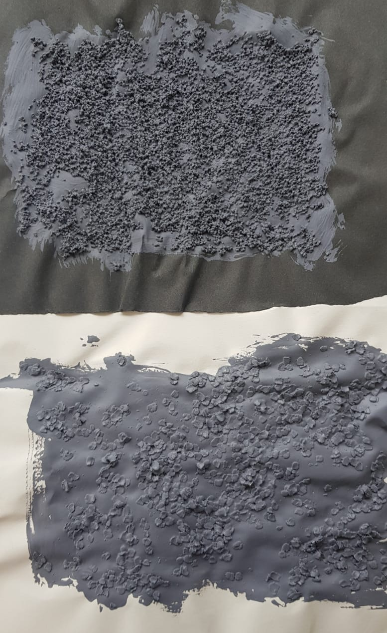
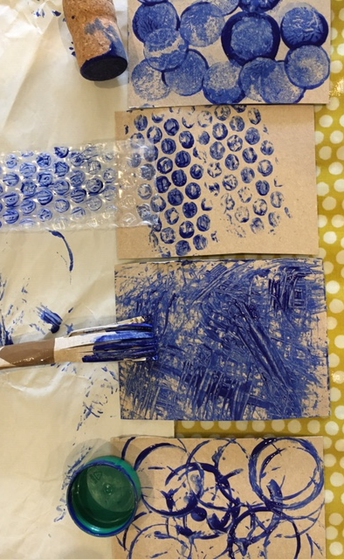
Painted technique examples
You could use paint and lentils/couscous/sand, try scrapping it printing, dabbing mixing it. What textures or patterns can you make? Please ask permission before using materials in your home or making a mess!

Slide 6
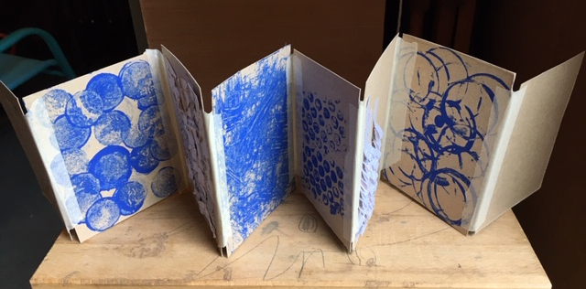
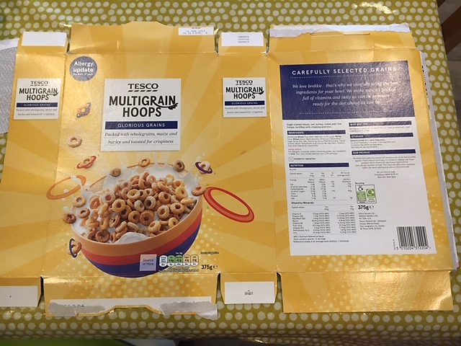
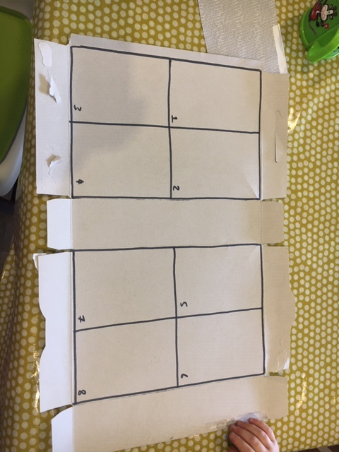
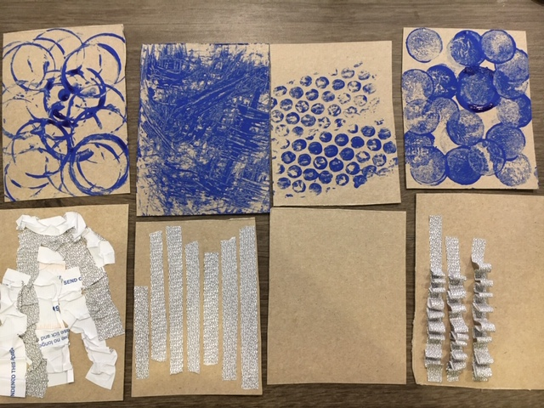
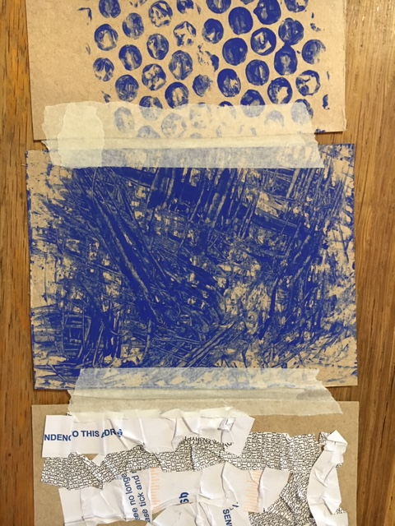
Texture book
Task 1-
Using the two largest areas of a cereal box cut out 8 equal squares/rectangles to create your texture book
b) Create 4 cards of painterly textures, you can use paint or google alternatives if you don't have any. Household emulsion or a strong mix of coffee and water might give good results (ask permission) and 4 cards of paper/string textures.
c) Once completed and dry, use tape to stick them together. Ensure you leave a gap between them or the book will not fold up.
d) Take a photo of your texture book and email it to me with your name and form. (as above). Keep it to show in the next online art lesson in two weeks time.
Challenge:
You could use the back of the book to do more textures, so it becomes double-sided. The more the better!

Slide 7
Work for two weeks beginning – Thursday 2nd July

Slide 8
During the past two weeks you have created some great texture books using painterly and papery techniques, here are some examples…well done if yours is below.

Slide 9
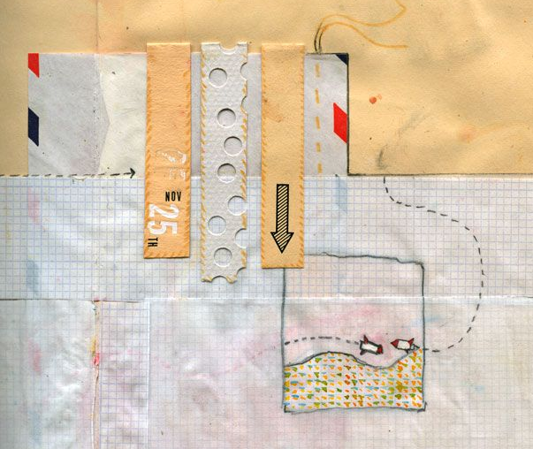
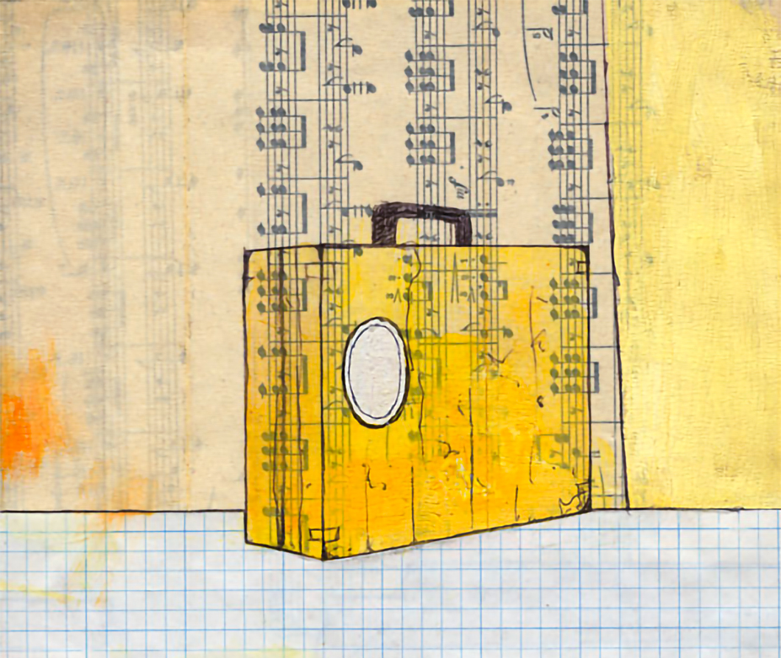
Lesson 2 : Lockdown map
Using the imaginative paper techniques you have used for your texture book; you are going to make a ‘Lockdown map’. The graphic designer Isaac Tobin uses collage and interesting ways of layering papers and materials together to make subtle images.
You could use; newspaper, sandpaper, paper plate edging, paper straws, maths paper, string, empty dried out teabags!, envelopes, crosswords, tin foil. You don’t need to get fancy materials – be imaginative and recycle. Please ask permission before cutting anything up
You might need:
Scissors
Glue
Hole punch
Stickers
Sharpie
Biro
Pencil
Paint or food dye or coffee stain
Paintbrush
Needle and thread?!

Slide 10
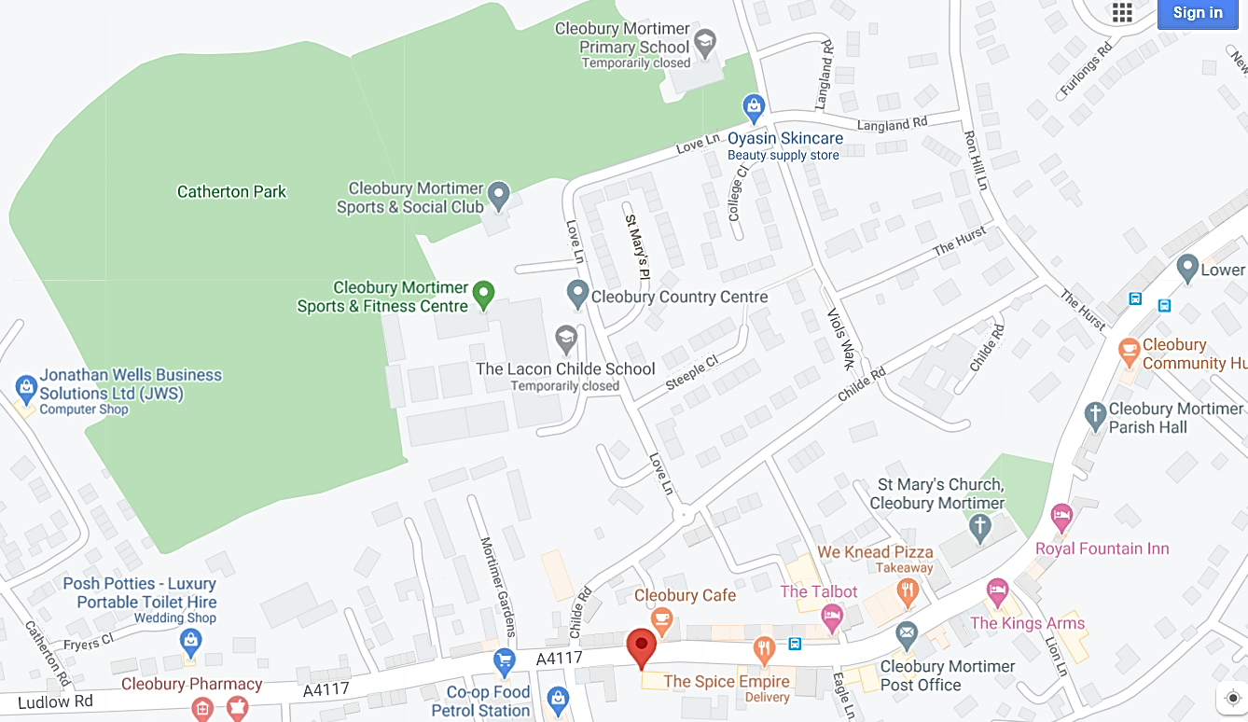
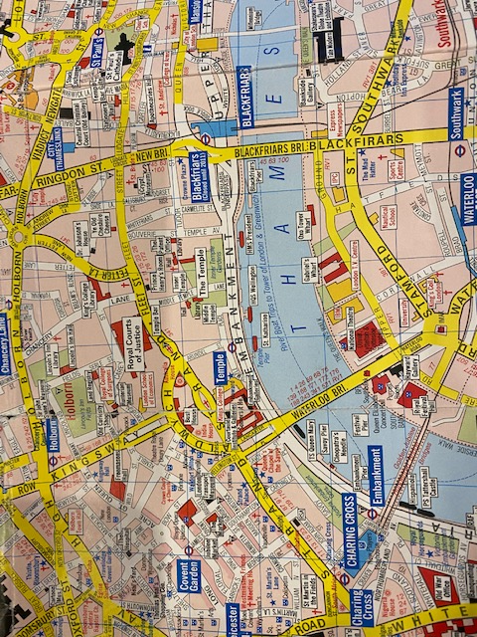
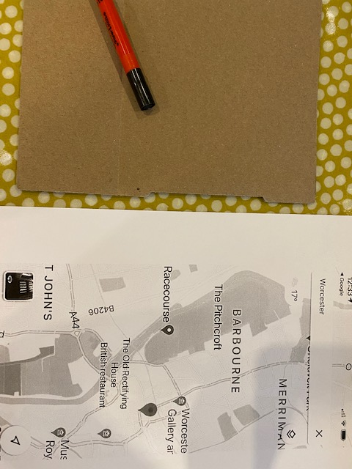
Step 1
Get a map of where you live. It can be printed off the internet black and white or colour or a physical map from your house (check first).
You can either;
a)Work straight onto the map, adding layers (easier)
Or
b) Work on card, adding layers
and then draw your map onto it (harder)

Slide 11
Next steps
2.
Draw your map image on top, main points using a thick pen.
Add more paper in the small spaces created
3.
Add more paper in small areas and small sections of paint or pen
1.
Add different layers of papers to your card, this is a background, you are not creating a picture
1.
Draw over your map with a pen to show where the main points are, not all of them
2.
Add papers into the small areas, use tracing paper or greaseproof paper to get the shapes correct
3.
Add more paper in small areas and small sections of paint or pen

Slide 12
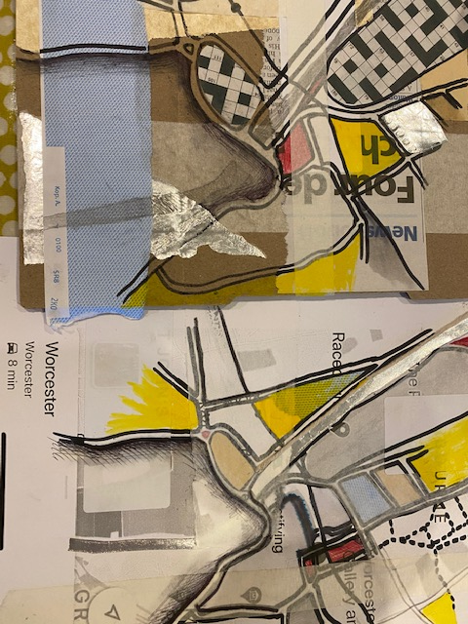
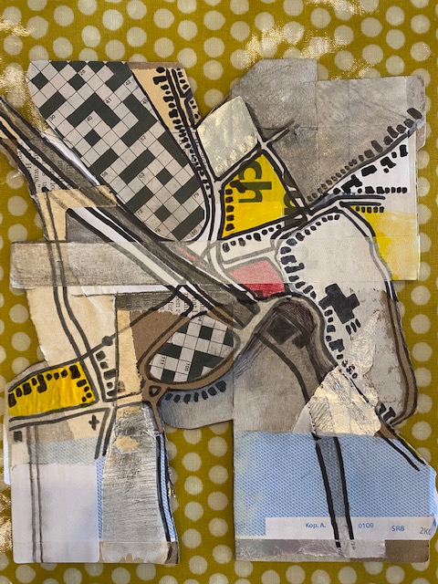
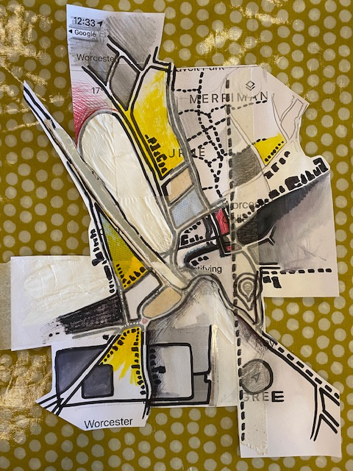
Next…
FINISHED RESULT ON CARD
Cut out shapes off the outside, following your lines
Try folding it in a way so it will stand up
4. Add pencil shading and more layers of paper, strips of masking tape or stickers on top
Add buildings and details
4. Add pencil shading and more layers of paper, strips of masking tape or stickers on top
Add buildings and details
FINISHED RESULT ON MAP
Cut out shapes off the outside, following your lines
Try folding it in a way so it will stand up

Slide 13
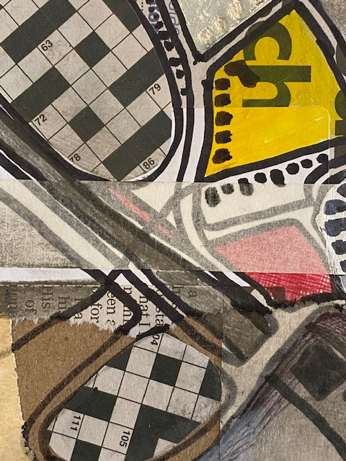
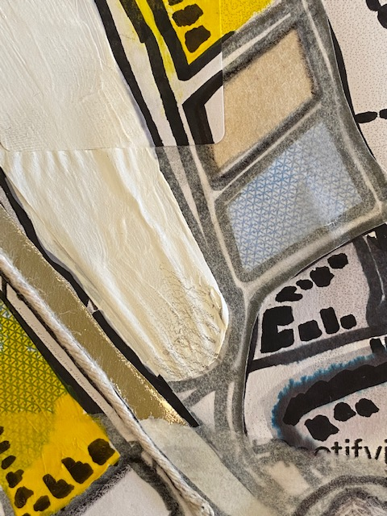
Lockdown Map
The task
1.) Print out a map of where you live or use a real map (ask first)
2) Either work directly onto the map or work on card
3) Add layers of paper onto the card or draw around the main areas and roads of your map
4) Add FLAT layers of paper, stickers, newspaper, thin string, masking tape in the small areas of the map
5) Add paint or watercolour wash or coffee stain to other areas and keep applying more layers of paper. Use pen to re draw roads and details. Add buildings and other elements – it doesn’t have to be completely realistic – watch the YouTube video, his isn’t real but still looks like a map
6) Can you cut around bits of the edge, following your lines, can you make it stand up?
7) Take a photo of your map and email it to me with your name and form. Keep it to show in the next online art lesson in two weeks time.
Close up of layering

Slide 14
More examples…
This is a YouTube video from an art teacher in Manchester. It is aimed at GCSE pupils, so might be a bit complex but it gives you some great ideas of how to use layers of paper to get a great effect. Watch it and pause it to get help with ideas,
Can you fold yours to stand up at the end?
Cut out interesting edges?
https://www.youtube.com/watch?v=AVaa-7t2Sw8

