Slide 1
60 Day Challenge
Over the next two months, we would like you to have a go at the activities on this list.
You can complete them in order, or you can mix them up.
If you miss a day, it doesn’t matter!
It would be nice to see pictures/evidence of you completing the activities, but you don’t have to!
It’s partly designed for you to have a go at things you wouldn’t normally do, but if you really dislike one of the challenges, forget it.
The point is to improve health and well-being - some are short and simple, others take a bit longer. Use the ideas to help you decide what makes you feel good.
You can print off the list and tick it off, or do it on-line.

Slide 2
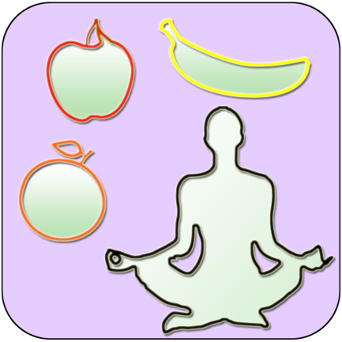
Here is the plan for the First 30 Days
Day 1 – Leave three happy notes for someone else to find in your house. | Day 2 Make a card for someone’s birthday/celebration coming up | Day 3 Call a relative or friend who is far away and have a chat with them. | Day 4 Write down five things you are grateful for. | Day 5 Research three jobs / career paths that interest you. | Day 6 Download a mindfulness App (CALM) on your phone.
Day 7 Visit a virtual museum! Go online and explore the collections online. | Day 8 Get in contact with a local care home and arrange to send a letter to one of the residents. | Day 9 Go on YouTube and try.. | Day 10 Look at the last 20 photos on your phone and think about how they make you feel. | Day 11 Say something positive to everyone in your household today. | Day 12 Do something helpful for a friend or family member today.
Day 13 Do a chore in the house without being asked to do it. | Day 14 Send a positive text to ten of your friends. | Day 15 Listen to your favourite song and dance around the room. | Day 16 Stay off social media for >3 hours straight and keep yourself occupied. | Day 17 Take a selfie and note down 5 things you like. | Day 18 Play a game that you haven’t played in a while.
Day 19 Think about two role models in your life. Why do they inspire you? | Day 20 Create a postcard for somewhere you have previously visited | Day 21 Play a card game or board game you haven’t played in a while | Day 22 Sit down in a silent room and focus on your breathing for 5 minutes. | Day 23 Email one of your teachers/TAs to say thank you for something | Day 24 Ask a friend who is having a hard time if they need anything.
Day 25 Write a blog about something you enjoy doing. | Day 26 Search on YouTube a “Tedx talks by kids” | Day 27 Watch a film with a family member and make sure you turn your phones off. | Day 28 Make sure you get >8 hours sleep tonight. Note how you feel the next day. | Day 29 Draw a picture of what you see in your garden or out of your window. | Day 30 Make breakfast for another family member

Slide 3
Here is the plan for the Last 30 Days
Day 31 – Find three inspirational quotes and write them down | Day 32 Create a digital photo collage using 5 images | Day 33 Write a letter or send a card (Email or E-Card) to an elderly relative | Day 34 Try wearing your hair differently. (No bright hair dye!) | Day 35 Make a list of 10 things you want to do one day. | Day 36 Go on YouTube and try…
Day 37 Create a gratitude list of everything you are thankful for | Day 38 Try leaving your phone downstairs at night and read a book before sleep. | Day 39 Create your own Playing card with your favourite number and suit | Day 40 Find a learning podcast and try it out! | Day 41 Ensure you have 5 fruit and Veg today | Day 42 Do something helpful for a friend or family member today.
Day 43 Write down five positive things about yourself on Post-It-Notes | Day 44 Tag your friends in a pic that brings you happy memories | Day 45 Visit a virtual museum! Go online and explore the collections online | Day 46 Try to go bed 1 hour early. | Day 47 Wake up early to watch the sun rise and see how beautiful it is | Day 48 Find a documentary on BBC iPlayer and watch it
Day 49 Do the washing up today | Day 50 Look up origami and make a crane | Day 51 Play an old computer game you haven’t played for ages | Day 52 Use 10 French or Spanish words today | Day 53 Research the minimum wage in the UK for different ages | Day 54 Design a new school logo for your school
Day 55 Learn some British Sign Language with Charlie | Day 56 Make a playlist of your top 10 songs and send to a friend | Day 57 Find a recipe you want to make and cook it for the rest of the household. | Day 68 Build the tallest Tower you can with a single piece of A4 Paper | Day 59 Learn the lyrics to a song that you really like, but didn’t know before. | Day 60 Wear your favourite items of clothing that make you feel great

