Slide 1
HELLO Year 6!
Welcome to the Year 6 transition project from Lacon Childe School.
We haven’t done one of these for a while but we think its important to say ‘hello’ before many of you come and join us in September. We are looking forward to meeting you!
Your teacher will introduce you to a poster competition and some challenge tasks to get you thinking.
We look forward to seeing your entries and your best efforts with the challenges.
Mrs Harding & the maths team at Lacon ☺

Slide 2
Calculator Crunch Transition Challenge – Summer Term 2023
Two part challenge linking SGET primary and secondary schools.
Part One: ‘Know your calculator’ poster competition.
Part Two: MEI Calculator Crunch.

Slide 3
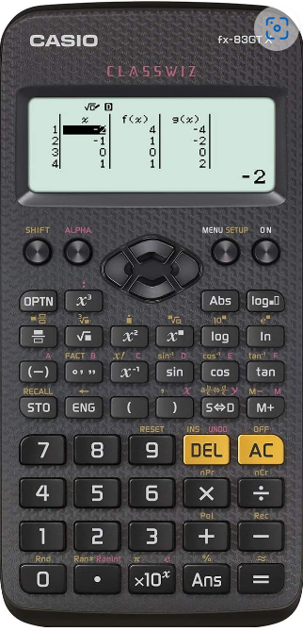
Part One: Know your calculator
At most secondary schools but definitely at
Lacon Childe School we expect all students to have a
scientific calculator in your school bag or pencil case every day.
You may not use it every day but you need to have it on hand
for those occasions where a calculator can make you a more
efficient mathematician.
We would like you to have a specific model, the Casio FX-83GTX.
They are around £10 and can be bought from most
Supermarkets, Amazon, WHSmith’s and others.

Slide 4
Part One: Know your calculator
Your first task is a competition.
You must create a poster, showcasing as many of the buttons or
‘functions’ of the calculator as possible.
Some you may know already, some you may need to research.
You can explain them in words or using calculations which demonstrate
what they do.
The poster can be any size you wish but will be judged on the quality
and quantity of mathematics it shows, rather than its art work.
Some examples of posters can be seen on the next slide to give you some
inspiration!

Slide 10
Part One: Know your calculator
Time frame: Y6 teacher defined.
Success criteria. The poster:
can be any size you wish.
will be judged on the quality and quantity of mathematics it shows, rather than its art work.
can consist of written explanations or numeric explanations.
Prizes are up for grabs for the winners!

Slide 11
Part Two: Calculator Crunch!

Slide 12
Part Two: Calculator Crunch!
Every year the Mathematical Education Innovation centre
publishes a week’s worth of calculator challenges for Year 6
students.
It uses Year 6 mathematics skills and encourages you to use
them alongside your calculator to develop confidence using
your calculator.
You can complete them as you wish, one a day as part of numeracy
lessons, all at once in a longer maths based carousel or once a week
as the term rolls along. There are nine challenges so you can select
those that best suit your students.
We would love to see examples of students work and to get them on
classroom walls to welcome them in September.
Please email us any photographs!

