Slide 1
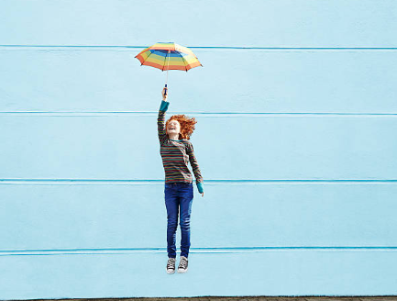

Session 9
Living well

Slide 2
Welcome to Session 9 – our very last session together.
Last time, we looked at ‘friendships and fallouts’.
We looked at the kind of friends you want and the kind of friend you want to be.
We explored the idea that sometimes friendships change and that is OK, BUT also that we should always act with kindness in each circumstance.

Slide 3

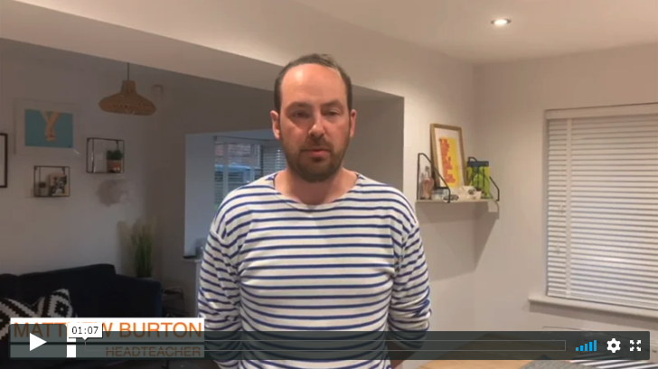
Here is Matthew Burton one last time to explain how he thinks you can live well as you start secondary school.
Read from page 117 to the end, if you have a copy of ‘Go Big’.

Slide 4
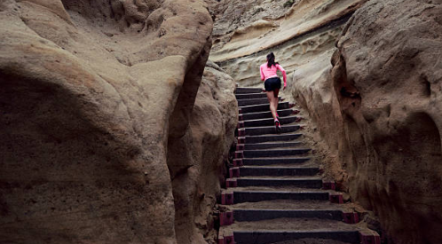
You can’t function well at school, or in life, if you don’t look after yourself and ‘live well’.
It is important that you have a healthy body and mind to cope with the transition of starting a new school.

Slide 5
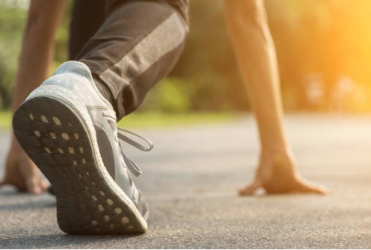
There are lots of different ways you can live well
Switching off from technology
Being kind to yourself and others
Getting enough sleep
Being patient
Keeping fit and staying healthy

Slide 6
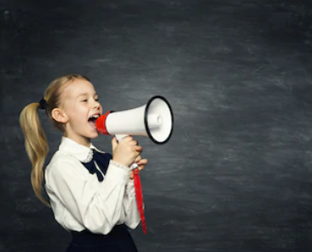
If you have a phone now, use it wisely
Put it away.
Turn it off.
Try to limit your screen time so you can perform your best in and out of school.
If you are doing homework, turn your phone off or put it away somewhere so that it doesn’t distract you.
Try to have time away from your phone and technology each day.
Be very careful what you look at and what you send to others.

Slide 7
If you are given a mobile phone for the first time,
it is worth taking this advice:
“The simple way to do things is to live by this rule: if you wouldn’t write the message you’re about to send to that person on a T-shirt and go into the local shopping centre wearing it, then don’t send it! If you wouldn’t want that selfie you’re about to send to someone printed on scatter cushions and spread across the sofa in your living room when everyone comes round on a Sunday afternoon then DON’T SEND IT!”
Matthew Burton, ‘Go Big’

Slide 8
If you are going to be online more and have a phone now that you’re moving to secondary school, then you need to think about this…
“Look after yourself and think about what your actions say about you. Are you proud of that person who’s the ‘online’ you? If so, then brilliant. If not, maybe it’s time to make a change.”
You get to decide the person you are going to be!

Slide 9
If you feel under pressure to do things that others are asking of you then remember this:
“When something doesn’t quite feel right, it usually isn’t right and if your ‘Spider sense’ tingles – remember, great power and great responsibility – then say no, and don’t dive in.”

Slide 10
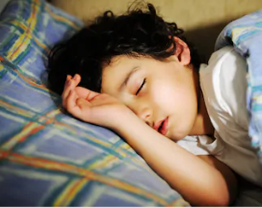
Sleep is so important for you to stay well
It will help you:
Feel good
Concentrate
Learn better
Improve your memory
Stay fit and healthy.

Slide 11
Be kind to yourself and others
If you wouldn’t say something to someone in person then don’t write it down.
Just be kind, be sensible and talk.

Slide 12

“Try to be a rainbow in someone’s cloud.”
Maya Angelou
American singer, dance, actor, writer, poet and activist

Slide 13
Be patient and keep the faith
Give new things a chance.
Don’t give up.
Embrace new opportunities.

Slide 14
Be patient and keep the faith
The connections you make, and the questions you ask in those subjects, are more important than any others. If your starting point in the subjects you don’t like is behind where it is in your favourite subjects, then you’ll have to try even harder to make more progress and get where you’re going. You can either look at that as something to be afraid of or something to challenge yourself with.
Read more on page 137

Slide 15
“Fear is just an emotion, you can’t let your emotions rule your life…you just have to do what you would do if you weren’t afraid and then go from there.”
Venus Williams
American tennis player

Slide 16
Spend your time at secondary school being the best version of you.
Spend time finding your way and make the mistakes you need to (and will) make to learn to be even better.

Slide 17
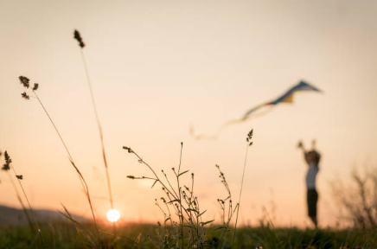
Activity: Keeping yourself well
Write down three things that you are going to do when starting your new school to help you stay well.

Slide 18
“Success isn’t always about greatness. It’s about consistency. Consistent hard work leads to success. Greatness will come.”
Dwayne ‘The Rock’ Johnson
American-Canadian actor, producer and former professional writer

Slide 19
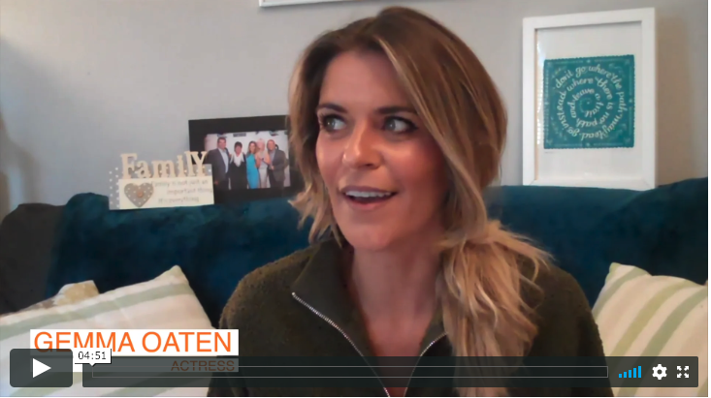
Here is the very final video from Gemma.

Slide 20
So our journey is now over. We have taken you through nine sessions to try and help you be ready for secondary school and to be awesome.
Now it is up to you! You are the one in the driving seat, deciding how you are going to live your life and make this transition.
Have a look through your workbook: have you completed all of the activities?

Slide 21
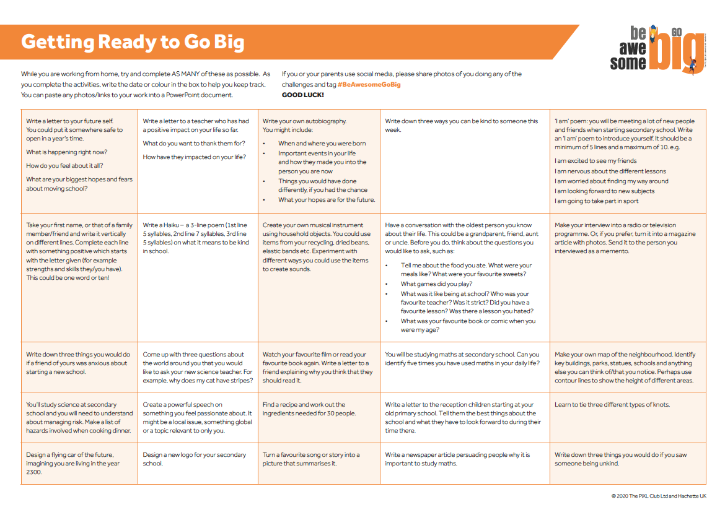
Here are some activities that will help you get ready for secondary school. Why don’t you try some of them?

Slide 22
Don’t forget to enter our Be Awesome Go Big competition!

Slide 23

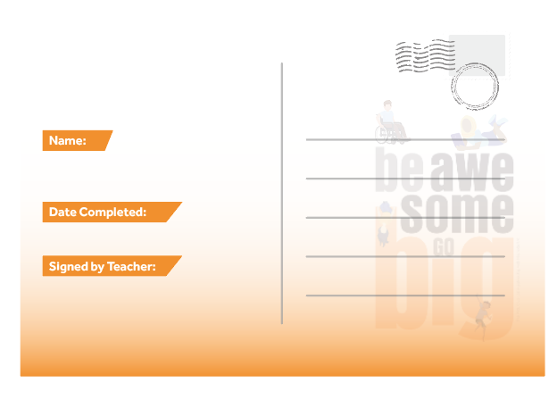
Why don’t you write to your new tutor at secondary school and introduce yourself? Tell them what you have learned from doing the ‘Be Awesome, Go Big’ sessions.

Slide 24
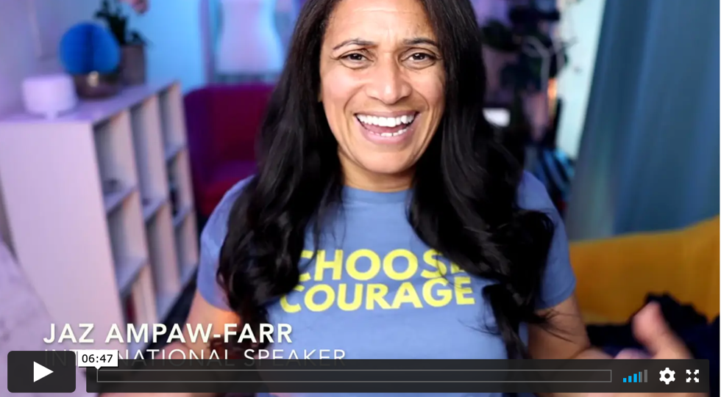
Thank you for joining us on this journey.
Here is someone who wants to wish you good luck!

Slide 25
Go and BE AWESOME as you GO BIG.
Be the kindest, most determined, most resilient generation that your secondary school has ever seen.

Slide 26
© 2020 The PiXL Club Ltd and Hachette UK
This resource may be shared with any primary school Year 6 student in its current form, and parts thereof, to enhance your transition work with students. All opinions and contributions are those of the authors. The contents of this resource are not connected with, or endorsed by, any other company, organisation or institution.
If there are any inadvertent omissions or errors in the acknowledgements or usage, this is unintended and we will remedy these on written notification.
Hachette UK own 'You Are Awesome' by Matthew Syed and 'Go Big' by Matthew Burton, which may be purchased by individuals and schools, should they wish to do so to enhance these resources for students. 'You Are Awesome' illustrations copyright © Toby Triumph. 'Go Big' illustrations copyright © Chris Madden.

