Slide 1
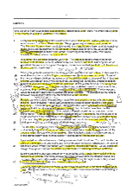
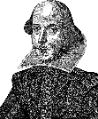
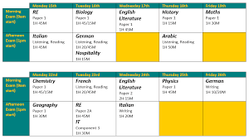
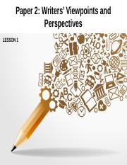
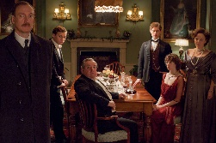
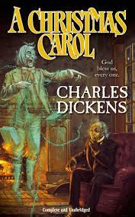
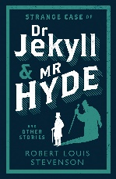
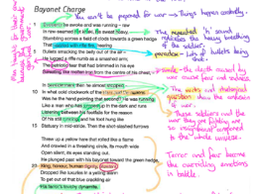
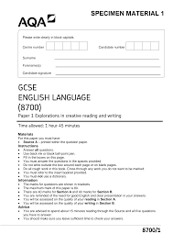
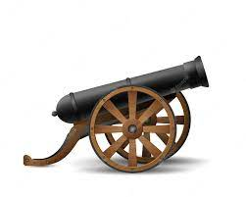
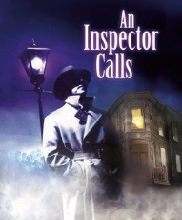
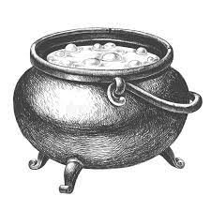
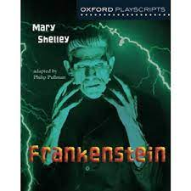
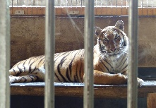
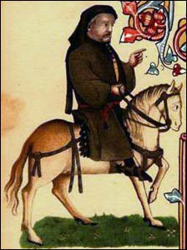
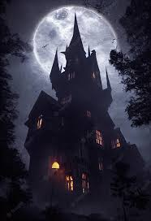
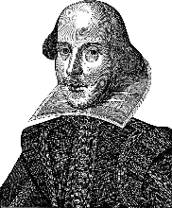
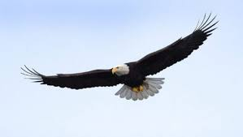
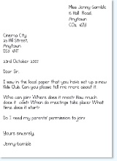
TWO COURSES, TWO GRADES
Lacon Childe
ENGLISH LIT & LANGUAGE
Learning Journey Curriculum Map
journalism
Marks for detail
Time yourself!
teaching
Lit paper 2:
2 hours 15 mins
A Level English
Practise, practise, practise…
Each exam
1 hour 45mins
Your
Future!
Summer 1:
Lit revision
GCSE exams
Summer 1
Lang
revision
Spring 2:
Lit Paper 2 revision & mock
Lit 1
Mock
exam
Language
exams
Essential for any career
Explore the ways Shakespeare presents…
Spring 1:
Mocks
Language
Paper 1 &
Paper 2
murder
hubris
Q1 true statements
Q2 summary differences/similarities
Q3 Language devices
Q4 compare writers’ views
Q5 viewpoint writing
avarice
fate
assessment
assessment
Explore the ways Stevenson…
Prose
mock
Autumn 1:
Language Paper 2
Autumn 2:
Macbeth
Y11
How does Dickens present…
Year 11: GCSE English Language & Literature
INFERS…
IMPLIES…
EVOKES…
INDICATES…
PERHAPS SUGGESTS…
Summer 2:
19th century
prose
assessment
assessment
assessment
assessment
The Birling Family
duality
Summer 1:
Paper 2
writing
Summer 1:
Unseen
poetry
Spring 2: Language
Viewpoint writing
Speaking assessment
humanity
Dramatic irony
Spring 1:
Modern
text:
the play
Q1 List 4 things
Q2 Language devices
Q3 structural devices
Q4 Evaluation agree/disagree
Q5 descriptive writing
Explore how Priestley…
How do writers present their views of war?
Autumn 1: Literature GCSE poetry anthology
assessment
Autumn 2:
Language Paper 1
assessment90
Socialism
Explore effects of devices
Y10
Term 3:
What is it
like to live
through
war?
Year 10: GCSE English Language & Literature
ambition
How does Steinbeck present marginalised characters?
Tragic hero
analysis
Term 2:
Does power corrupt?
Term 1: Will society ever be free from prejudice?
Y9
What stories do your family have about war?
annotation
Year 9: Prejudice, Power & People in war
Term 3:
What
does the
future
look like?
Inference and deduction
How does Conan Doyle structure his crime story?
playscript
Tension & suspense
foreshadowing
Will Romeo and Juliet escape their fate?
Phillip Pullman
Y8
Term 1: how do we solve mysteries of the past?
Term 2: Does your past determine your future?
Are we better off with AI?
Term 3:
How do words create fear?
Year 8: Past, Present, Future
DYSTOPIAN
Viewpoint writing: Is it right to keep endangered animals in captivity?
Where do words come from?
Y7
Term 2: How can words capture the power and beauty of nature?
Term 1: What makes words stand the test of time?
Gothic horror
What conventions do writers use in horror stories?
Year 7: The Power of Words
Letter to my teacher
Pathetic fallacy
poetry
metaphor
What makes Shakespeare’s plays timeless?
metaphor

