Slide 1
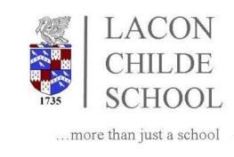



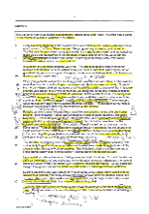

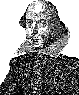
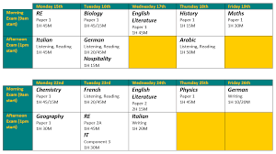
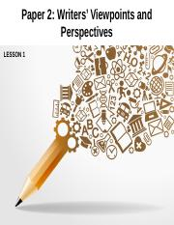
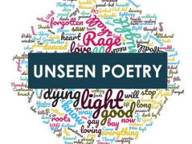

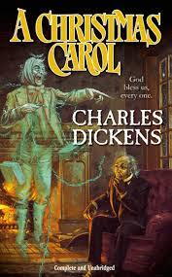

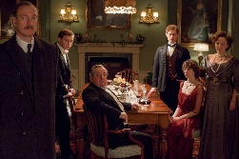
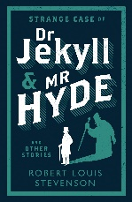
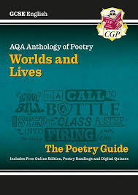
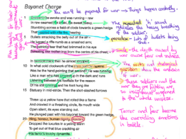
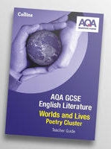
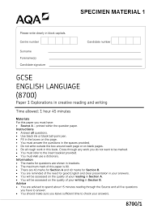
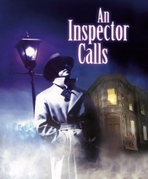

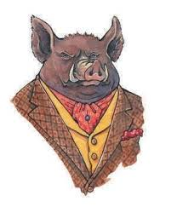


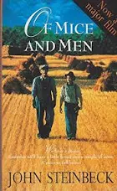









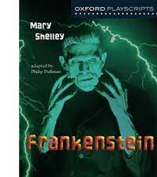


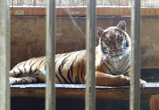



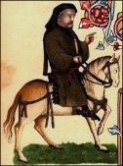
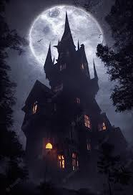

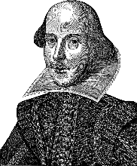
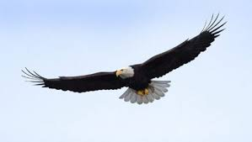
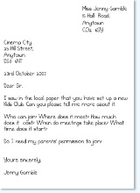
TWO COURSES, TWO GRADES
Lacon Childe
ENGLISH LIT & LANGUAGE
Learning Journey Curriculum Map
journalism
Each exam
1 hour 45mins
Time yourself!
teaching
Lit paper 2:
2 hours 15 mins
A Level English
Marks for detail
Your
Future!
Summer 1:
Lit revision
GCSE exams
Summer 1
Lang
revision
Spring 2:
Lit Paper 2 revision & mock
Language
exams
Essential for any career
Practise, practise, practise…
Explore the ways Shakespeare presents…
Spring 1
Language Paper 2
& mock
murder
hubris
Q1 true statements
Q2 summary differences/similarities
Q3 Language devices
Q4 compare writers’ views
Q5 viewpoint writing
avarice
fate
assessment
How does Dickens
present…?
Prose
mock
Autumn 1:
Macbeth
Mocks
Language paper 1
Literature paper 1
Explore the ways Stevenson…
Y11
Year 11: GCSE English Language & Literature
INFERS…
IMPLIES…
EVOKES…
INDICATES…
PERHAPS SUGGESTS…
Summer 2:
19th century
prose
duality
assessment
assessment
The Birling Family
Summer 1:
Paper 2
writing
assessment
assessment
Summer 1:
Lit 2
revision
Spring 2: Language
Viewpoint writing
Speaking assessment
humanity
Dramatic irony
Explore effects of devices
Spring 1:
Modern
text:
the play
Q1 List 4 things
Q2 Language devices
Q3 structural devices
Q4 Evaluation agree/disagree
Q5 descriptive writing
Explore how Priestley…
How do writers present their views of the world?
assessment
assessment90
Capitalism
Y10
Autumn 1: Literature GCSE poetry anthology
Autumn 2:
Language Paper 1
Term 3:
What does poetry tell us about people and the world?
Year 10: GCSE English Language & Literature
Socialism
ambition
How does Steinbeck present marginalised characters?
Tragic hero
analysis
Term 2:
Does power corrupt?
Term 1: Will society ever be free from prejudice?
Y9
What stories do your family have about war?
annotation
YEAR 9: PREJUDICE, POWER & PEOPLE
Term 3:
What
does
the
future
look like?
Inference and deduction
How does Conan Doyle structure his crime story?
playscript
Tension & suspense
foreshadowing
Will Romeo and Juliet escape their fate?
Phillip Pullman
Y8
Term 1: How do we investigate mysteries of the past?
Term 2: Does your past determine your future?
Are we better off with AI?
Term 3:
How do
Words
create
fear?
YEAR 8: PAST, PRESENT, FUTURE
DYSTOPIAN
Viewpoint writing: Is it right to keep endangered animals in captivity?
Where do words come from?
Y7
Term 2: How can words capture the power and beauty of nature?
Term 1: What makes words stand the test of time?
Gothic horror
What conventions do writers use in horror stories?
YEAR 7: THE POWER OF WORDS
Letter to my teacher
Pathetic fallacy
poetry
Metaphor
personification
simile
What makes Shakespeare’s plays timeless?
metaphor

