Slide 1
Lacon Childe School
Welcome to
Y10 Information Evening
Notes:
https://www.youtube.com/watch?v=MFzDaBzBlL0

Slide 2
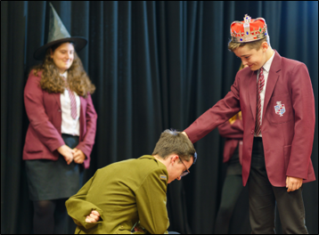


Aims of this Academic Year Be motivated to succeed Get involved in a range of opportunities Be resilient Access support where necessary Be informed about all aspects of school life including Post 16 and Careers BE THE BEST YOU CAN BE!

Slide 3
Overview of KS4 – Key Dates
3rd December 2025 - Data Report.
11th December 2025 - Year 10 Parents Evening.
14th April 2026 - Year 10 Mock Exams.
22nd May 2026 - Data Report.
6th July 2026 – Work experience.
July 2026 - College Visits.
November 2026 - Year 11 Mock Examinations.
May 2027 - GCSE Examinations.

Slide 4
Year 10 Curriculum (2 week timetable) GCSE – written examinations at the end of Year 11 with some non-examined assessments (NEA) OCR Nationals – equivalent to GCSE with some examined modules
Subject | Qualification | Time
English | GCSE | 8 hours
Maths | GCSE | 8 hours
Science | GCSE | 9 hours
Option subjects (x4) | GCSE/OCR | 5 hours
Core PE | N/A | 4 hours
PSHE | N/A | 1 hour

Slide 5

Grading system for GCSE

Slide 6

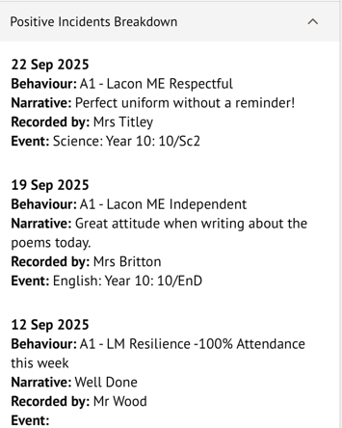
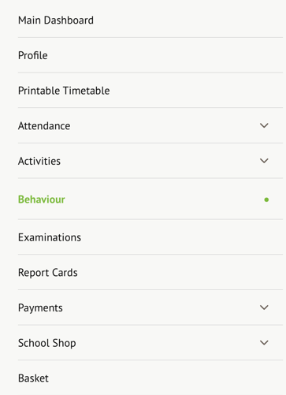
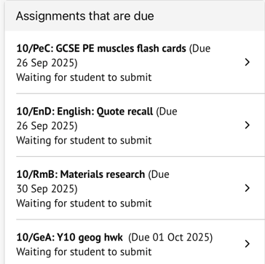
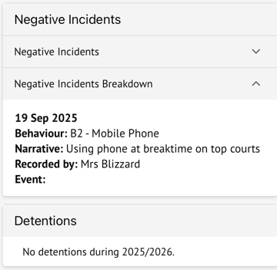

How can you monitor your child's progress?

Slide 7

Homework - Revision set by experts Why is homework important? If a student completes an hour’s homework per school night for five years, it is the equivalent of an extra school year. In addition: It can help students to make more rapid progress in learning. It can also provide students with the opportunity to: - practise further what has been learnt in class. - apply what they have learnt in new contexts or situations. - prepare them for future learning. - integrate skills with knowledge and concepts.

Slide 8


Homework – Tasks set at Lacon Childe Sparx Maths and Reader Online quizzing Retrieval/revision tasks: Flashcards Read, Cover, Repeat, Check Mind Map Revision Clock Application tasks: past papers pre-reading with questions planning for extended writing pieces

Slide 9
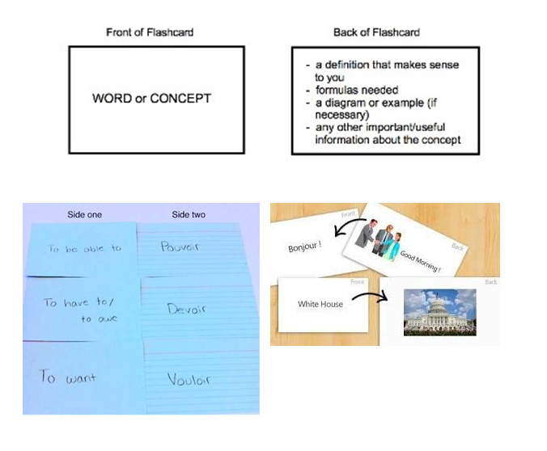
Flashcards

Slide 10
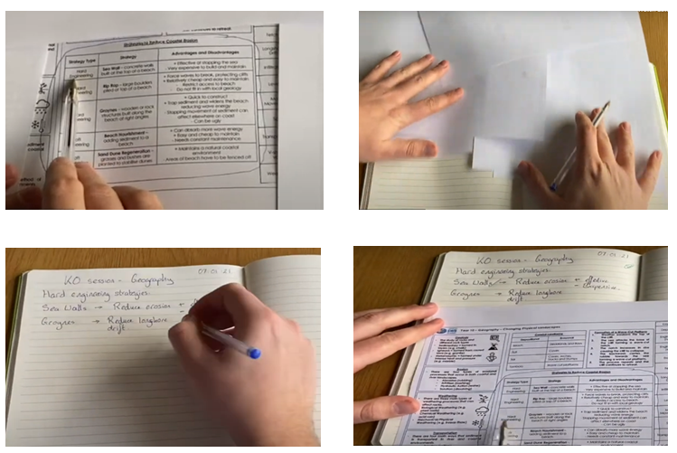
Read, Cover, Repeat, Check

Slide 11
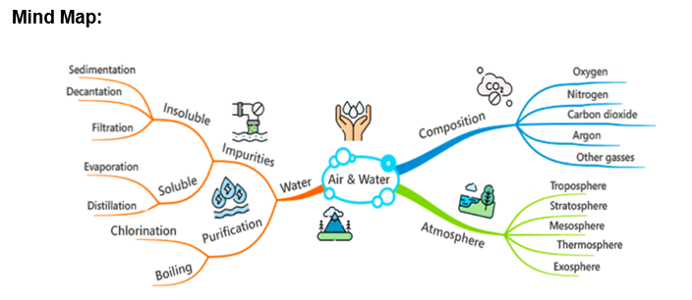
Mind Maps

Slide 12
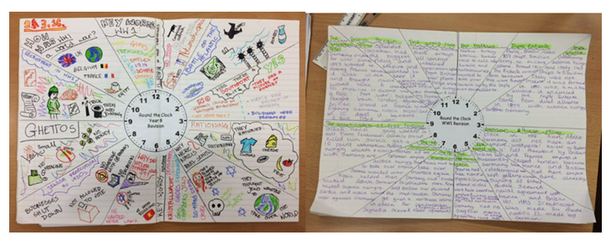
Revision Clocks

Slide 13


Year 10 Team Head of KS4 - Charlotte Johnston Charlotte.Johnston@laconchildeschool.co.uk Assistant Lead - Alice Martin Alice.Martin@laconchildeschool.co.uk Form tutors 10 Clee - Aleks Koziel Aleksandra.Koziel@laconchildeschool.co.uk 10 Mortimer - Helen Gilder Helen.Gilder@laconchildeschool.co.uk 10 Stretton - Sam Martin Sam.Martin@laconchildeschool.co.uk 10 Wrekin - Marianne Salmon Marianne.Salmon@laconchildeschool.co.uk

Slide 14

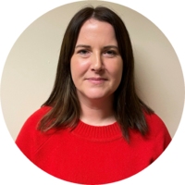

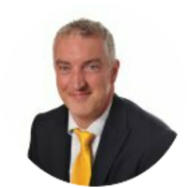
Support at LCS for Year 10 students Safeguarding Team Designated safeguarding lead - Kara Guise Kara.Guise@laconchildeschool.co.uk Operational Designated Safeguarding lead - Kerry Jasper Kerry.Jasper@laconchildeschool.co.uk Deputy Safeguarding Lead for KS4 - Charlotte Johnston Charlotte.Johnston@laconchildeschool.co.uk SEND SEND Coordinator - Tim Stiles Tim.Stiles@laconchildeschool.co.uk Support Assistant – Becky Young School nurse – Emma O'Connell (Wednesday Week B) Social Prescriber – Becky Rohr (Monday/Tuesday) Mental Health and Support Team – Charlotte Elvidge (Thursday)

Slide 15

External support

Slide 16
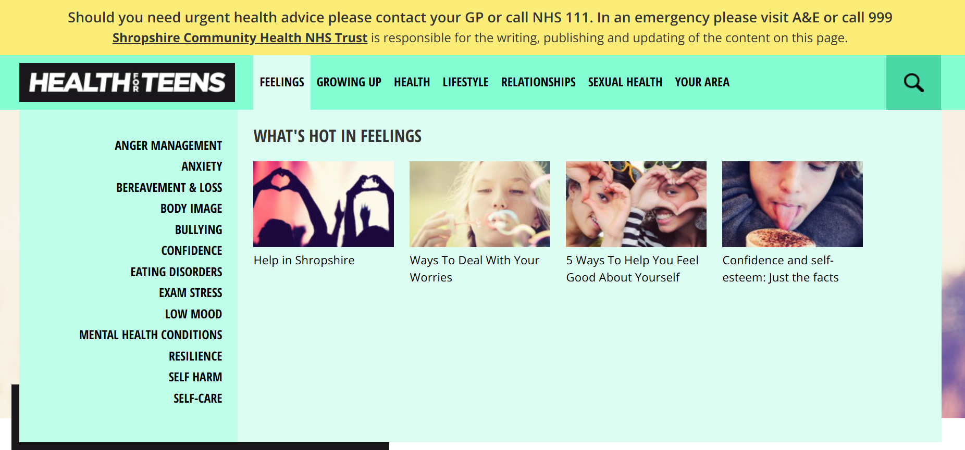
External support https://www.healthforteens.co.uk/shropshire/find-help/
https://www.healthforteens.co.uk/shropshire/find-help/

Slide 17

https://www.youngminds.org.uk/parent/

Slide 18


Successful Students
Hard work over a period of time.
Excellent attendance.
Good behaviour profile.
Attend additional classes and revision sessions.
Control their social media lives effectively.
Take part in whole school/out of school activities.
Take personal responsibility for their own learning.
A Growth mindset and respond constructively to setbacks

Slide 19
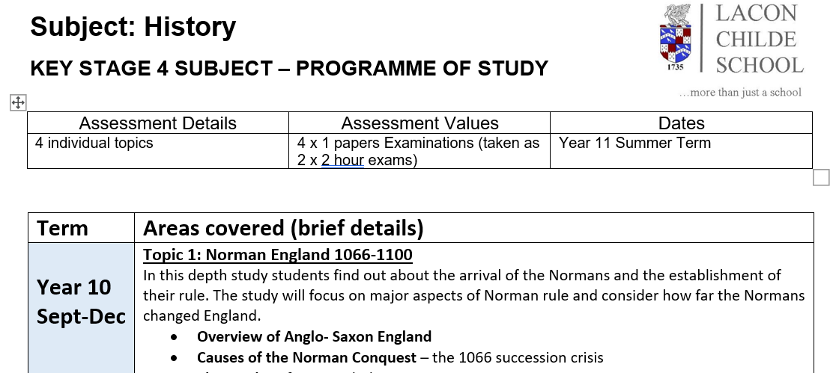
Year 10 GCSE Booklet
Assessment details.
Revision strategies and helpful tips.
Exam grading.
Subject Specifications.

Slide 20

Year 10 Mentoring
For Year 10’s to mentor younger students in the school that maybe struggling to settle in school, struggle socially or need help with organisation.
Mentors will have training and input from teachers.
Mentors will need to be committed, enthusiastic, trustworthy, empathetic and reliable.
There will be an application process.
This will be good for a personal statement when applying for College or University.

Slide 21
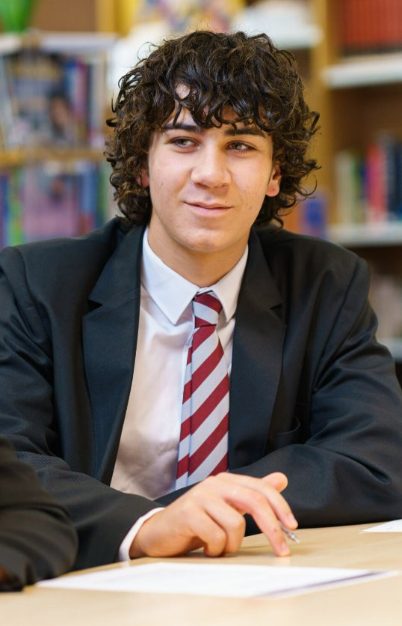
Year 11 Prefect Application
For students who demonstrate they are conscientious and considerate.
Excellent attendance, punctuality and uniform.
Excellent behaviour record.
Willingness to contribute through service to the school and leadership.
Written applications to KS4 lead and interviews.
The role includes duties, organisation of whole school activities, open evenings, parents evenings and ambassadors for the school.
Commence role in Year 10 Summer Term 2.

Slide 22
Lacon Childe School Expectations
Be the best you can be
Aim for 100% Attendance
Treat all people with respect
Engage positively with all
Bring the correct equipment each day
Catch up on any work missed
Join in all aspects of school life
Reject all forms of bullying or discriminatory behaviour.
Positively reject all forms of anti-social behaviour or attitudes at all times including travelling to and from school and when using digital technology and social media.

Slide 23
Expectations Around School
Treat school property and the school environment with respect.
Dispose of rubbish in the litter bins.
Chewing gum and mobile phones are not permitted in any area of the school or on school buses.
Always wear school uniform properly and with pride.
Walk calmly and purposefully.
Assist and be courteous to others.

Slide 24
Classroom Rules & Expectations
At the start of the lesson, students are expected to:
• Arrive on time and line up sensibly and quietly outside the room wearing full and correct uniform.
• Wait until the teacher greets them at the door and welcomes them into the classroom.
• Enter the room calmly and move quietly to their allocated seat.
• Place all equipment for the lesson on their desk, ‘be lesson ready’.
• Engage in the starter activity without talking whilst the teacher is taking the register.

Slide 25
Classroom Rules & Expectations
During the lesson students are expected to:
• Listen silently and attentively to the teacher and contributions from their peers.
• Engage fully and positively.
• Take responsibility for their own learning.
• Behave positively to allow their own learning and that of other students to take place without interruption.
• Be polite and courteous to all adults and students.

Slide 26
Classroom Rules & Expectations
At the end of the lesson, students are expected to:
• Pack away equipment when told to do so.
• Stand behind their chair and wait in silence for the teacher to dismiss them.
• Respond to their farewell and thanks from the teacher as they leave.
• Move promptly to the next lesson.

Slide 27
Mobile Phones
On your person – not on show
Phones to be stored in bag or zipped inside pocket of blazer.
No phones to be stored inside pockets of blazer where they can be seen.
If they are seen using their phone it will be taken from them and handed in at the office.
Image capture and sharing of media of any form will result in sanction.
THIS IS NON-NEGOTIABLE

Slide 28
Behaviour What happens if a student doesn’t follow the rules?

Slide 29
Disruption to Learning
B5: Serious incident: PSR / Suspension / PX
B4: Further disruption despite removal or serious disruption On call / SLT intervention required: Removal to PSR, Results in time in PSR
B3: Continued disruption to the learning of others:
Student needs to be removed to nearby class to protect
the learning of others. 1 hour after school detention
B2: Behaviour persists despite significant intervention: Formal Sanction is put in place 20 mins detention and recorded on Arbor – further intervention may involve moving seating plans / discussion with student.
B1: Verbal Warning. Students have clear guidance to support them in correcting behaviour / making a positive choice. students have a last chance to address behaviour before a sanction is put in place.

Slide 30
Interventions
PX
Governors Disciplinary panel
Local authority involvement, review of progress and strategies and interventions.
Headteacher Review Hearing: review of behaviour log, PSP, progress and strategies and interventions.
SLT intervention: Meeting with year lead and SLT to open PSP. PSP targets agreed, year lead report used to monitor progress, regular meetings with parents to review.
Year Lead intervention: Ongoing / persistent patterns of behaviour concerns. Contact / meeting with parents: year leader report. Targeted interventions with Learning mentors.
Tutor intervention: Patterns of behaviour concerns / repeated concerns: Tutor contact home, Tutor report with specific targets monitored by tutor.
Class teacher intervention: Isolated incidents of disruption / low level concerns. Contact with home, sanctions and strategies for support put in place.

Slide 31
Rewards
Yearly: Celebration
Trip, Student of the year,
KS3 Awards Evening, Y11 presentation Evening
Termly: Celebration Assembly, Merit mentions, Prize draw Student of the term, Social with staff, Weekly lunches with students, DISCO, Film Night,
Half Termly: Year group celebrating success assemblies, Student of the half term, Attendance certificates, Non uniform day, Early lunch, Sports Rewards, freebies…. Focus fortnight 0 B2’s, 100% attendance, Lacon Me focus, Clear conduct card,
Fortnightly: Year group recognising success assemblies, Lacon Outstanding Pupil Award postcards, Achievement certificates ,Year group student of the fortnight
Daily: Achievement Points, positive phone calls / emails home.

Slide 32
Attendance
Not only do schools equip children with the knowledge and qualifications they need for later life, but they are also places where children make friends, learn new hobbies, and build on their ambitions for the future. If we want to offer every child the best chance in life, it must start with ensuring that they can regularly attend school.
Rachel de Souza, Children’s Commissionner

Slide 33
Why does attendance matter?
Students fall behind in work and lessons.
Students have lower motivation to be here at all.
Students' enjoyment of learning is less.
Students have less chance of achieving GCSEs.
Students more likely to show poor behaviour.
Students miss out on the social life of school, extra curricular opportunities and experiences.

Slide 34
Knowing Our Students - Landscape
105 students in the year group
Attendance 96.6%
11 students below 90% - PA
41 students have been late to school or a lesson
671 lost minutes

Slide 35
Absence Bands
Attendance Band | Range of Days Missed | Range of Weeks Missed
95% - 100% | 0 – 9.5 | 0 – 1.9
90% - 95% | 9.5 – 19 | 1.9 – 3.8
85% - 90% | 19 – 28.5 | 3.8 – 5.7
80% - 85% | 28.5 – 38 | 5.7 – 7.6 (Approx Half a Term)
60% - 65% | 66.5 – 76 | 13.3 – 15.2
50% - 55% | 85.5 – 95 | 17.1 - 19
< 50% | > 95 | > 19

Slide 36
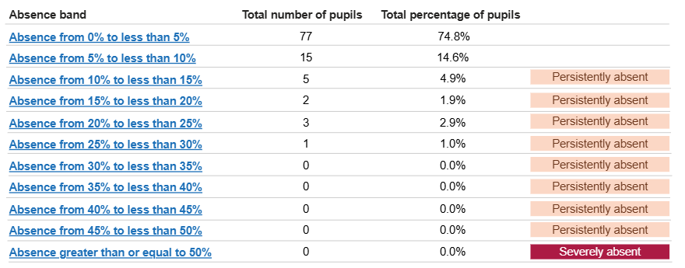
Knowing Our Students – Y10 Banding

Slide 37
Importance of Attendance – DFE Research
At KS4
Band 1 students (95-100%) 1.9 times more likely to achieve the Grade 5 in English and Maths GCSE compared to those in Band 2.
Band 1 students 3 times more likely to achieve the Grade 5 in English and Maths GCSE than persistently absent students who only attend 85-90% of the time.
This means missing just 10 days reduced the likelihood of achieving grade 5 in English and Maths by around 50%.

Slide 38
Importance of Attendance – DFE Research
Moving up a single attendance band, attending school 2 extra weeks a year is associated with an increased chance of achieving the expected outcome of at least 10% (KS4) across the full range of attendance.
At KS4, moving from 90-95% to 95-100% was associated with largest increase in chance from moving up one band.
There will be gains in attainment by improving attendance of all pupils by a single 5% band across the range of attendance bands.

Slide 39

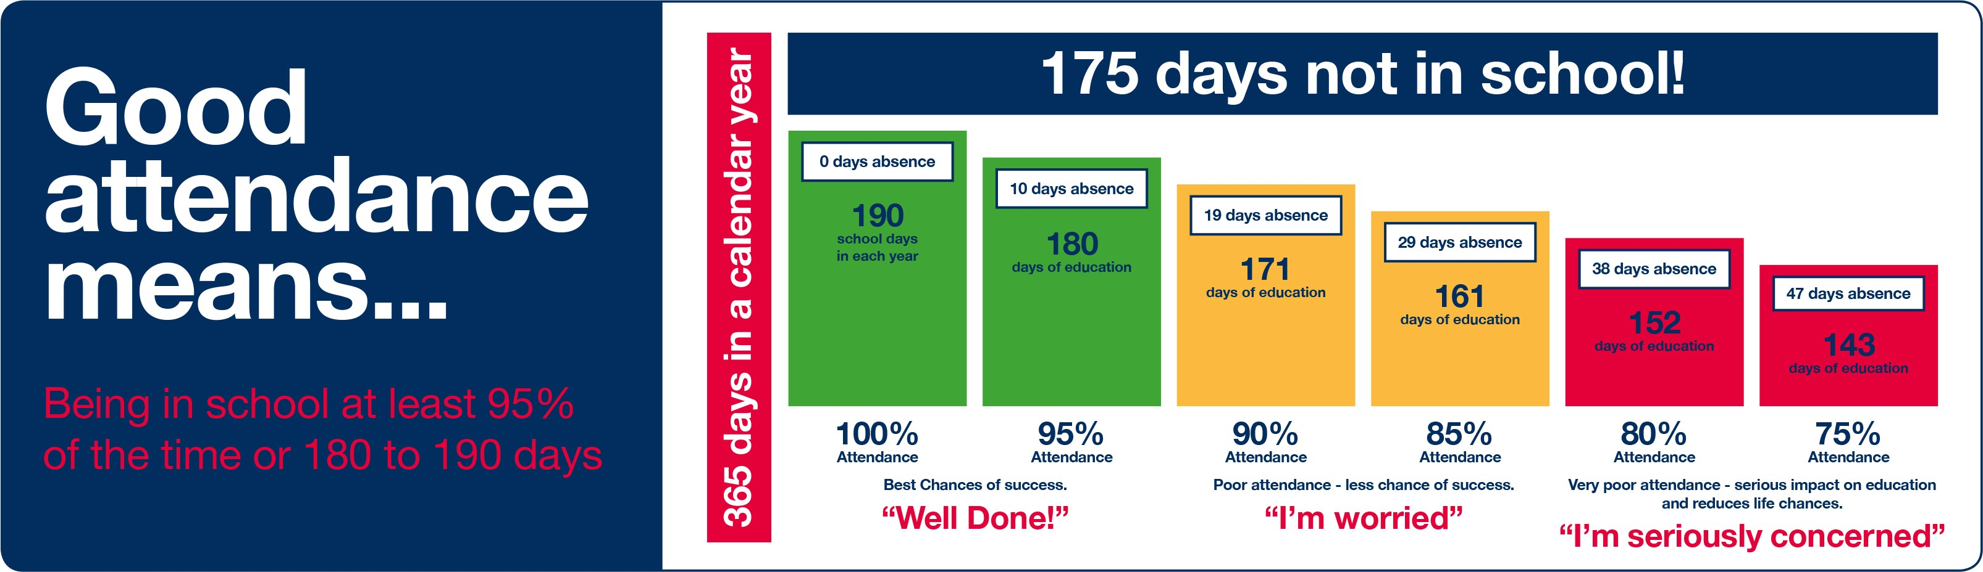

Slide 40

Mathematics GCSE Edexcel board
Information for Parents

Slide 41
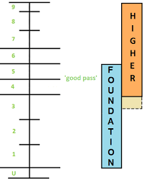
Year 10 Maths
Your exam board is Edexcel.
Exam: 3 x 80-mark papers. 1 non-calculator and 2 calculator papers.
Foundation Tier (Grades 1 - 5) 20 units
Higher Tier (Grades 3/4 – 9) 19 units
Unit 1 began in Year 9.

Slide 42
For students
Each unit ends with an end of unit assessment. These are now open book.
Taking accurate notes is more important than ever.
There is so much content, homework retrieval is the key.
Y10 mock exams will have revision sessions before and intervention support afterwards.
Start to get an idea of what you need for college courses you might want to do. Your tier of entry affects this.

Slide 43


For Parents
Please make sure your child is fully equipped.
Encourage resilience when completing homework rather than relying on external support.
Revision workbooks rather than revision guides.
November assessment: fluency check for all.
Mock exam week April: 2 x GCSE papers

Slide 44
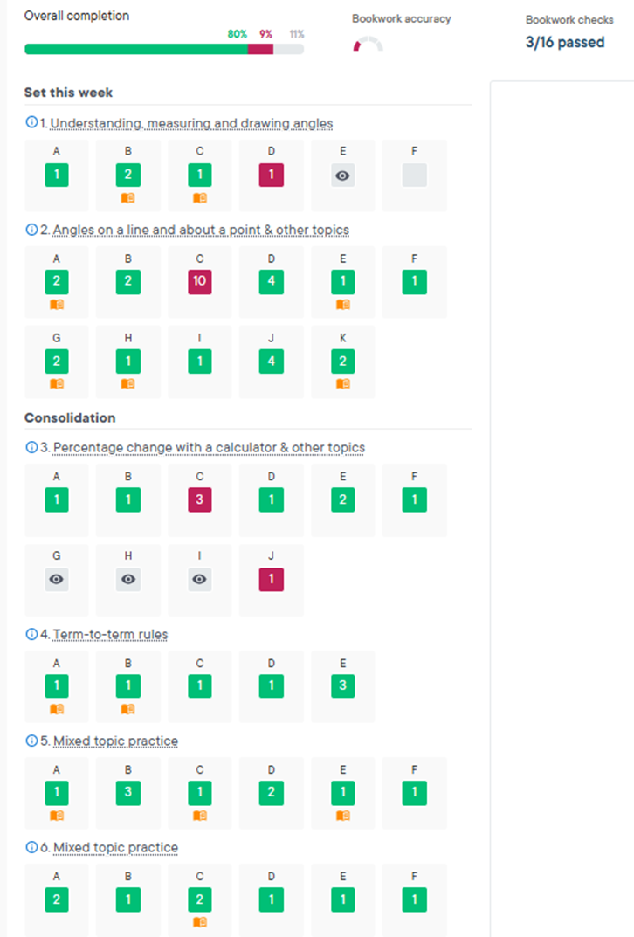
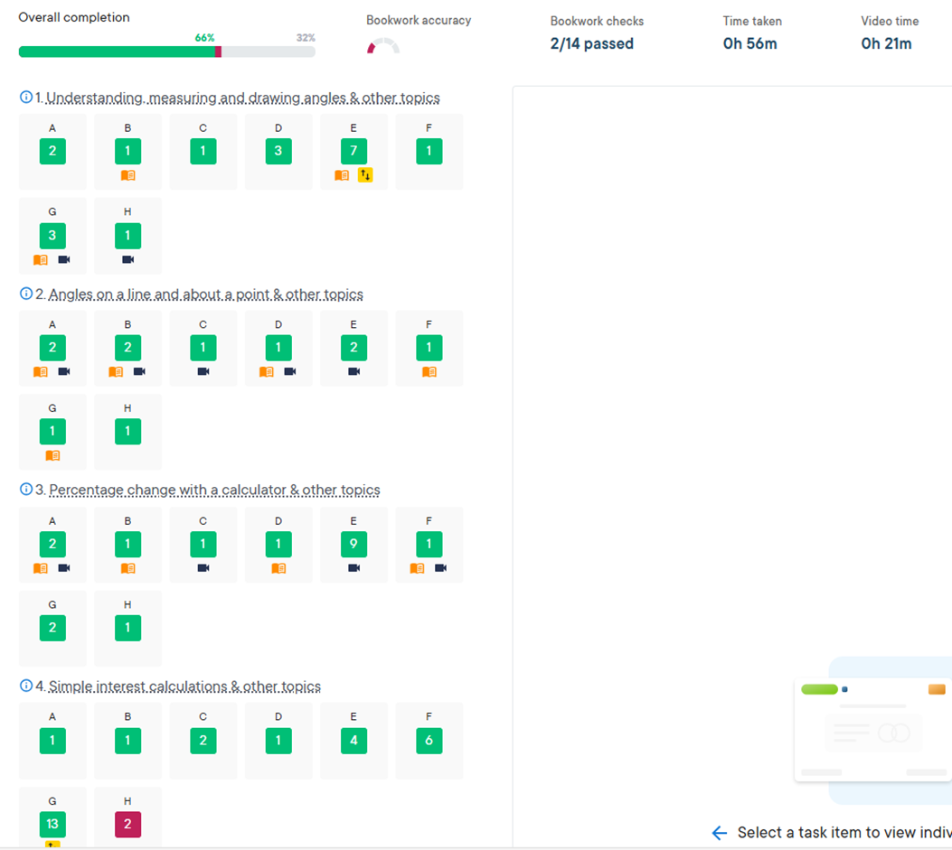
For parents & students - homework
100% pass rate.
Encourage your child to use the videos.
Weekly completion of SPARX homework from year 9 to 11 alone has been proven to increase final GCSE grade by up to one whole grade.

Slide 45

English Language and Literature
Information for Parents

Slide 46

GCSE English/ English Literature AQA
4 exams – 2 each for Language and Literature, a total of 7.5 hours of exams.
Both important. Practising skills for each question crucial for Language.
Closed book
No tiers – all sit the same exams.
Challenging texts – focus on 19th Century Prose for Language and Literature. So confidence with reading independently is important.
Higher % of marks given for technical accuracy, punctuation, grammar, sentence structure and vocabulary for writing in Lang papers and added to Lit.

Slide 47

For students
Be proactive with study and organisation. Don’t waste lesson time. Keep up with notes. See test assessments as a positive learning experience.
Take pride in the work produced and get the basics right.
Little and often for revisiting Literature texts, learning quotations and speed writing.
Act on feedback. The only way to secure success is to rework and improve.
Go the extra mile and challenge yourself e.g. own creative writing and poetry for anthology, Poetry by Heart.
Get in a routine with Sparx Reader.

Slide 48

For Parents
Copies of texts to purchase will be available shortly on Parentmail. Crucial that they have these. CGP revision guides useful.
Ask about the texts. Ask about characters, themes and the methods writers’ use in these texts.
Talk about the context, e.g. Edwardian times, Victorian London.
Encourage them to produce mind maps or revision cards on the texts – focus on methods/ quotations/ context. This needs to be on-going, not left until Year 11.
Encourage them to use YouTube for independent learning. Also sites such as Poetry Genius and Bitesize.
Support with Sparx Reader
Extra-curricular opportunities i.e. Poetry Live Event January

Slide 49
Sparx Reader and Independent Reading
Why is it important?
There is significant correlation between reading age ability and performance in GCSEs. Reading builds a strong vocabulary which impacts on academic success and college readiness. Students below chronological reading age will be disadvantaged in exams.
Sparx reader is a measurable way of checking on reading progress and working that reading muscle!

Slide 50
GCSE Science
Your child will be following one of these course at KS4: Edexcel Combined Science Resulting in the award of 2 GCSE’s.
6 Exams-1hour and 10 mins each. (2 x Biology, 2 x Chemistry and 2 x Physics) 16.67% for each Exam.
Edexcel Separate Sciences (Triple Science) Resulting in the award of GCSE’s in Biology, Chemistry and Physics.
6 Exams-1 hour and 45 mins each. (2 x Biology, 2 x Chemistry and 2 x Physics)

Slide 51


Revision and Homework in Science
Homework is set from our Science workbooks for Year 10 and 11.
On the Edexcel website there are past papers and mark schemes that students can access.
In Science Examinations pupils will require calculators and rulers.
Useful websites include BBC bitesize, save my exams and Edexcel.

Slide 52
PSHE
Year 10 PSHE curriculum
Term 1 | Term 2 | Term 3
Health and Well-being How do I manage my physical and mental health in the last two years of secondary school? | Relationships How do I stay safe in my romantic relationships? | Living in the Wider World Can I consider life beyond school?
TOPICS COVERED | TOPICS COVERED | TOPICS COVERED
Drugs and alcohol Attitudes to Mental Health Dealing with anxiety Staying safe | Healthy relationships Rights, trusts and values Communication The impact of pornography Family Life and parenting Marriage | Careers Saving and managing money Employment rights Targeted Data College visits Inclusion and extremism

Slide 53

Careers Guidance We have a careers advisor who comes in once a week on a Tuesday to talk to our students. Mrs Hunter will conduct one-to-one interviews with our Year 10 students. She is an expert in Careers guidance and has helped hundreds of our students to better understand what they want to do and how they can get there. If your child is in any doubt about their future or has not made any decisions yet, please feel free to get in touch with Mrs Koziel for more information.

Slide 54

Work Experience 6-10th July 2026. One week placement. Student responsibility. Can be anything! Placement finalised by first week in December Sort it out as soon as possible! Unifrog - 29th October student log in deadline.

Slide 55


Slide 56

Post-16 Options Now is the time to start thinking about the future! Will your child’s decision fall under: Sixth Form College Apprenticeship Other Career Options Lacon Childe School Careers Fayre - 6th October

Slide 57
Y10 Information Evening
Thank you for attending Please stay behind if you would like to ask us any questions
Notes:
https://www.youtube.com/watch?v=MFzDaBzBlL0

