Slide 1
Testing and Evaluation
In the testing and evaluation section of your folder you should have;
An evaluation against the specification.
A testing section with client feedback and reflections of your own.
A product and manufacturing final evaluation – see slide 13.
Remember your evauations do not need to follow the same order, there are different examples of what could be included in the example work.
***Please email me your NEA when it is completed.

Slide 3
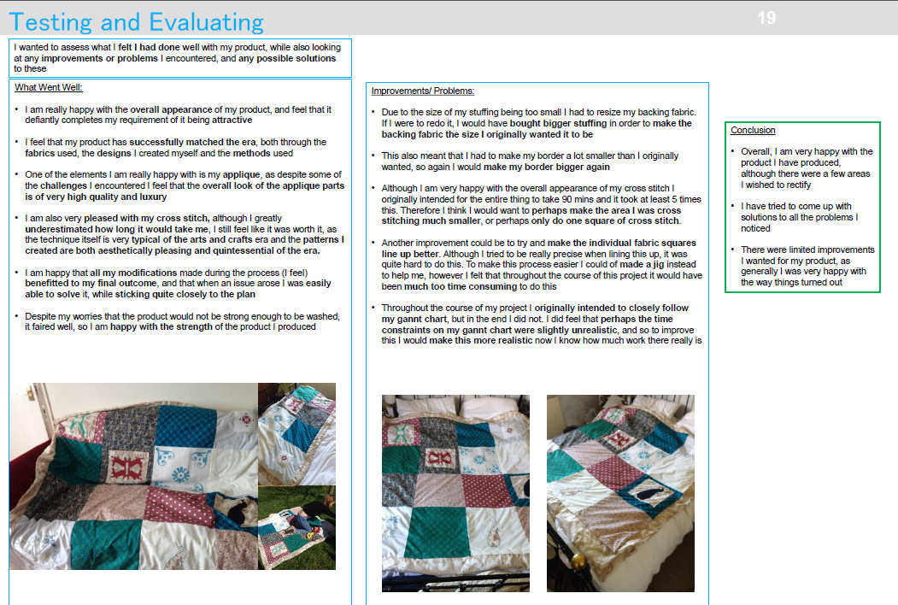

Slide 4
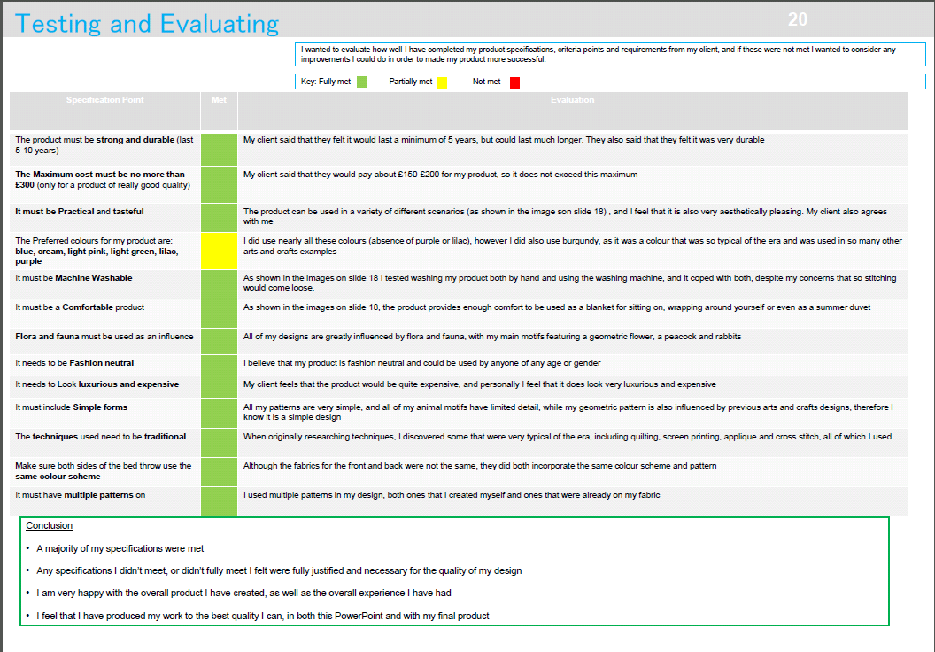

Slide 6
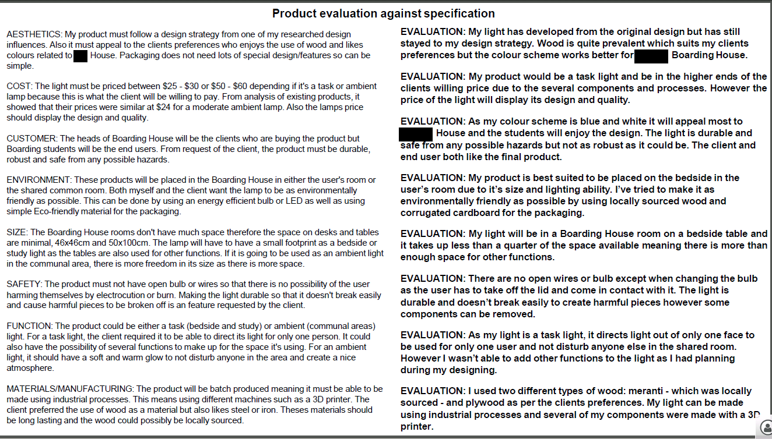
Notes:
Join pin group.

Slide 7
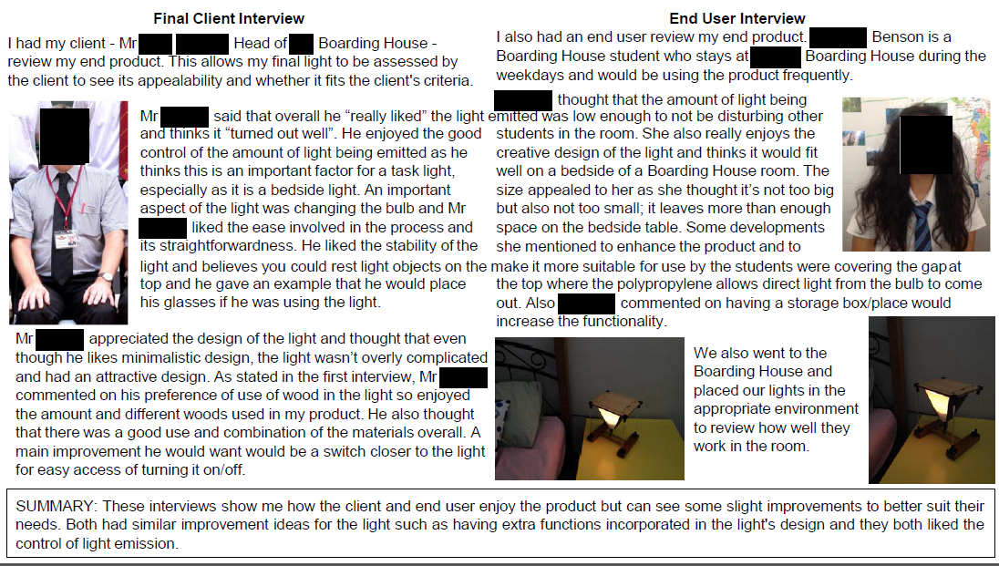

Slide 8
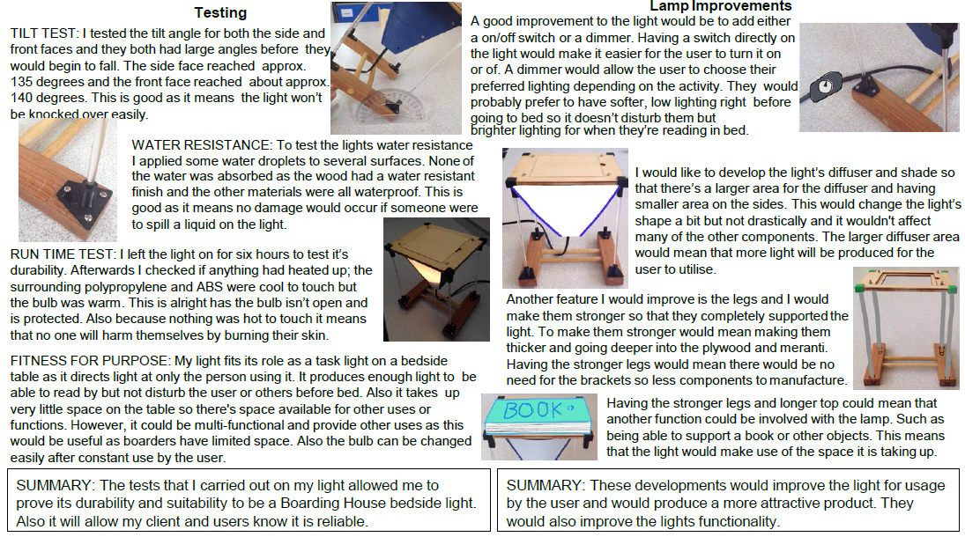

Slide 10
Evaluation
Specification Point | Met? | Evaluation/ Explanation
Appearance As my client said that he will be hanging it up on the ground floor of his home, any visitors to his house will see it. As a result, the wall hanging needs to look impressive, but also complement other furniture in the house. |  | The black back fabric contrasts nicely with the vibrant colours that I have used for the decoration, and for the reverse applique I used the black fabric on top so it acts as a border for the technique. I think that the product is very versatile in that it could fit in with a vast range of schemes, although it would fit it particularly well with furniture from the design movement that the product was inspired from.
Weight Owing to the size of the product, and the amount of decoration covering the surface area of it, the product will be quite heavy. As a result, I will have to ensure that the tab tops and cane will be able to support the product. |  | Having hung the product up when it was completed with its’ bamboo cane, it was obvious that weight would not be an issue that would compromise the function of the product. Although, when purchasing the bamboo to suspend the product, I selected a cane that had a bigger diameter as smaller canes may have become flexible under its’ weight, and potentially end up snapping.
Size My client has expressed a wish for the wall hanging to cover a lot of wall space. As a result, I will consider this when determining the size of the product, but it should not be too big and end up ‘dwarfing’ other items of furniture in the clients’ home. |  | My product measures approx. W130cm x H75cm which, when hung up on the wall, looks very eye-catching due to this size. My client wanted it to cover a lot of wall space, and subsequently, my product could be used as a centrepiece for a room.
Function My client wants the wall hanging to complement existing furniture in either the dining room or the lounge. Regardless, the product will be seen by visitors to the house, and therefore it needs to be highly decorative and eye-catching. The wall hanging will also improve the acoustics of the room and minimise any echoes, and therefore make the room feel more ‘lived in’. |  | I think that the product contains many design features, both obvious and subtle, that nod towards the 1960s. The chalet style house was a popular type of dwelling during the period, and the pattern of the curtains was inspired from ‘fashionable’ colour schemes and patterns. These striking elements draw the eye in to appreciate the smaller details, such as the furniture and removal men. It is quite versatile in that it can compliment a range of different interior schemes while preventing echoes in the room in which it is placed.
Surface decoration I will use a variety of techniques that best capture the key design elements of the wall hanging. I will try and use cotton where I can, because my client has expressed a preference for it over more man- made materials such as polyester. |  | Throughout my product, I have extensively used cotton which satisfies the clients’ wishes to avoid man- made materials where possible. Through my technique trials, I assessed each technique and its’ suitability to each individual design. Heat transfer was used on intricate designs, and for larger components such as the house, I used reverse applique.
Theme I am basing the theme of the wall hanging loosely around the ‘contemporary’ style, which my client is interested in. For the decoration of the product, as well any patterns on the fabrics that I may use, I will centre it around my theme. |  | To manufacture the CAD CAM woman who was produced on the computerised sewing machine, I found a selection of old household product adverts from the 1960s, whose products were aimed at housewives and regularly portrayed a woman using the product, and used the images of them to create my person. Again, I have tried to incorporate popular colours in the clothes she is wearing. Elsewhere on the wall hanging, there are inclusions of furniture and architecture that are all iconic of the era.
Safety My client does not have any children, and therefore the design of the item will not be compromised by having to omit small decorations that may easily break off and pose as a choking hazard. |  | Although my target market majorly comprises of young adults without children, embellishments such as beading would have the potential to pose as a choking hazard to young children who may visit them. My product does not have any beading or similar decoration that would be dangerous in this way. Besides, the wall hanging will be situated off the floor, and out of the reach of young children. Despite this, if one of the corners of the product was pulled from below, it may end up falling on top of the toddler. However, my product will be hung from metal L- shaped brackets that would mean that this would not happen.
Samuel Lloyd- candidate no: 4190 Page 29 of 35

Slide 11
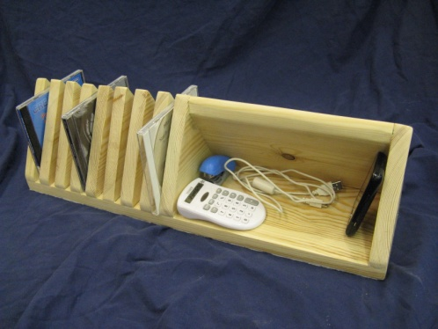
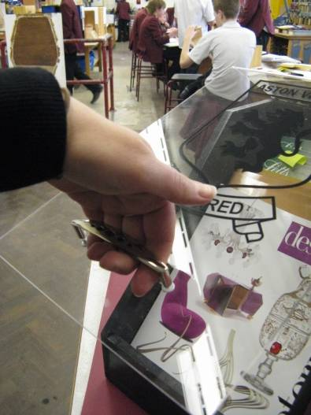
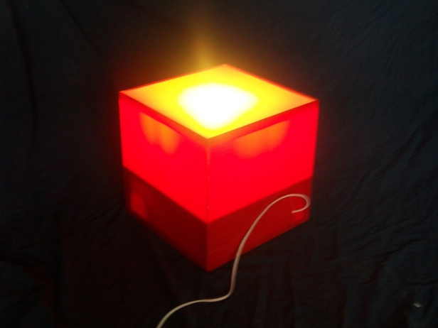
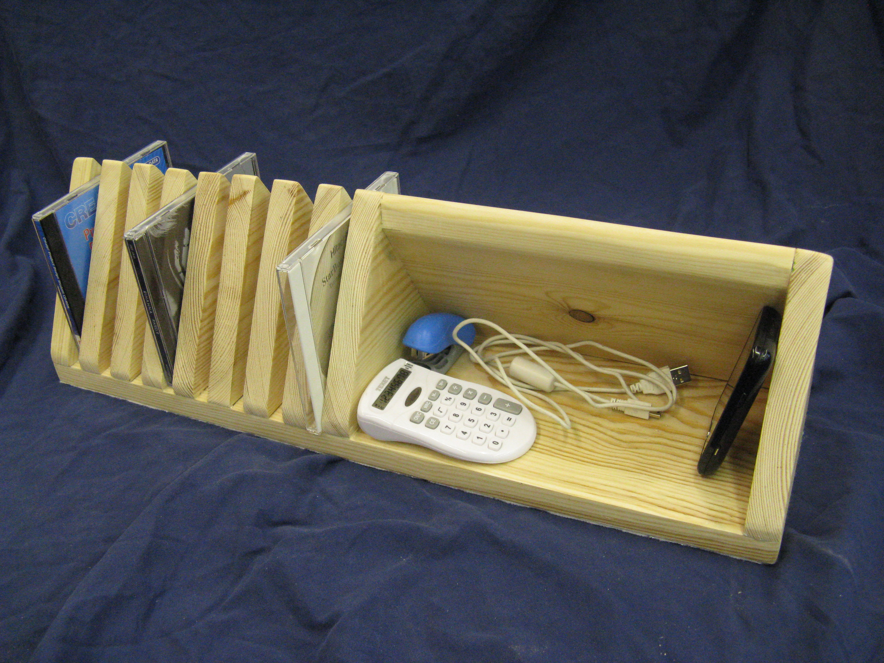
Testing your product
Get the intended user to test your product.
Photograph the product in use.
Include feedback from the user, this could be in the form of quotes or for extra marks a client interview would be excellent.
When testing make comments of any problems and make suggestions for a solution to the problems or ways to enhance the product..

Slide 12
Product and Manufacturing final evaluation
Product
Is your product suited to its purpose? Does the final product meet your design specification requirements? If not explain why.
Is it suitable for the user it was intended for? (Your target market, you could refer to your customer profile).
Is your product aesthetically pleasing? (Does it look good?). Discuss colour scheme and design.
Is your product well made? Look at the stitching, fastenings, quality of dyeing etc. If yes, why? If not, why not?
Discuss reasons why your product is successful, for example;
Is your product functional? (Can it be used/worn)
Will it be durable? (Hard wearing, washable)
Are any added details (fastenings, decoration, logo, etc) appropriate for the intended use?
Improvements and modifications
Now that you have carried out your testing, what changes/modifications needs to be made.
How can your product be improved?
Is your product environmentally friendly? What could be changed to improve this?
Manufacturing in school compared with Industrial Manufacture
How would your product be made differently in industry? (method of production, specialised equipment, sub assembly lines etc).
Have you created a manufacturing specification and flow chart? Are they easy to follow?
Have you created a costing sheet? Is your product cost effective?
Why would this change in industry? Cost of fabrics and components etc.

