Slide 1
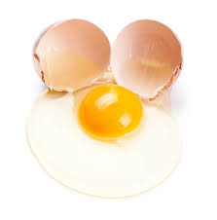
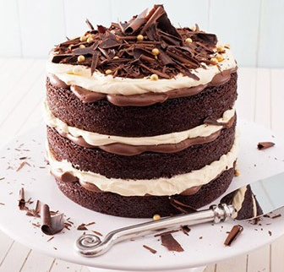
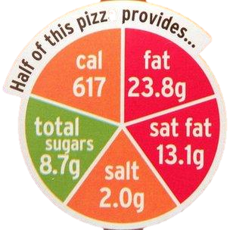
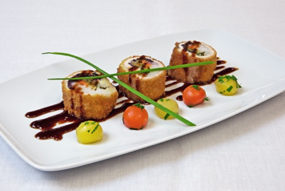
Home learning Food Preparation and Nutrition
There are 30 challenges to complete, use your Food lesson time to complete them. You don’t need to do them in order- just cross them off as you do each one.
30 activities to complete over 6 weeks.
Make bread adding a filling or topping of your choice | Design a rainbow cake for NHS Thursday Clap for cares | Design a table place mat to help children learn about healthy food choices. | Make Pasta 100g Four, 1 egg Add your own flavour, including chocolate!!!! | Change the taste and aroma of a well known dish through the use of infusions, herbs or spices. | Watch these clips on BBC teach https://www.bbc.co.uk/teach/class-clips-video/design-and-technology-gcse-food-preparation-and-nutrition/zvjh8xs
Make the evening meal for your family | Watch the truth about takeaways on iplayer. https://www.bbc.co.uk/iplayer/episode/m000fs5n/the-truth-about-takeaways | Research the environmental issues associated with food and create a PowerPoint presentation. https://www.bbc.co.uk/bitesize/guides/z7fw7p3/revision/3 | Design and make a show-stopper cake! https://www.youtube.com/watch?v=BIyZVC45V6s | Make a food Quiz. Send to me. Prize for the best one | Adapt your evening meal to be vegan friendly.
Keep a food diary for 1 week. Analyse it and identify the nutrients in it. Use Food 4 life website | Review how healthy your breakfast was and write in detail on how you could improve it. | Create a presentation on Protein – Talk about - The functions • The main sources • The effects of deficiency and excess. | Cook a casserole for your family. | Use one or more of the following foods - vegetables, meat, fish or alternatives such as halloumi, seeds and nuts; to char/grill or toast. | Watch an episode of Bake off stand up to cancer. https://www.channel4.com/programmes/the-great-celebrity-bake-off-for-su2c/on-demand/67792-002
Investigate raising agents – How do they work, what can be used as a raising agent? https://www.youtube.com/watch?v=0USi4DbRVVQ | Make a soup with your favourite vegetables. | Make a swiss roll! | Design a 3 course menu in the theme of your favourite book or film. | Research the importance of hydration and the functions of water in the diet. | Make a pizza dough.
Research food labels, what are the essential things that should be on food labels? What other kind of information is also included? | Collect at least 3 pieces of fruit from the fruit bowl and makeup a recipe using it. Use other ingredients from the cupboard. Photograph and send it to me! | Make the Sunday lunch using only what you can find in the cupboard. Take a picture and send it to me!! | Try making a mug cake – create a new flavour https://www.bbcgoodfood.com/howto/guide/how-make-mug-cakes https://www.bbcgoodfood.com/videos/hacks/easiest-ever-microwave-mug-cakes | Create a presentation on Carbohydrates – Talk about – *The functions *The main sources *The effects of deficiency and excess. | Make a Fish Pie

