Slide 1
Wants and Needs
Think – What is the difference between something we want, and something we need?

Slide 2
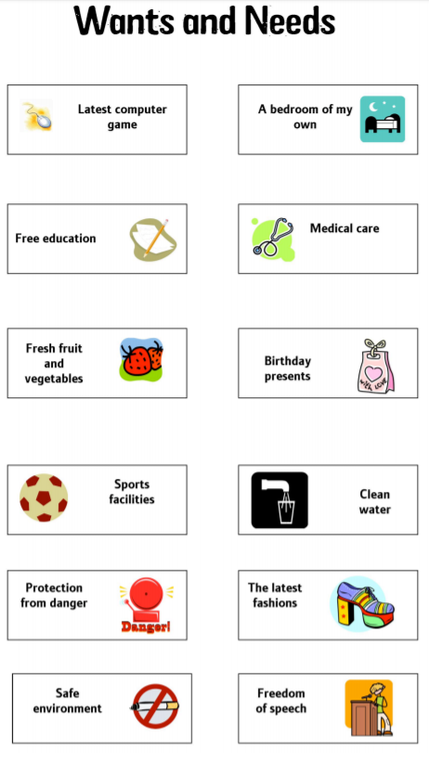
Lesson 5
Think about the 12 points on the list.
Which are wants and which are needs?
Rank them into order. First being the most important.
Why did you put them in that order?

Slide 3
Imagine …. “U.K. government to ban all non-essential use of water for at least a year”.
Decide what you think are essential and non-essential uses of water. – eg enough to drink –v- washing the car
Write your answers in your book
What effects would a ban on use have on our daily lives?
How difficult would it be to lead a normal life?
How would life change?
How do you think water shortages would impact life in LICs?

Slide 4
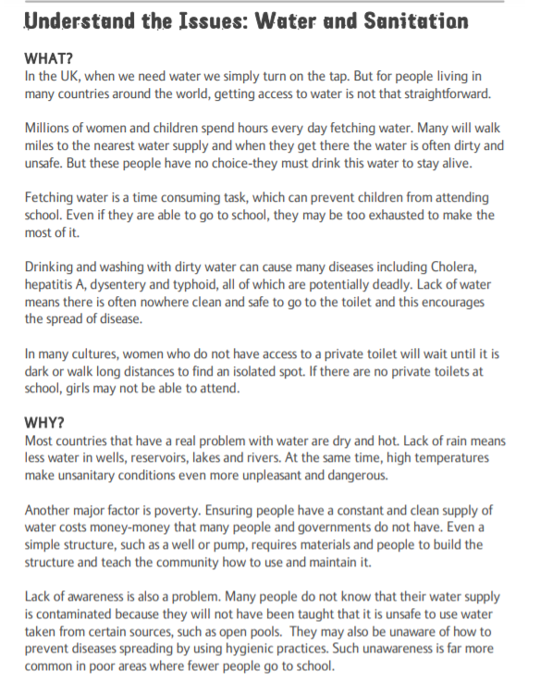
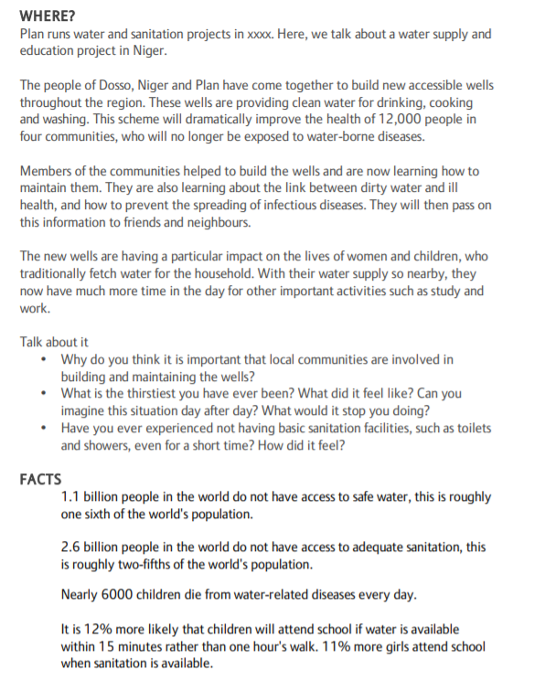
Read through the resource

Slide 5
Water Issues
Summarise the main points from the text into a poster in your book. Include pictures and colour to make your poster interesting. Finish for homework.

Slide 6
Lesson 6
On the next slide, there are 9 causes of water shortage.
Choose three of the causes of water shortage and answer the questions in detailed sentences.

Slide 7
Climate What weather conditions create a water shortage? What is drought? What problems does a drought create? How does a drought affect people and the land? Is this a physical or human problem? | Pollution What is pollution? Why would water sources become polluted? Give examples. Do people drink contaminated water? What is the effect of drinking contaminated water? | War How might wars affect water supplies? How might wars affect pipework and wells? How will the local population be affected? Will the population be able to collect water? If not, why not?
Dams What is a dam? How might dams affect water supplies? Who could suffer if a river is dammed? How many countries does the river Nile pass through? What is the problem with this? | Tourism What is tourism? How can tourists affect water supply? Can you think of a place in a LIC which is popular with tourists? Is there a water shortage there? How do tourists get water? How do local people get water? | Lack of education If people are not educated well what mistakes might they make when collected water? How do people in LICs collect water?
Poverty What does poverty mean? How might poverty affect water supply? Can you give an example of a country in poverty? Why cant people in the country get water? | Overpopulation What is over population? How might over population affect water supply? Can you think of a place that might be over populated and suffers from water shortages? | Farming methods Why is water needed on farms? Where does the water come from? How might farmers misuse/waste water?

Slide 8
Water for Life

Slide 9
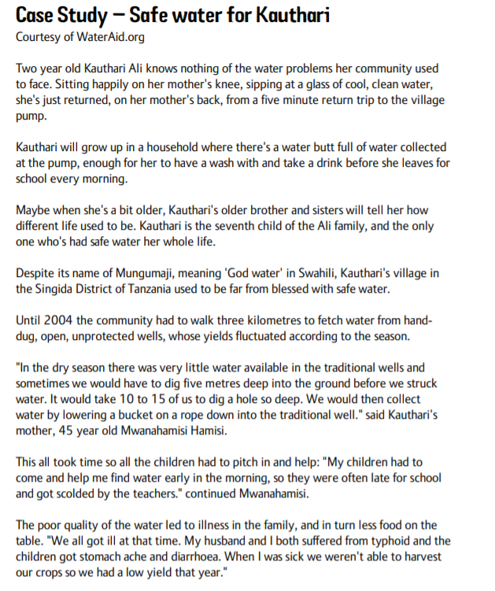
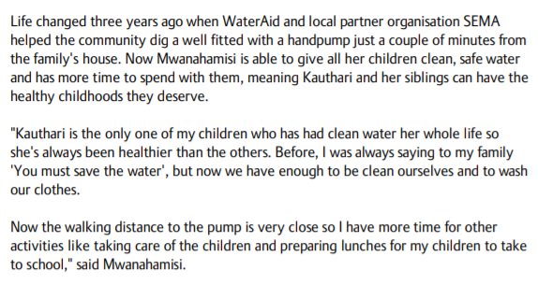
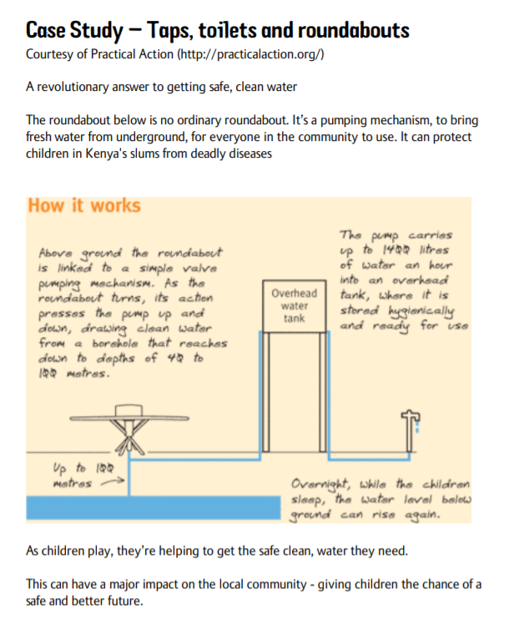

Slide 10
Board Game
Either make a copy or print a large copy of the next slide. The idea is to create a board game that can be played to teach other children about the problem of water shortages in the world.
You will create your own version of the game deciding what to write in each square using the information they researched over the last two lessons.
The ladder squares should reflect some of the work being done by various charities to help and the improvements made and the snake squares should reflect the causes of shortages and the problems associated with a lack of water.

Slide 11
