Slide 1
Options Information Evening
Thursday 27th February 2025
Mr. N. Roff
Assistant Headteacher

Slide 2
Core – all students study these subjects
English Language + English Literature – 8 hours per fortnight
Mathematics – 8 hours per fortnight
Science (Combined or Triple) 9 hours per fortnight
PSHE 1 hour per fortnight
Core PE 4 hours per fortnight
The KS4 curriculum and the options process.

Slide 3
Grading and differing qualifications
Difference between academic and vocational subjects
GCSE
Will be mostly traditional written examinations at the end of the course with coursework or controlled assessments in a few subjects
Pass grades range for all subjects will be 9-1
Cambridge National Awards
Approximately 50% coursework based – are equivalent to 1 GCSE. Students who pass are awarded from level 1 pass equivalent toa grade 1 at GCSE to Level 2 Distinction* worth between and 8 and a 9 at GCSE

Slide 4
Option Choices
Student should opt for one subject from each column.
Students should ensure at least one of their options is either History, Geography, French or Computer Science. This is to help ensure academic breadth across their options.
Students cannot opt for GCSE PE and Sports Studies, nor can they opt for Computer Science and I-media.
Triple science will no longer be an option choice, it will run alongside combined science within the core hours.
Students should also make a reserve choice, this can be from any of the columns but cannot be a subject they have already chosen.

Slide 5
Making your options
Students complete these via Microsoft Forms.
Students should ensure they have spoken to members of staff and discussed their options at home before making final choices and submitting responses.
No guarantee that all 4 choices will be possible
Essential to select a reserve choice
Some subjects will only have 1 group
Where pupil option numbers are too low the subject will not be able to run
Oversubscribed groups will have to go through a selection process
Performance and attitude to subject over KS3 will influence that decision
Notes:
Students will do this via Microsoft Forms. A link will be sent to the parental email address. Please do not rush to complete this, it is not run on a ‘first come first served basis’. Students should ensure that they have seen the subject presentations that will take place in classes, spoken to members of staff and discussed their options at home before making final choices and submitting responses.

Slide 6
Importance of balance to your choices
Future colleges and employers want to see a breadth of qualifications.
You should consider a range of subjects in addition to your core. You should avoid choosing very similar options e.g. you won't be able to take two DT options or two PE/sport-based options or Computer Science and I-Media.

Slide 7
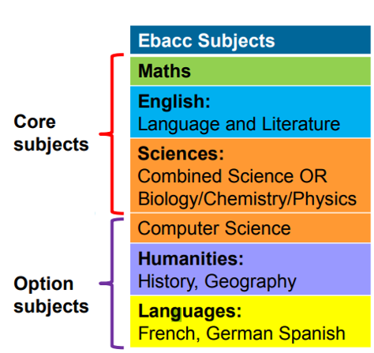
EBACC
The EBACC is a qualification gained if you opt for, and pass; English Language and Literature, Maths, Science (combined or triple), History or Geography and French.
Some universities might prefer students who have completed the EBACC suite of subjects.
Notes:
The EBACC is a qualification gained if you opt for, and pass; English Language and Literature, Maths, Science (combined or triple), History or Geography and French. Some higher education providers like applicants to have this qualification as it shows a broad experience of academic subjects. There is some evidence that students who take the EBACC go on to stay in study for longer and perform better in English and Maths.

Slide 8
Making the right choice
Making good choices

Slide 9
Points to consider.....
•Don’t base decisions on which member of staff you want to be taught by.
•Don’t choose a subject just because friends are.
•Don’t rush into a decision about future careers.
Notes:
Be careful not to base decisions on which member of staff has been teaching the subject so far. Timetables change every year and there is no certainty or guarantee which subject specialist will be teaching in Years 10 and 11.
•It can be a mistake to choose a subject just because friends are. They may well end up in a different group and, as you’re no doubt aware by now, friendships can change as you grow older.
•Don’t rush into a decision about future careers. Most people change their job several times throughout their lifetime. You can keep your options open by maintaining a broad range of subjects using a broader range of skills.

Slide 10
Points to consider.....
•All subjects are inclusive to all students.
•Talk things through with subject teachers as they know your strengths. No one can predict how well they may do in Years 10 and 11.
•Some subjects still have some controlled assessment element. It is vital that you are aware of the controlled assessment commitment of all your subjects put together (details can be found in the Options booklet).
•Listen carefully to your teachers as they will explain clearly the requirements of their course e.g. do not choose GCSE PE if you do not play sport outside of school.

Slide 11
Key Dates
Thursday 27TH February – Option Information Evening – option booklet available to download online from school website
https://lacon-childe.org.uk/information-for-parents/year-9-options
Thursday 27th March– Year 9 Parents Consultation Evening
Monday 31st March – Option form return deadline

Slide 12
Option A | Option B | Option C | Option D
History | DT Food | Art | Art
Geography | DT Textiles | Drama | French
French | DT RM | Sports Science | Child Development
Computer Science | History | I-Media | History
Study Skills | Sports Science | Voc | RS
Music | Geography | GCSE PE

Slide 13
Option A | Option B | Option C | Option D
History | DT Food | Art | Art
Geography | DT Textiles | Drama | French
French | DT RM | Sports Science | Child Development
Computer Science | History | I-Media | History
Music | Sports Science | GCSE PE | Religious Studies
 | Geography

