Slide 1
Starter:
Which of the following factors enhance enzymic browning in fruit? Oxygen Low temperature Copper and iron tools Glass and plastic tools Chopping them finely Leaving them whole and intact [2 marks]
What type of flour already has baking powder added to it? [1 mark]
Identify three vitamins that are considered to be antioxidants [3 marks]

Slide 2
Starter:
Explain why bicarbonate of soda has to be used in combination with an acid when baking muffins [2 marks]
Identify two dishes in which steam is used as a LEAVENING agent. [2 marks]

Slide 3
Revision- Food Science- Raising Agents
Learning Objectives:
Recall information about Raising Agents
Address any misconceptions
Apply knowledge to exam questions

Slide 4
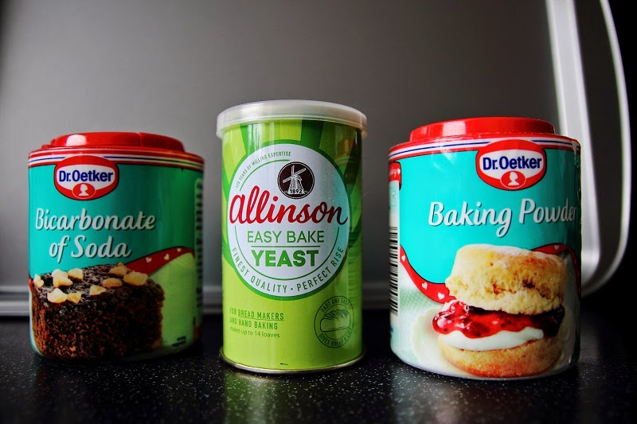
In depth look- Raising Agents
Definition- RAISING AGENT= is an ingredient or process that incorporated a gas into a mixture to lighten it.
Heat a mixture+ raising agent ➔ gas expands+ mixture rises
Gases- air, steam and CO₂
3 types of raising agents- chemical, mechanical, biological

Slide 5
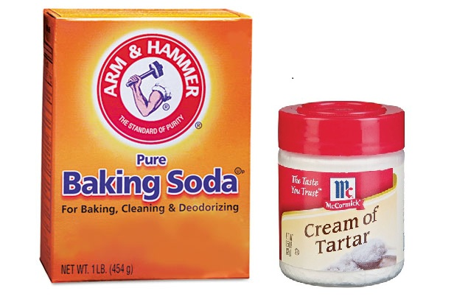
In depth look- Chemical
Chemical raising agents produce Carbon Dioxide when heated with a liquid
Examples are- bicarbonate of soda and baking powder
Baking powder is a mixture of bicarbonate of soda (alkali) and cream of tartar (acid) which are neutralised in the reaction, providing lift.
What foods would you add bicarb to when making and why?

Slide 6
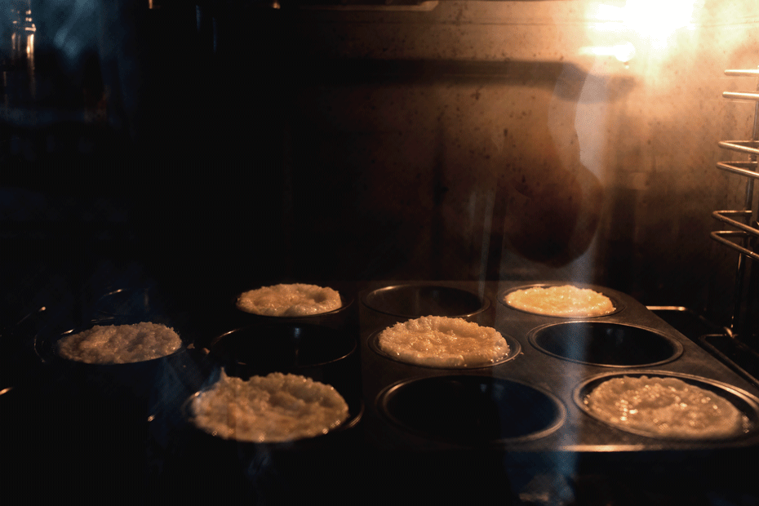
In depth look- Mechanical
These use air and steam as the leavening agent
Methods include:
Whisking (trapping air- e.g. roulade/meringue) Beating (air bubbles trapped- e.g. batter) Folding (layers of air trapped between layers of pastry- e.g. puff pastry) Sieving (flour particles trap air- e.g. cakes) Creaming (beating fat and sugar incorporates tiny bubbles, heating sets mixture- e.g. cakes) Rubbing in (air trapped in mechanical action- e.g. pastry/scones)
Steam- used in making Yorkshire puddings, choux, puff and flaky pastry (high water content products

Slide 7
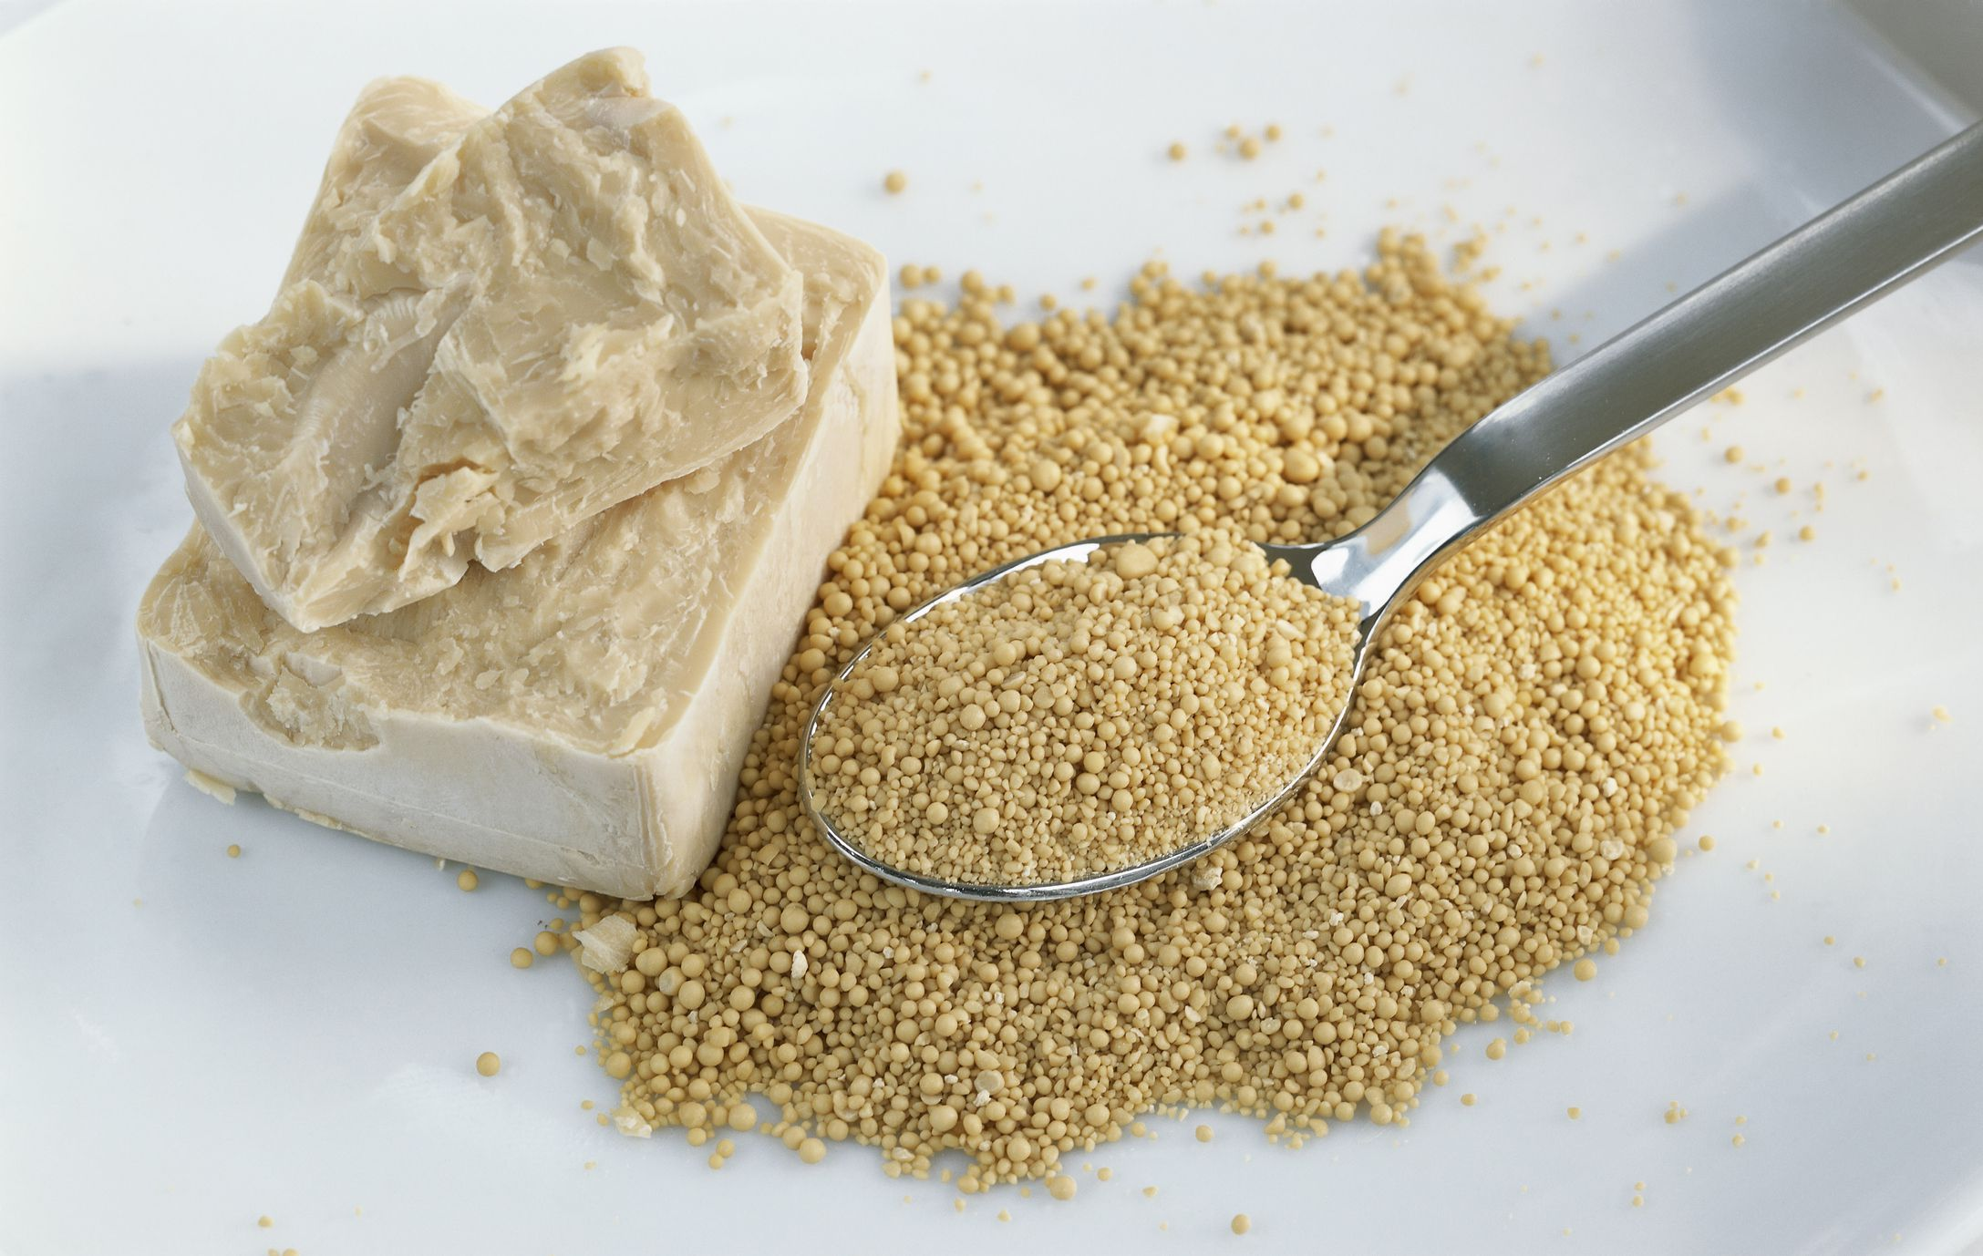
In depth look- Biological
Yeast is a biological raising agent
It produces CO₂ by fermentation. It needs warmth, food and moisture to ferment
Definition- FERMENTATION= the process in which yeast eats sugar and respires creating CO₂ and alcohol
Different types of yeast: fast acting easy blend yeast, fresh yeast and dried yeast

Slide 8
Plenary- Exam question
List three gases which are used as leavening agents in cooking. [3 marks]
Identify one raising method used when: [4 marks]
Making a meringue
)Baking Yorkshire pudding
Baking puff pastry
Preparing sponge cake
Explain how yeast works as a raising agent and provide an example of where yeast is used in the food industry. [4 marks]

Slide 9

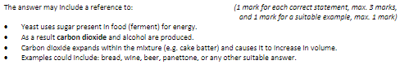
Mark Scheme

