Slide 1
Mock examination 2025

Slide 2
You need to revise everything we have covered in year 10 as well as the work this term. *All yr10 revision ppts saved on teams in the revision folder
List of what we have covered so far…
Smart materials – What are they?
Obsolescence
Methods of manufacture – Mass, batch etc.
Thermosetting plastics p23
Properties of natural fibres – In book Page 24
Renewable energy p8
Stock forms and sizes p98
Fairtrade/Recycling – why? P132 and p10
Crowd funding
Anthropometrics p125
Ergonomics p125
Toile and other modelling p137
Gears
One point perspective and isometric drawing.
3rd orthographic projection

Slide 3
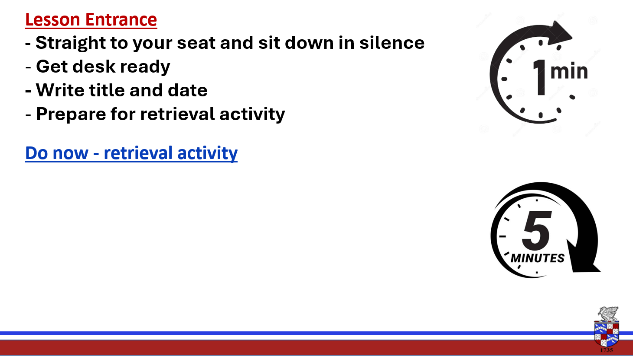
Write down the definition of the following key word
Stock form –
Give an example of a stock form
Запишіть визначення наступного ключового словаФорма запасу –Наведіть приклад біржової форми

Slide 4

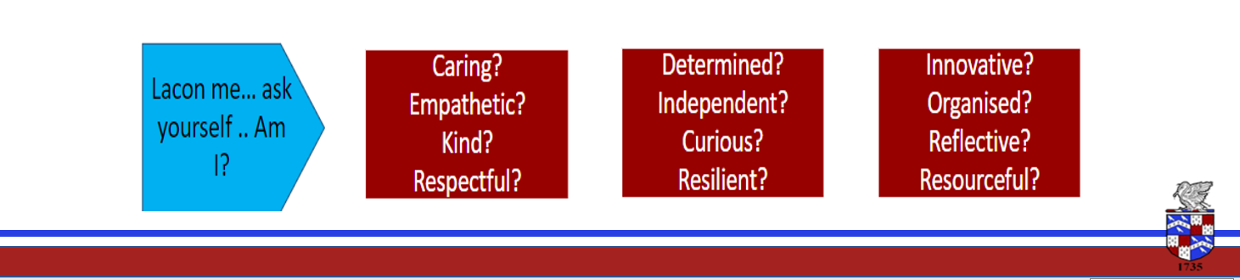
Lesson Intention - To understand what a manufactured board is. - To be able to name three types of board and understand the characteristics. - Revision of keywords and topics to refresh memories and practice retrieval.
Keywords
Plan
Template
Applique
Construction
Decoration
Heat transfer
Silk painting

Slide 5
Manufactured boards
Processed pieces of wood can be combined with glue and compressed into panels – Forming a new material called Manufactured board.
The three main types we need to know are…
Medium density fibre board (also known as MDF)
Plywood
Chipboard

Slide 6
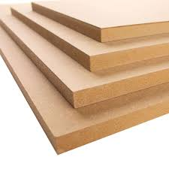
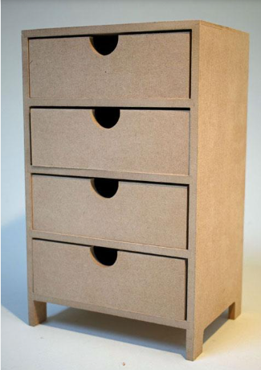
MDF Medium density fibreboard
MDF is made from tiny fibres of softwood timber held together by glue.
Because it is just small bits glued together it has no natural grain.
Positives -It is quite low cost, dense and has a smooth surface that takes paint and other finishes well.
Negatives – It is pourous so can be damaged by moisture.

Slide 7
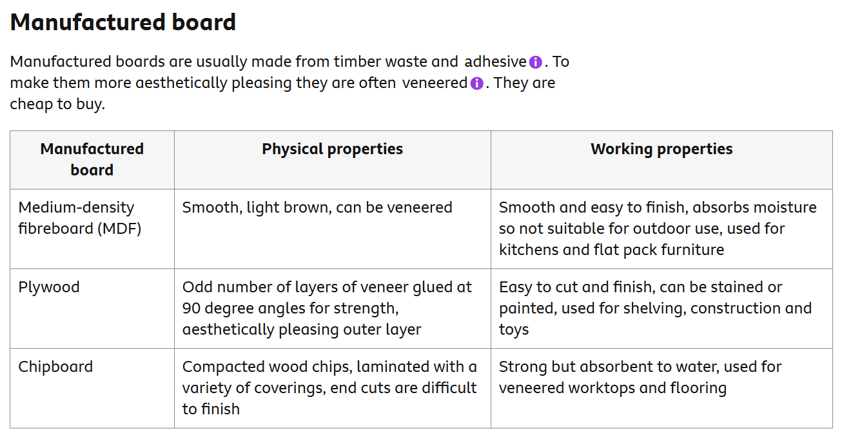
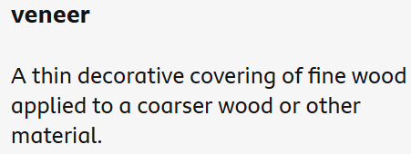

Slide 8
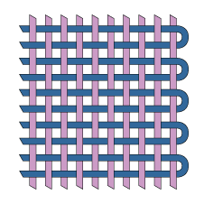
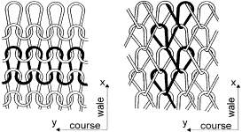
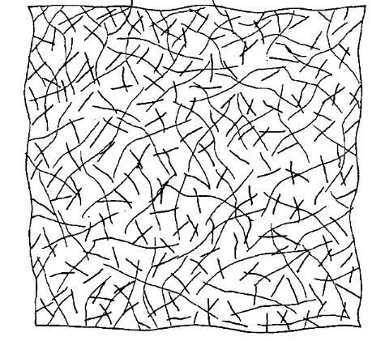
Fabrics can be constructed in 3 main ways…..
Woven
Knitted
Non-woven

Slide 9
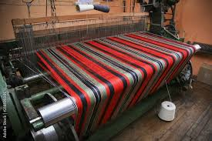
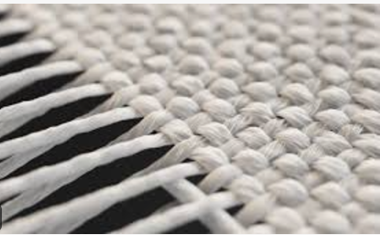
Industrial Weaving
Weaving looms can be automated and linked to CAD to allow for changes in pattern design of a very large scale.
Designs can undergo a ‘test weave’ to assess the suitability of a design for commercial manufacture before committing too much time and resources on production.
Once set up, weaving looms can produce very large quantities of fabric at low cost due to reduced human involvement.
Woven fabric can be constructed in different ways to give a wide variety of different qualities such as strength, durability, aesthetic appeal, drape and comfort
https://www.youtube.com/watch?v=K6NgMNvK52A

Slide 10
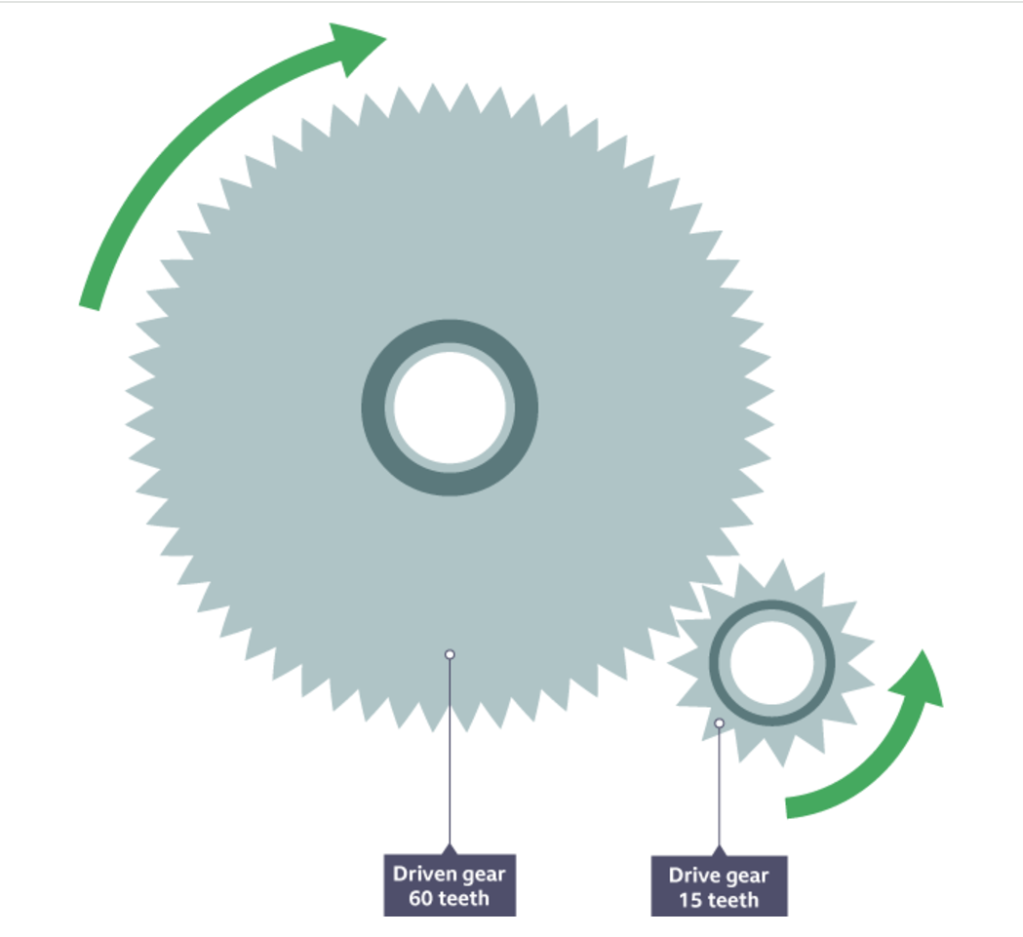
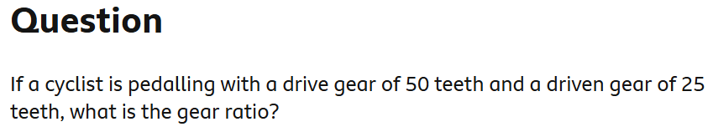
Gears
Gear ratio = number of teeth on driven gear ÷ number of teeth on the drive gear

Slide 11
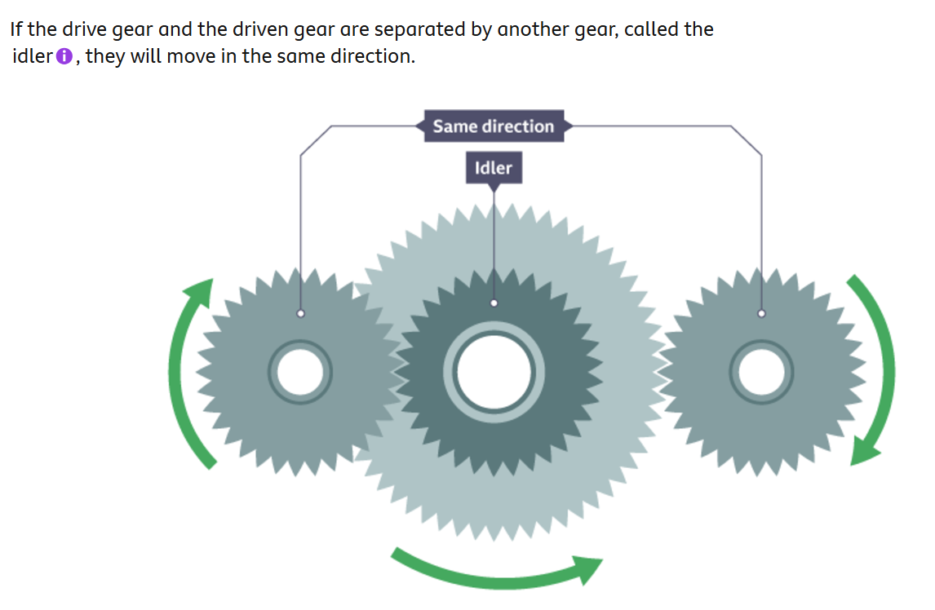

Slide 12
Motion
See motion ppt saved on teams.

Slide 13
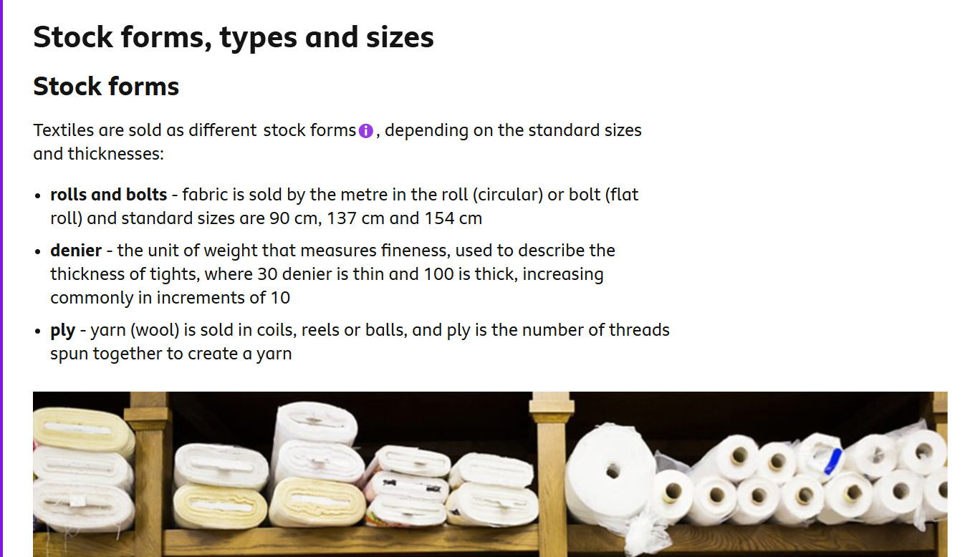
Stock form

Slide 14



User centred design
In this strategy the wants and needs of the user are prioritised – Their thoughts are given lots of attention at each and every stage of the design process.

Slide 15
You need to revise everything we have covered in year 10 as well as the work this term. *All yr10 revision ppts saved on teams in the revision folder
List of what we have covered so far…
Smart materials – What are they?
Obsolescence
Methods of manufacture – Mass, batch etc.
Thermosetting plastics p23
Properties of natural fibres – In book Page 24
Renewable energy p8
Stock forms and sizes p98
Fairtrade/Recycling – why? P132 and p10
Crowd funding
Anthropometrics p125
Ergonomics p125
Toile and other modelling p137
Gears
One point perspective and isometric drawing.
3rd orthographic projection

