Slide 1
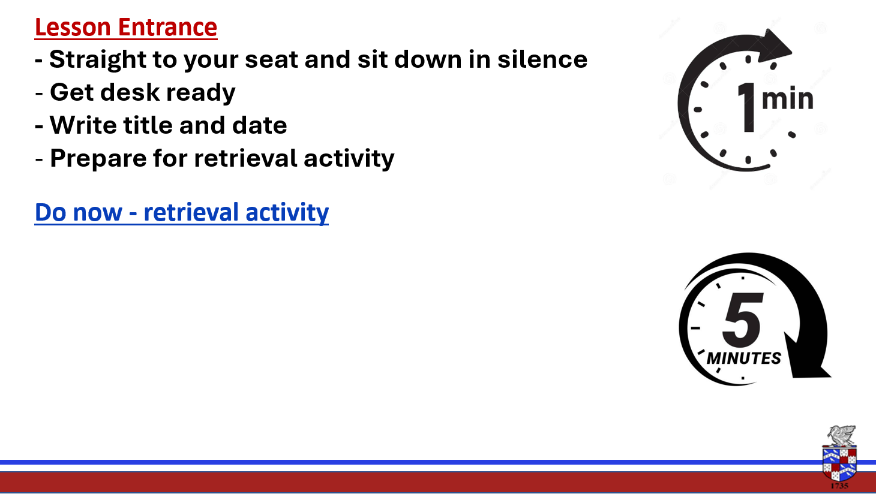
In the front of your books
Write the heading Industrial Manufacture and today s date 09/01/25
Retrieval – Make a small mind map of as many words as you can think of that you think link to the word industry/industrial
Industry -activities involved in the process of producing goods for sale, especially in a factory or special area.
Industrial – Normally large-scale production.

Slide 2

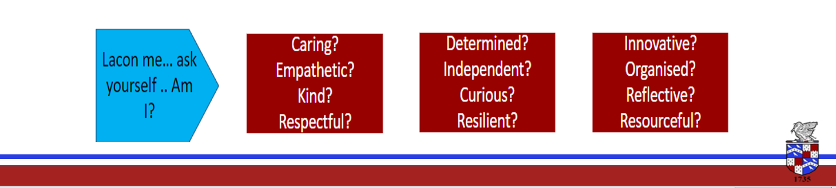
Lesson Intention - To understand and reinforce knowledge on the scales of manufacture - Know what scales of production particular products utilise - Explore a range of manufacture methods - Gain an understanding of modern manufacturing systems used in industry including the use of ICT and robotics in production.
Keywords
Production
Batch
Mass
Bespoke
Robotics
CAD
CAM

Slide 3

Key Terms
Manufacturing
ICT
Robotics
Industry
Continuous
Bespoke
Production Line
Volume
https://www.youtube.com/watch?v=NGR7-rBmi_E

Slide 4
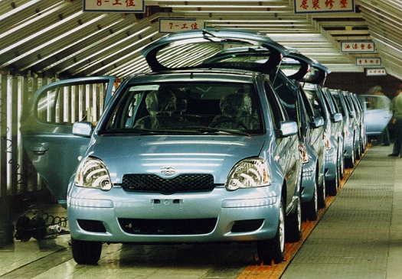
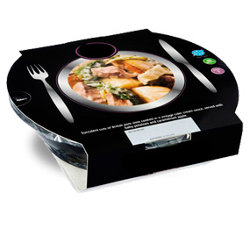
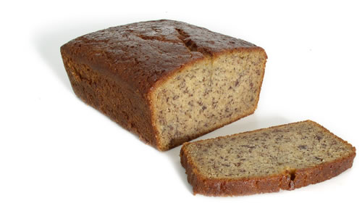
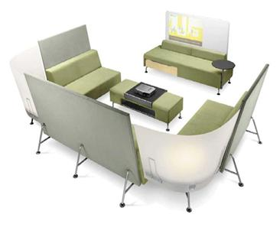
Scales of Manufacture
Mass Production
Quantity of 10,000+
Cars
Electronic goods – phones, kitchen electrical
Flat-pack furniture
Batch Production
Quantity low 100’s, maybe low 1000’s
Pottery
Fashion garments
Bread
Furniture (sofas)
One-Off Production (Bespoke)
Quantity of 1
Jewellery
Made to measure suit
Specialist equipment for elite sportsman

Slide 5
Bespoke Production
One-off production is where you make a single product. This is often made to an individual design for one customer, such as ‘custom-made’ furniture.
One-off products are often made by hand by skilled craftsmen.
One-off products are normally expensive, because of the amount of time taken to make them.
Summary:
Products are highly specialised, custom built
High level of skill required
Costs extremely high
Can reliability ensure very high quality of build and finish

Slide 6
Batch Production
Batch production makes small quantities, from a few hundred to a few thousand, depending on the type of product.
Each batch of products will have the same design. However, different batches might be customised in some way. For example, the same design might be made in a different colour or size.
Batch production normally uses machine tools, and costs less to make products than with one-off manufacture, because you don’t have to spend as much time setting up machines to make each product.
Summary:
Products are produced intermittently – with gaps between production
Relatively small volume produced
Uses some industrial methods, and makes good use of CAD/CAM
Responds to demand from consumer
Systems are often flexible (make more than one version or type)

Slide 7
Mass Production
Mass production makes very large quantities of the same product. Most things that you use every day are mass produced.
Mass production is usually carried out on an assembly line. This is a collection of machines, often robots, that are just used to make that product. Each machine will just do one thing to the product, before passing it on to the next one.
The cost of setting up a production line is very high, so you have to make large quantities of a product to pay for it. Machinery and tooling is often very expensive and specialist.
Summary:
Products are produced at high volume, cheaply.
Increased automated systems
Huge investment needed. Initial set up costs high…long term cost low

Slide 8
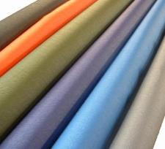
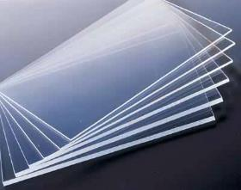
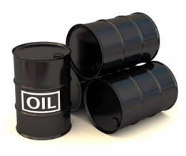
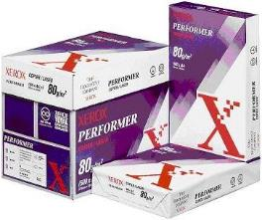
Continuous Production
Continuous production is used to make products like steel, oil or chemicals.
Many of these products are used as the materials to make other products. Factories that operate continuous production often run 24 hours a day, seven days a week. The process needs to be continuous because it would be very expensive to stop it and then turn it on again.

Slide 9

Deliberate practice
https://www.bbc.co.uk/bitesize/guides/zn4bcj6/video
Lets test our knowledge….
Which type of production is best for the following items;
A fashion top from H&M
A car – e.g ford focus
A made to measure wedding dress
A made to measure cabinet

Slide 10
In the back of your books please write the following with an explanation of what each means.
Mass Production
Batch production
Bespoke production

Slide 11
Recap
In the back of your books please write the following with an explanation of what each means.
Mass Production
Batch production
Bespoke production

Slide 12
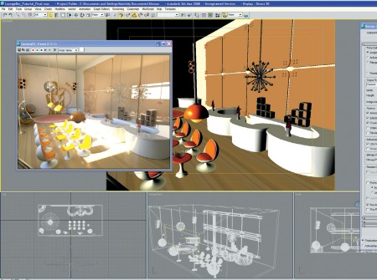
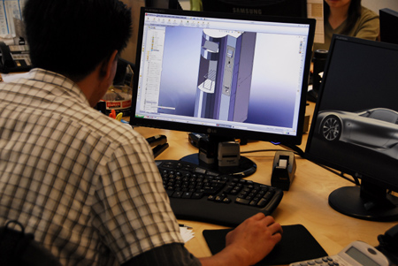
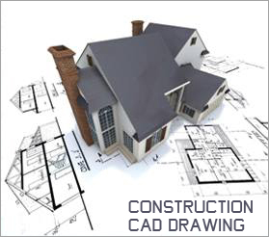
CAD
CAD stands for Computer Aided Design and uses a range of software to help develop a
product using virtual 2D and 3D “drawing”.
Examples include:
2D Design 3D Studio Max
Pro/Engineer Solid-Works
Benefits:
Virtual Reality Modelling
Communication with clients and suppliers
Low Cost
Files can be saved and altered with ease
Can rapidly product detailed engineering spec. to reduce lead times
Drawbacks
High demand of initial training/High cost of set up
Possible loss originality of work

Slide 13
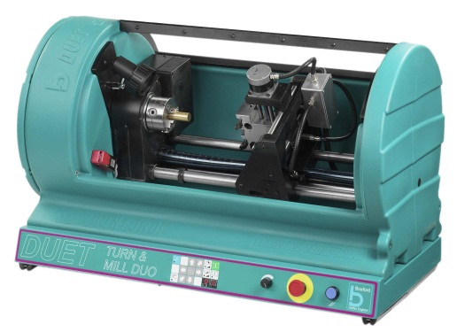
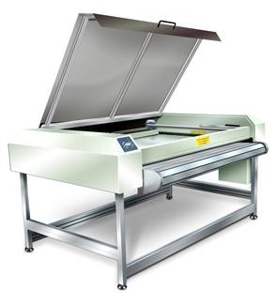
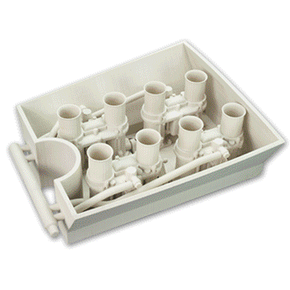
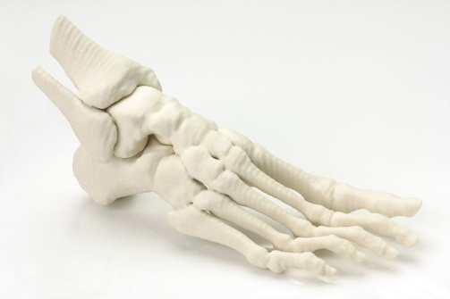
CAM
CAM (Computer Aided Manufacture) is a series of processes and equipment that
allow products to be manufactured via machines governed by computers not us.
Equipment includes:
CNC Routers Laser Cutters
CNC Lathes Vinyl (Plotter) Cutters
RPT (Rapid Prototyping) 3.D printers
Benefits
Cost effective and relatively fast
Removal of human error
In-built Quality Control
Drawbacks
Loss of traditional skills
Loss of jobs
High initial set up costs
http://www.esacorp.com/animations/prototype-animation.gif

Slide 14
Manufacturing Concepts
CIM
Computer Integrated Manufacture is the process whereby every single step in the
manufacture of a product incorporates the use of computers.
For example:
Designing using a CAD drawing program
Testing via Virtual Simulation
Prototyping models using CNC machines (3D Printing)
Controlling stock by scanning codes on parts
Using Robots to manufacture components
Intermediate scanning/testing using sensors for Quality Control
http://www.technologystudent.com/rmprp07/intman1.html

Slide 15
Manufacturing Concepts
JIT (Just In Time)
This is a Japanese based concept whereby all the parts needed for a product arrive at
the factory at the last minute.
The factory estimates how long a process will take to manufacture, and orders the
parts to arrive just before needed, in small batches.
They are not stored at the factory.
Benefits:
No storage/warehouse costs to the company
Efficiency
Easy monitoring of stocks/parts
Increased jobs/scope for companies to supply parts
Drawbacks
Relies on punctuality of delivery
Relies on effective ICT systems (and fully operational!)
Risk of wrong parts arriving
Environmental concerns due to number of deliveries.
More info…
JIT involves an ICT dependent system that tells the factory and its supplier how many of a product is needed and when by. The factory will have a logistics division that are responsible for getting the part from the supplier just in time for it to be assembled into the final product.

Slide 16
Automation /Robotics
https://www.youtube.com/watch?v=-EFiVZXuZ-I
https://www.youtube.com/watch?v=l24yg_lthkk

Slide 17
Deliberate practice
Explain Mass production
What is JIT production and why would companies choose to use it?
Which type of production is best for the following items;
Plain black leggings
A patterned shirt from asos
Steel

