Slide 1
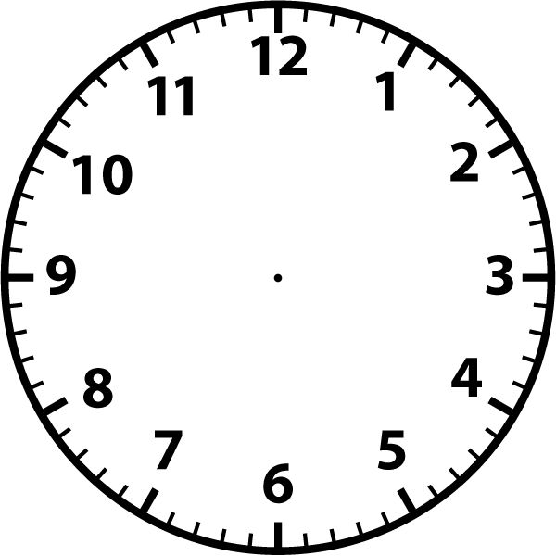
Describe an isotonic concentric contraction, along with a sporting example
Describe an isotonic eccentric contraction, along with a sporting example
Name 2 flat bones and how they protect you during sport
Name the bones of the body
Name the 6 functions of the skeletal system
Describe an isometric contraction along with a sporting example
Musculoskeletal System
Want is an agonist and antagonist muscle? Give a sporting example
Identify the 6 components of the synovial joint and their purpose
Name the 8 movements, giving a sporting example for each
Name the 2 types of joints and their locations
Name 5 antagonistic pairs of muscles in the body
Name the muscles of the body

Slide 2
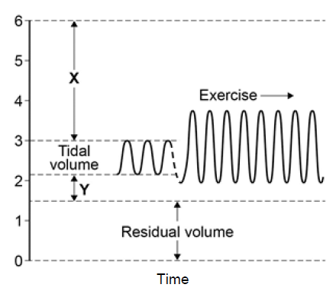
Name the 6 features of the alveoli to allow gaseous exchange to take place
What are the 3 blood vessels and their role?
Name the 4 chambers of the heart
Vasoconstriction V Vasodilation
What are the 6 features of the respiratory system?
Diastole V Systole
  Cardiorespiratory System
Mechanics of breathing
What is the pathway of blood?
Inhalation at rest
Exhalation at rest
Label the spirometer trace
1.
What is the definition of HR & MHR? What is meant by the term anticipatory rise?
3.
4.
2.
What is the definition for stroke volume?
What is the equation for cardiac output?

Slide 3
What is the equation for aerobic respiration?
Name 3 sporting examples which are closely linked with aerobic respiration
Name 3 sporting examples which are closely linked with anaerobic respiration
What does the term
EPOC stand for?
What is the equation for anaerobic respiration?
  Aerobic & Anaerobic Respiration
When does EPOC occur?
What is the best form of recovery process and why?
What happens during EPOC?
What are the reasons for the manipulation of a diet?
What are the reasons for ice baths/massages?
What are the reasons for a cool down?
What does DOMS stand for?

Slide 4
Immediate effects of exercise
(during exercise)
Short term effects of exercise
(24-26 hours after exercise)
  Effects
  Of
  Exercise
Long term effects of exercise
(months and years of exercising)

Slide 5
What is the rhyme to remember the lever systems?
Draw the first class lever system
Draw the second class lever system
Draw the third class lever system
Describe your understanding of the mechanical advantage
What is in the middle for a first class lever?
  Lever Systems & Mechanical Advantage
What is the equation for the mechanical advantage?
What is in the middle for a second class lever?
Where and what movement would occur for a third class lever?
Where and what movement would occur for a second class lever?
Where and what movement would occur for a first class lever?
What is in the middle for a third class lever?

Slide 6
Name the three acronyms for remembering the planes and axes information
Name 2 sporting examples which create movement through the transverse plane and longitudinal axis
Name 3 sporting examples which create movement through the sagittal plane and transverse axis
Name 1 sporting example which creates movement through the frontal plane and sagittal axis
What is the plane and axis for the movement of flexion and extension?
Draw a line in the direction of the
longitudinal axis
  Planes and Axes
  of Movement
What is the plane and axis for the movement of rotation?
Draw a line in the direction of the
transverse axis
What is the plane and axis for the movement abduction and adduction?
How would you separate the body for the sagittal plane?
How would you separate the body for the frontal plane?
How would you separate the body for the transverse plane?

Slide 7
What is the definition of health?
What is the definition of fitness?
Name the 10 components of fitness?
Link each component of fitness to an appropriate sporting activity
How do you record the data for one of the fitness tests listed?
  Health, Fitness & Components of Fitness
List the reasons for fitness testing
What does quantitative data mean?
List the limitations of fitness testing
Can you name the procedure for a fitness test?
What are the fitness tests for each component of fitness?
What does qualitative data mean?
List the equipment needed for a different component of fitness test

Slide 8
What is acronym for the principles of training and give a brief description for each?
What is the acronym for the principle progressive overload? Give a brief description for each
Name the 7 training methods
  Principles of Training &
  Training Methods
Name a sportsperson who would use each training method
Give a brief description of each training method
Which components of fitness would be linked to the different types of training methods?

Slide 9
How do you calculate your aerobic training zone?
How do you calculate your anaerobic training zone?
How do you calculate your MHR?
What type of weight training would you consider for muscular endurance?
State another of the three seasons and describe what it entails
What type of weight training would you consider for strength/power?
  Optimise training & Prevent Injury
State another of the three seasons and describe what it entails
List the factors to consider to prevent injury
State one of the three seasons and describe what it entails
What type of sportsperson would train at high altitude?
What are the three training seasons?
How is high altitude training carried out?

Slide 10
What are the phases of a warm up?
What are the phases of a cool down?
  Warm ups and Cool downs
What are the benefits of a warm up?
What are the benefits of a cool down?

