Slide 1

Starter:
Definite the term dextrinisation [1 mark]
What kind of carbohydrate undergoes gelatinisation? [1 mark]
Explain the process of gelatinisation [4 marks]
How can you prevent lumps in a gelatinised sauce? [1 mark]
Give two functions of sugar in cooking and provide an example for each. [4 marks]

Slide 2
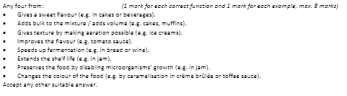
Mark Scheme

Slide 3
Revision-
Food Science- Carbohydrates
Learning Objectives:
Recall information about carbohydrates
Address any misconceptions
Apply knowledge to exam questions

Slide 4
In depth look- Gelatinisation
Definition- Gelatinisation= is the process in which moist heat is applied to starch grains, which swell(60⁰C), increase in size and then break open (75-87⁰C), releasing amylose, which thickens the mixture around boiling point (100⁰C).
Starch grains do not dissolve in water. When the liquid cools it forms a gel that will set (think cold gravy).
Starches that can be used to thicken sauces:
  Cornflour, arrowroot, potatoes, small pasta shapes, rice, barley

Slide 5
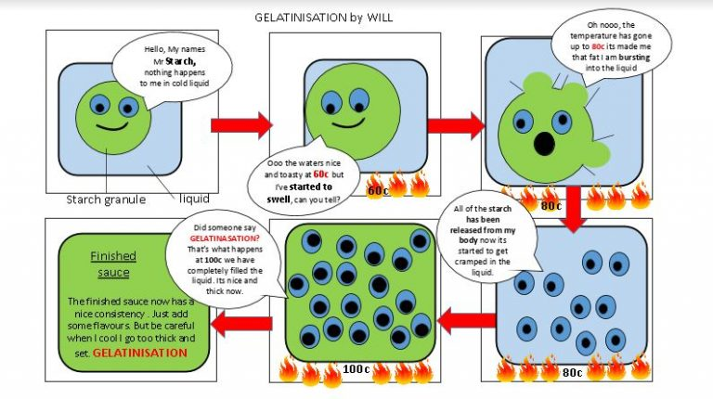

Slide 6
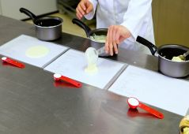
In depth look- Gelatinisation
What can affect gelatinisation?
  Amount of liquid
  Type of starch
  Temperature- starch will NOT dissolve in cold water
  Stirring- starch will settle at the bottom of the pan and form lumps
  Sugar- competes for water, sauce will be runny, add sugar after gelatinisation if needed
  Acids- should be added after, as it can breakdown the gel

Slide 7
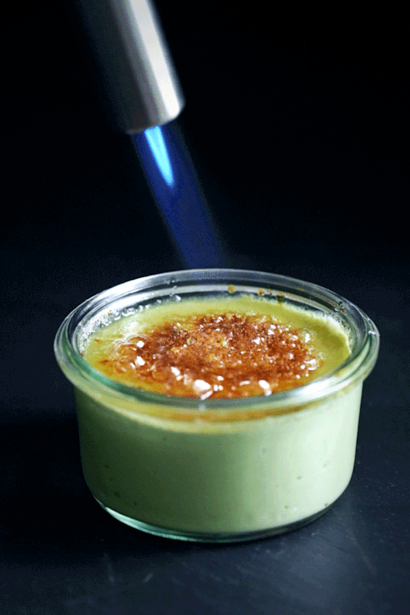
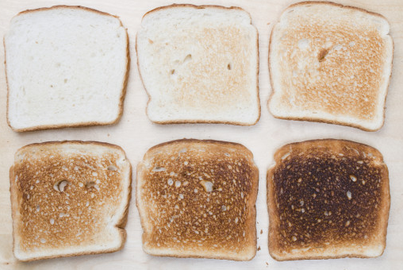
In depth look- Caramelisation
Caramelisation causes changes to a food’s colour and also flavour
When food products come in contact is heat (180⁰C) sugars breakdown and start to darken, going from clear, to dark amber to black when burnt (which will produce a bitter taste- turning into pure carbon at 200⁰C)
It happens because water is released from sugar as steam.
It also occurs during the dry heating, shallow frying and roasting of meat and vegetables.
Dextrinisation
  Similar to caramelisation, but limited to a dry heat turning starch brown.

Slide 8
Plenary- Exam question
What are some factors to consider when making a sweet, lemon sauce to ensure a good quality outcome? [4 marks]
Identify two dishes that could use a gelatinised sauce. [2 marks]
Identify potential issues for someone making a gelatinised sauce and explain how they could combat these. [4 marks]

