Slide 1
Starter:
Define lactose intolerance [1 mark]
State one symptom characteristic of lactose intolerance [1 mark]
List two products or dishes not recommended for individuals with this condition [2 marks]
Describe two situations/ health conditions in which a high-fibre diet might be of benefit [2 marks]

Slide 2
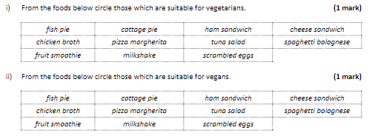
Starter:

Slide 3
Revision-
Nutritional Needs Part 2
Learning Objectives:
Recall information about nutritional needs
Address any misconceptions
Apply knowledge to exam questions

Slide 4

In depth look- Vegetarians etc
Vegetarians
  Lacto-vegetarians- do eat dairy products
  Lacto-ovo vegetarians- do eat dairy and eggs
  Ovo- vegetarians- Do eat eggs
Vegans- no animal products!
Issues with these diets:
  B12 deficiency
  Non-haem iron
  Need to eat fortified foods

Slide 5

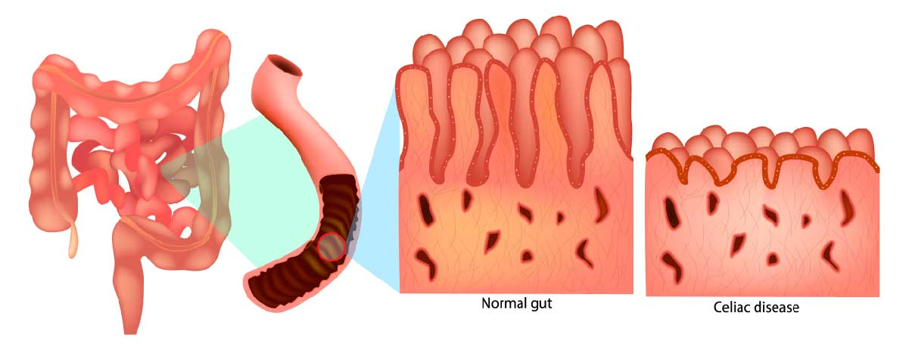
In depth look- Coeliac Disease
Sensitivity to gluten
Gluten = protein found in wheat, rye, barley and sometimes oats (processing)
Those who suffer from it, their body attacks healthy tissue by mistake, can damage the lining of the intestines, which stops nutrients being absorbed.
Food labelling laws means that gluten needs to be shown as part of ingredients
How do you avoid contamination from gluten?

Slide 6

In depth look- Lactose Intolerance
Fairly common in the UK
Body is unable to digest sugar found in milk (lactose)
Enzyme in the digestive system called lactASE needed to breakdown lactOSE
Lactose is a disaccharide (glucose and galactose)
Because it is not broken down, it stays in the digestive system and ferments, producing gases.
This leads to a bloated stomach and stomach pains, wind and diarrhoea

Slide 7
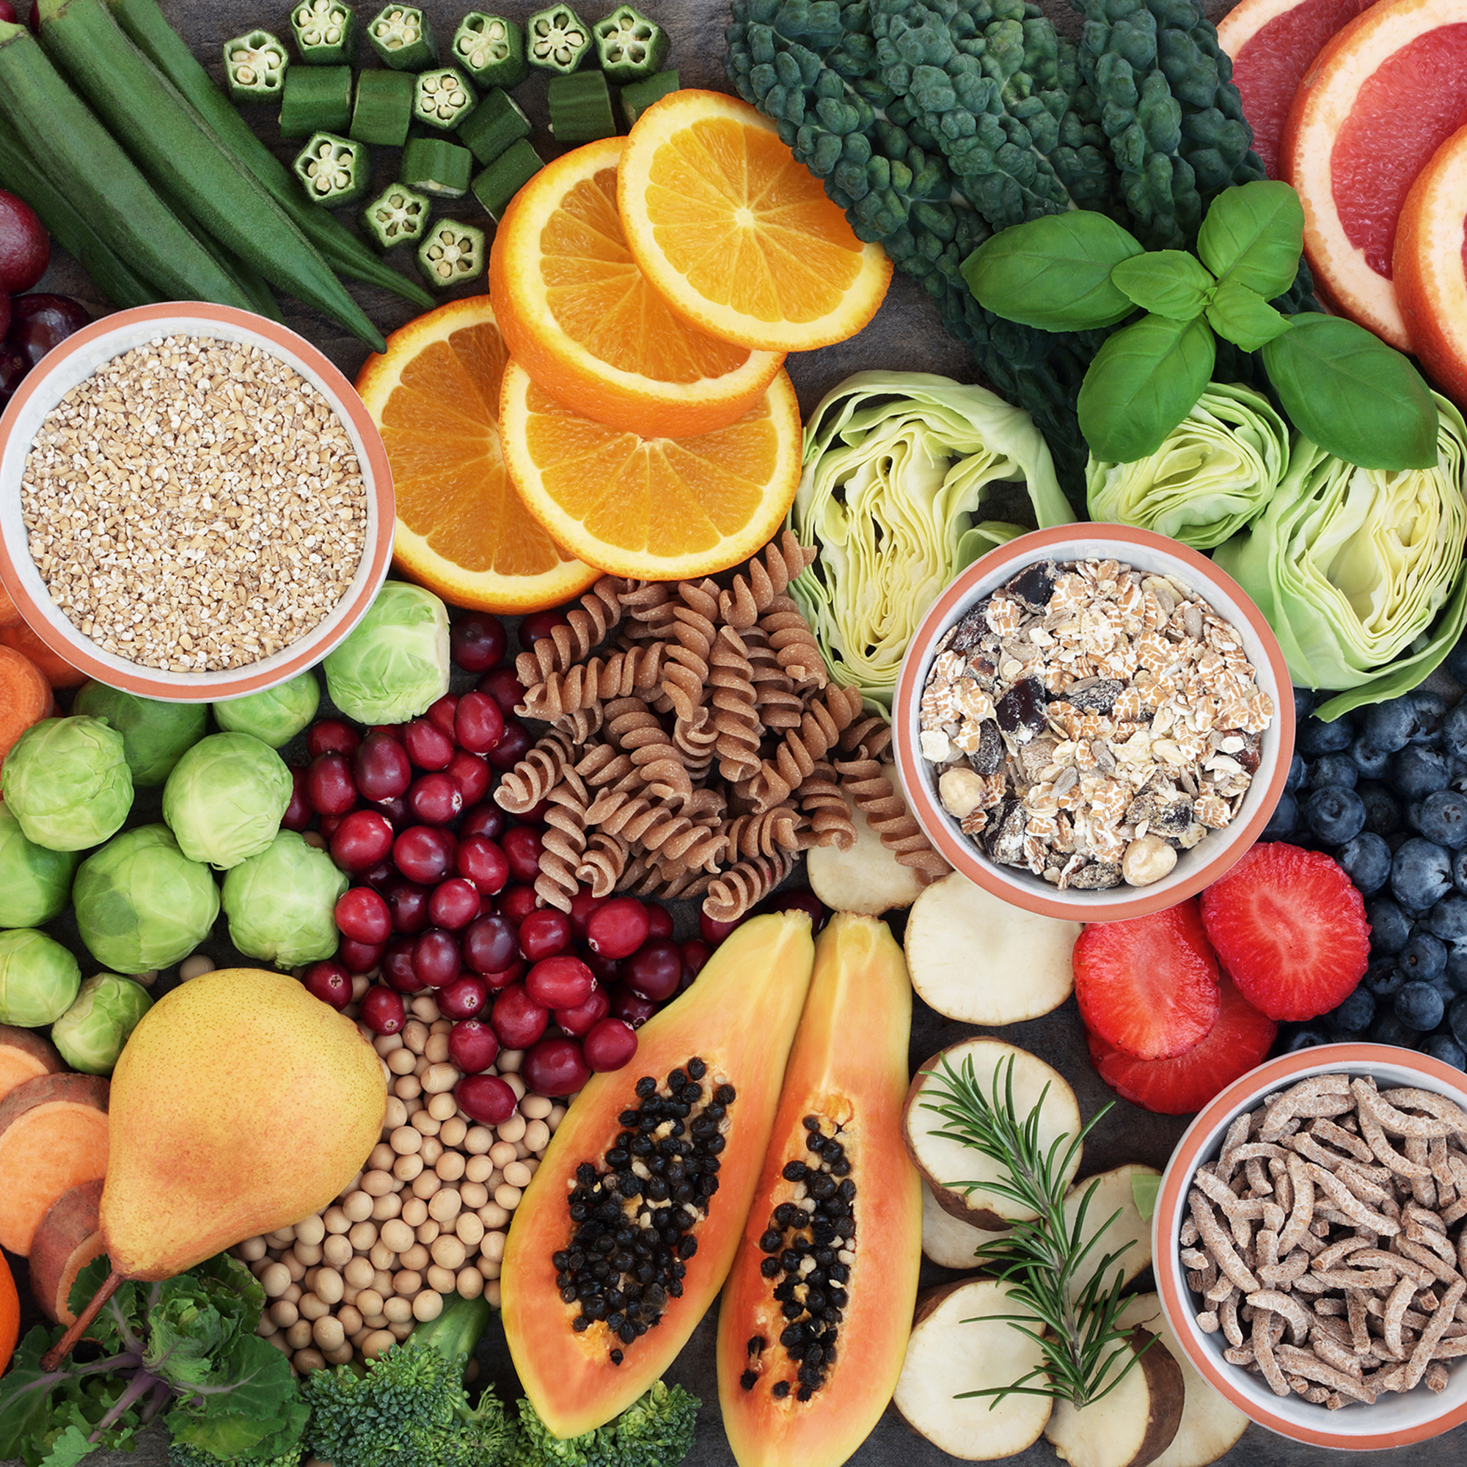
In depth look- High-fibre diet
Important as part of a healthy diet
Adults should have 30g fibre a day
Easily done by switching out refined ‘white’ foods for wholemeal/grain alternatives
Insoluble fibre (makes up your poop)
Soluble fibre (reduces cholesterol, and therefore CHD)
Less likely to over eat (due to feeling full)
Should add fibre gradually, otherwise you may become constipated/gas/stomach pains

Slide 8
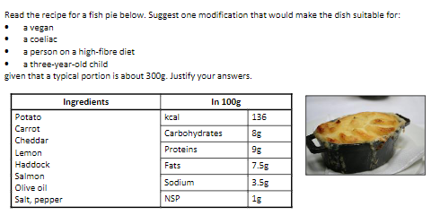
Plenary- Exam question

Slide 9
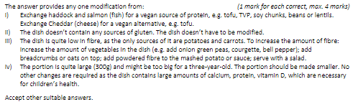
Mark Scheme

