Slide 1
Starter:
Cooking food helps to make food safe to eat by killing pathogenic bacteria. True/False [1 mark]
Dry-frying increases the amount of fat in food. True/False [1 mark]
Explain how cooking affects the shelf life of food. [1 mark]
Identify one way in which cooking would affect the texture of: meat, tomato-based sauce, sponge cake. [3 marks]

Slide 2
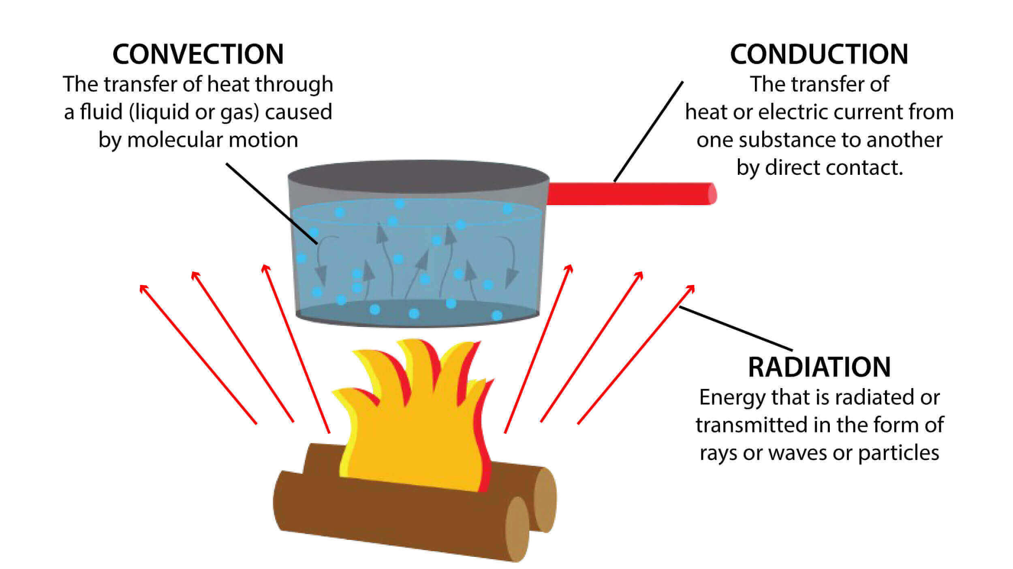
Draw and explain what is happening at each section of this heat transfer diagram

Slide 3
Revision-
Cooking Food and Heat Transfer
Learning Objectives:
Recall information about nutritional needs
Address any misconceptions
Apply knowledge to exam questions

Slide 4
In depth look- Cooking Food
Why?
  To make food safe to eat
  Improve flavour of food
  Improve appearance and smell
  Improve texture
  Improve shelf life
  Variety to diet
Give 3 examples of foods that you could cook via each heat transfer method

Slide 5
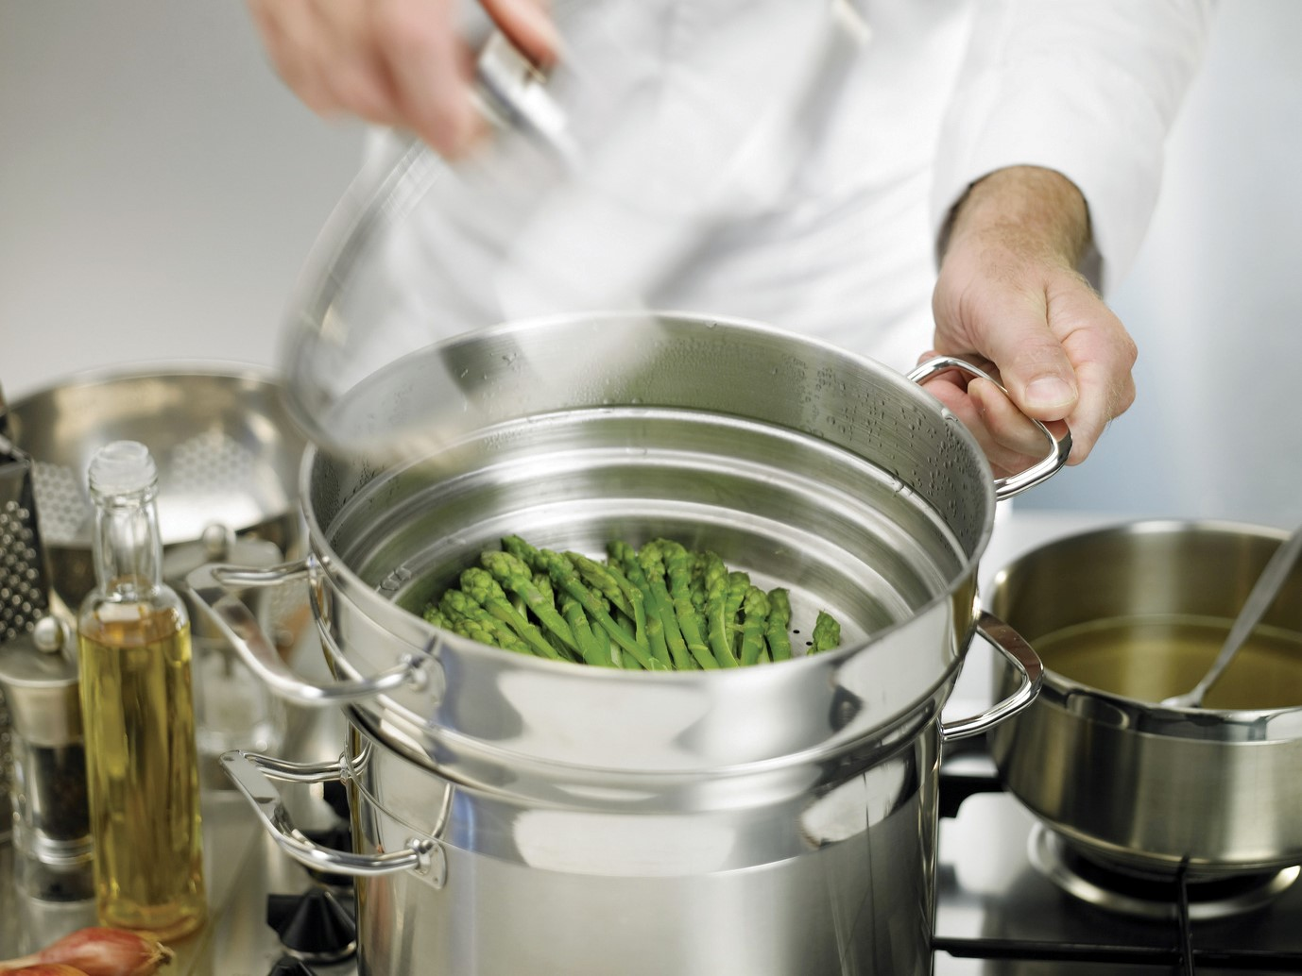
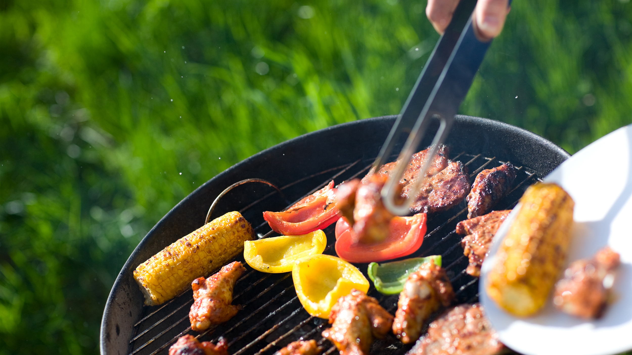
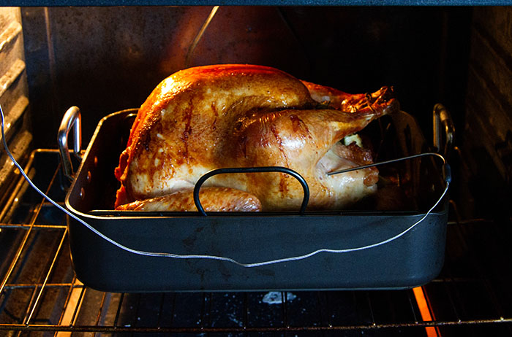
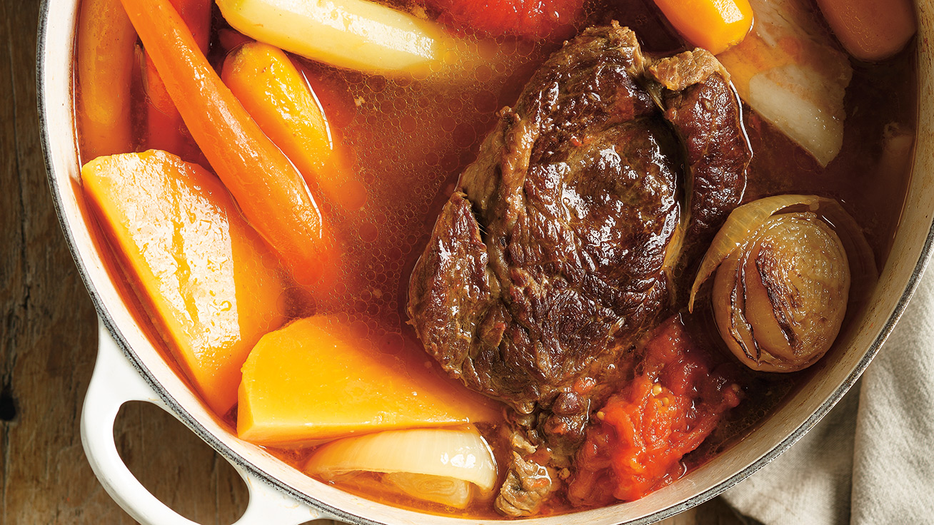
In depth look- Appropriate cooking methods
Cooking with water
  Blanching
  Boiling
  Braising
  Poaching
  Simmering
  Steaming
Cooking with dry heat
  Baking
  BBQ/chargrill
  Stir-frying
  Grilling
Cooking with fat
  Roasting
  Shallow frying
  Stir-frying
  Deep frying
Conserving nutrients
  Steaming (water soluble vitamins) Poaching
  Barbecuing Grilling
  Dry frying (no additional fat added) Stir-frying (little fat is added)

Slide 6
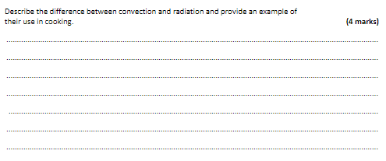
Plenary- Exam question

Slide 7
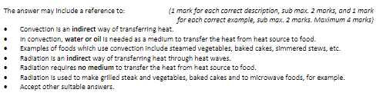
Mark Scheme

Slide 8
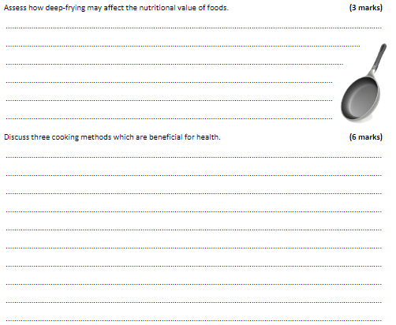
Plenary- Exam question

Slide 9
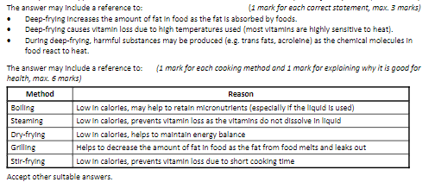
Mark Scheme

